Slide 1
Laboratory Techniques II: Titration
Go to browse and set to full screen.

Slide 2
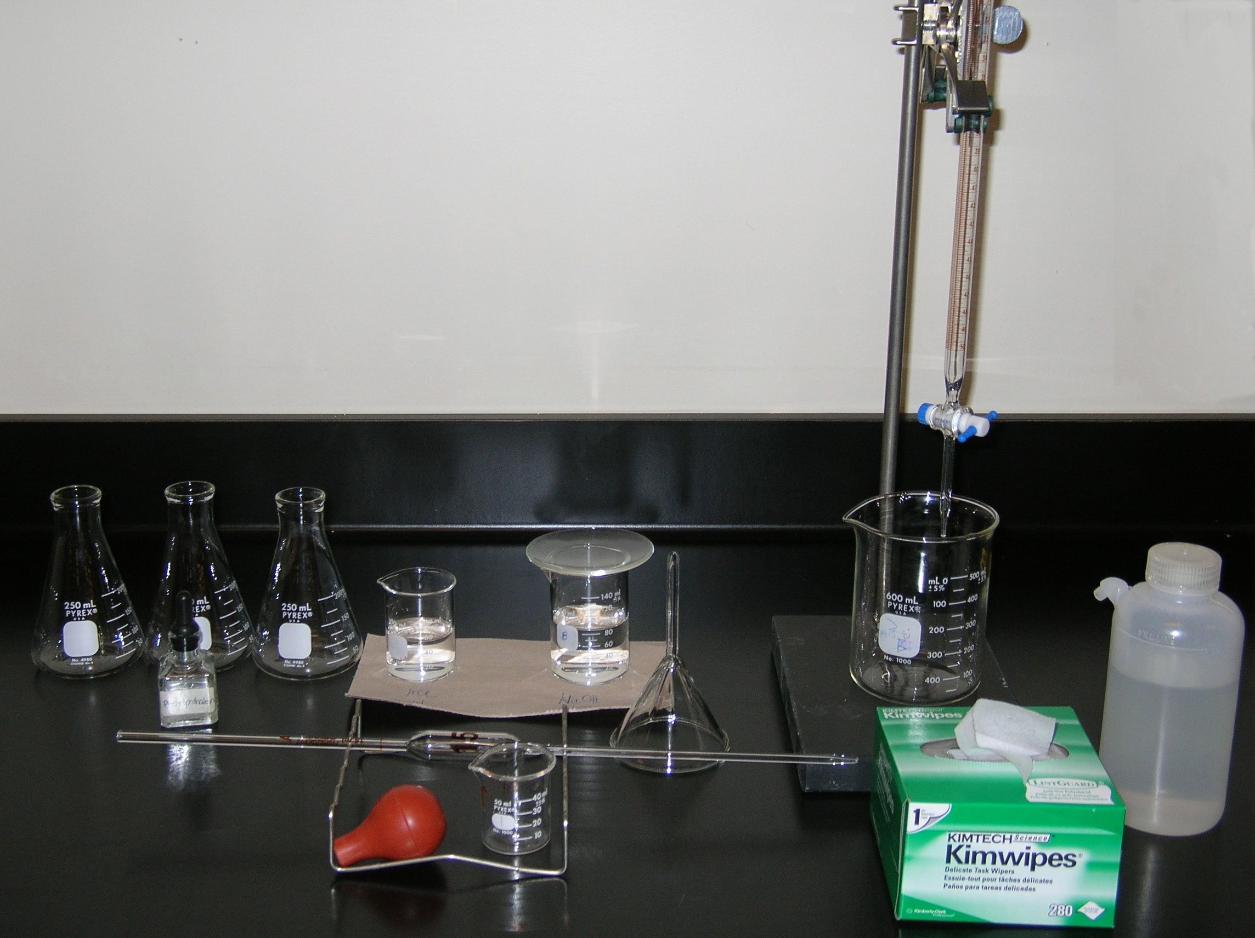
buret clamp
Part II: Titration
buret
three 250 mL Erlenmeyer flasks
150 mL beaker (80 mL of base)
100 mL beaker (60 mL of acid)
waste beaker
stand
indicator
glass funnel
15.00 mL volumetric pipet
bulb
50 mL beaker

Slide 3
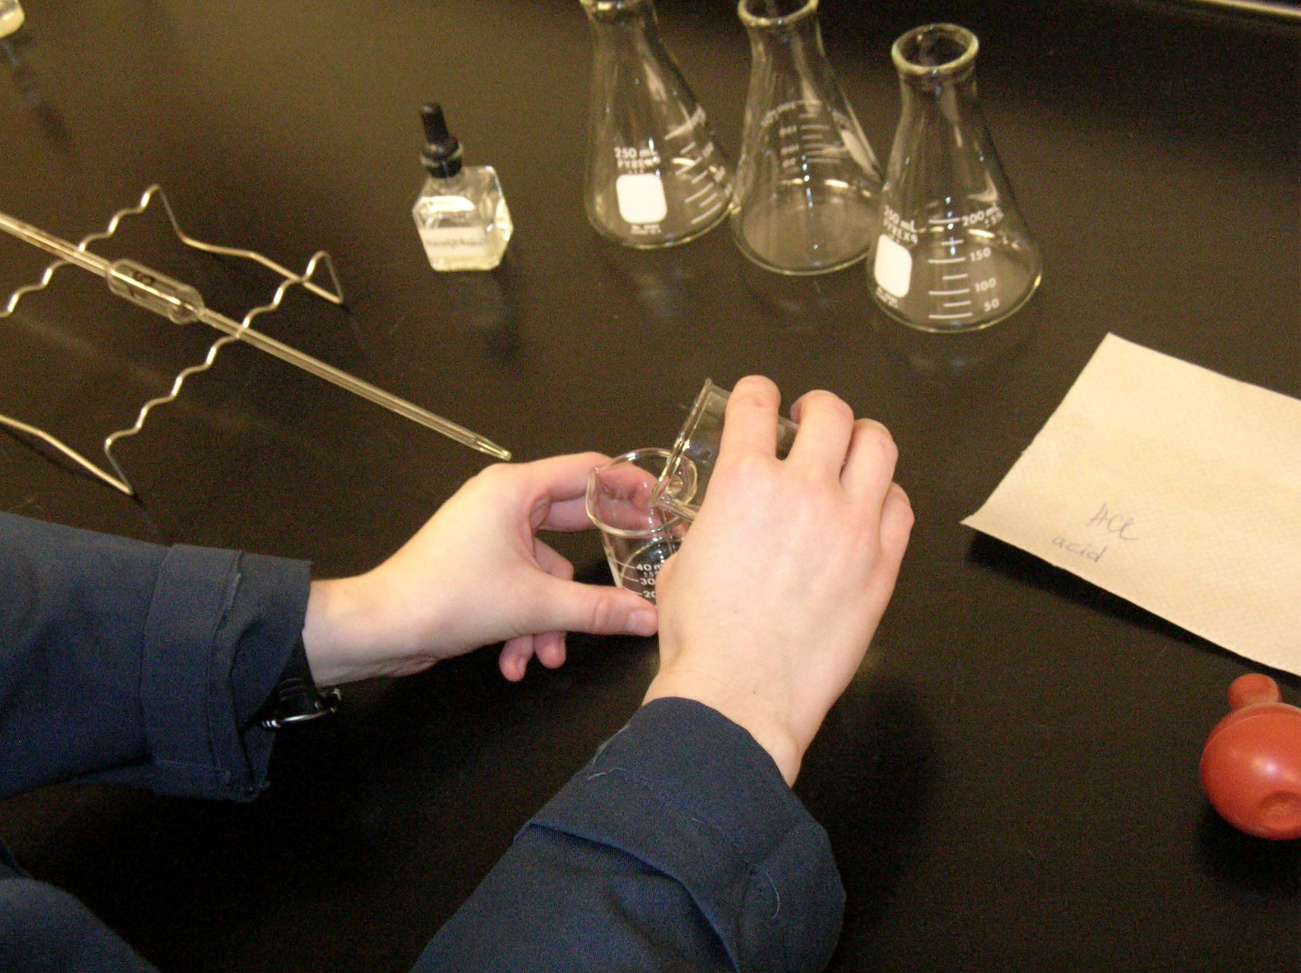
Pour 20 mL of acid solution into the 50 mL beaker and rinse the 15.00 mL volumetric pipet three times with a small amount of it.

Slide 4
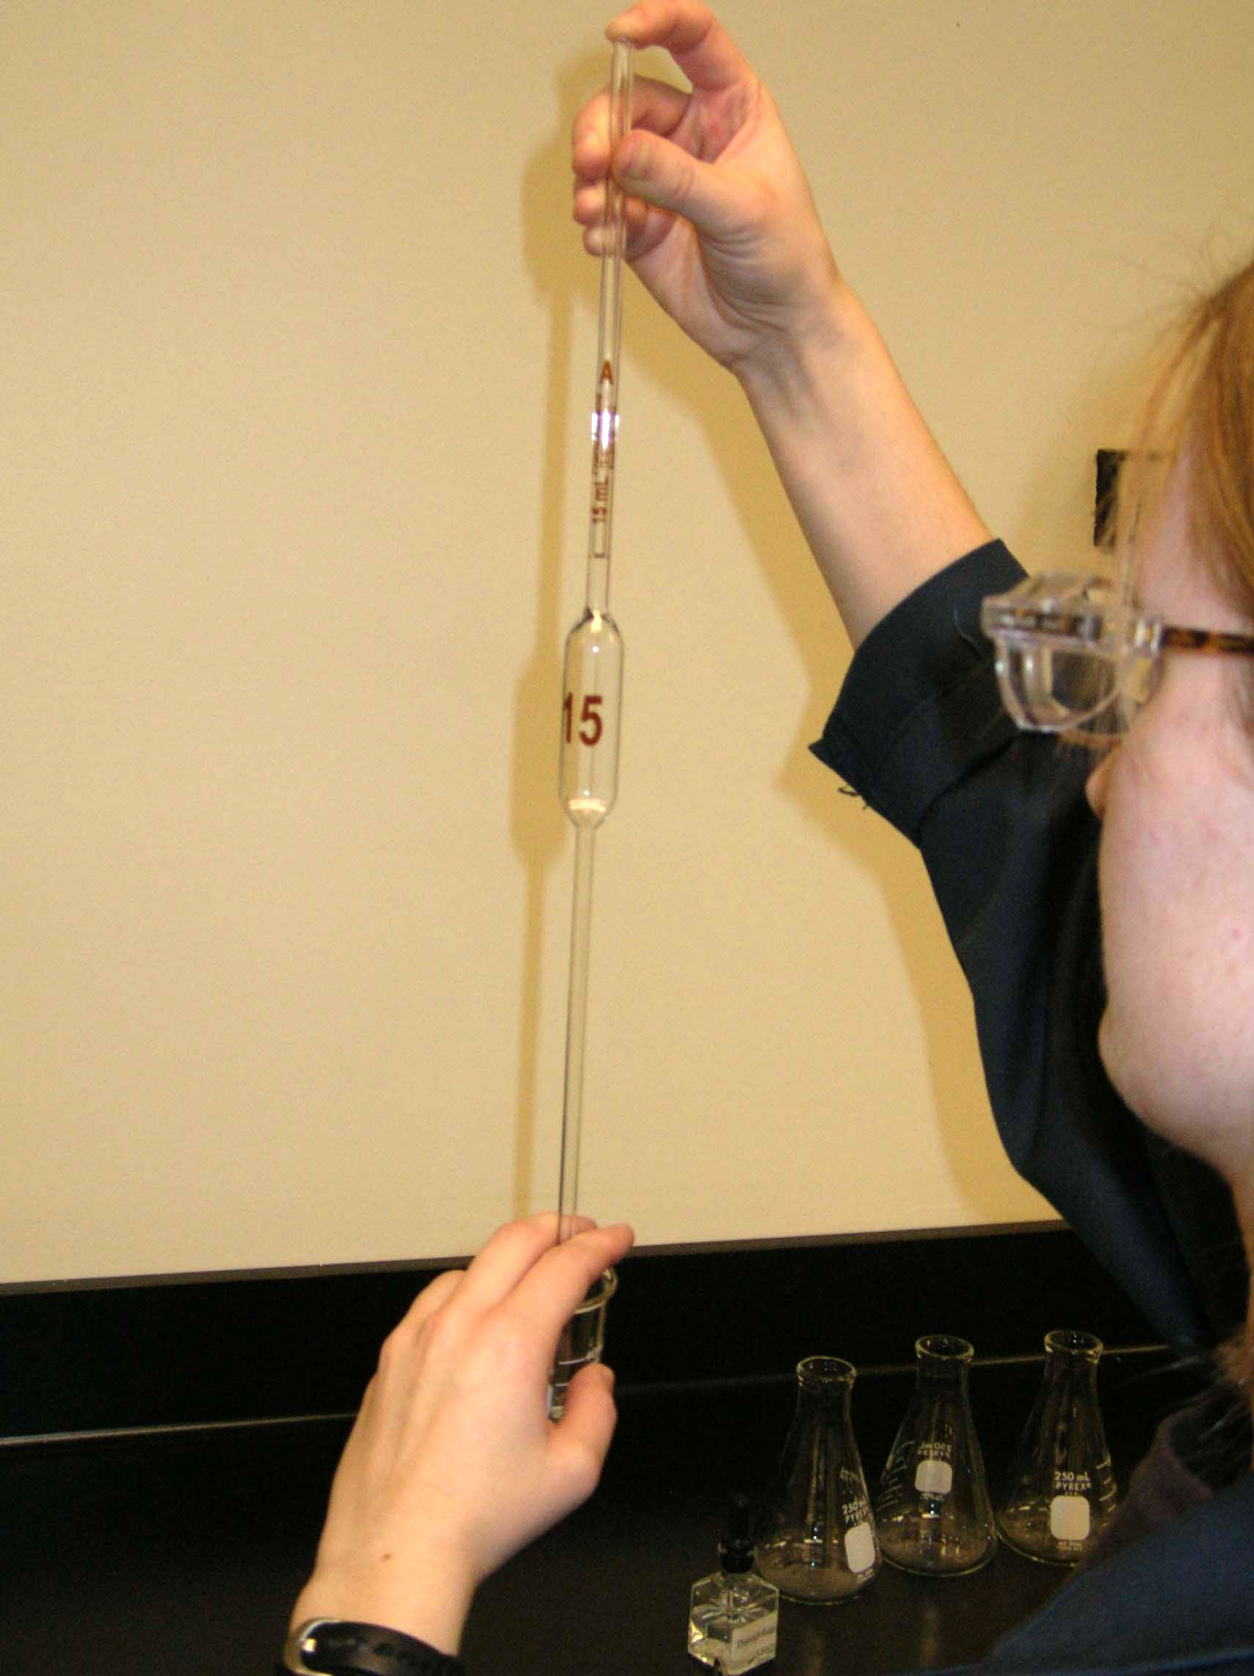
Make sure to place your index finger on the end of the pipet.
Fill the pipet with the acid solution above the calibration mark. Dry the outside of the pipet with a Kimwipe.
To obtain an accurate reading, you should have the calibration mark (meniscus) at eye level; i.e., your line of sight should be parallel with the mark.

Slide 5
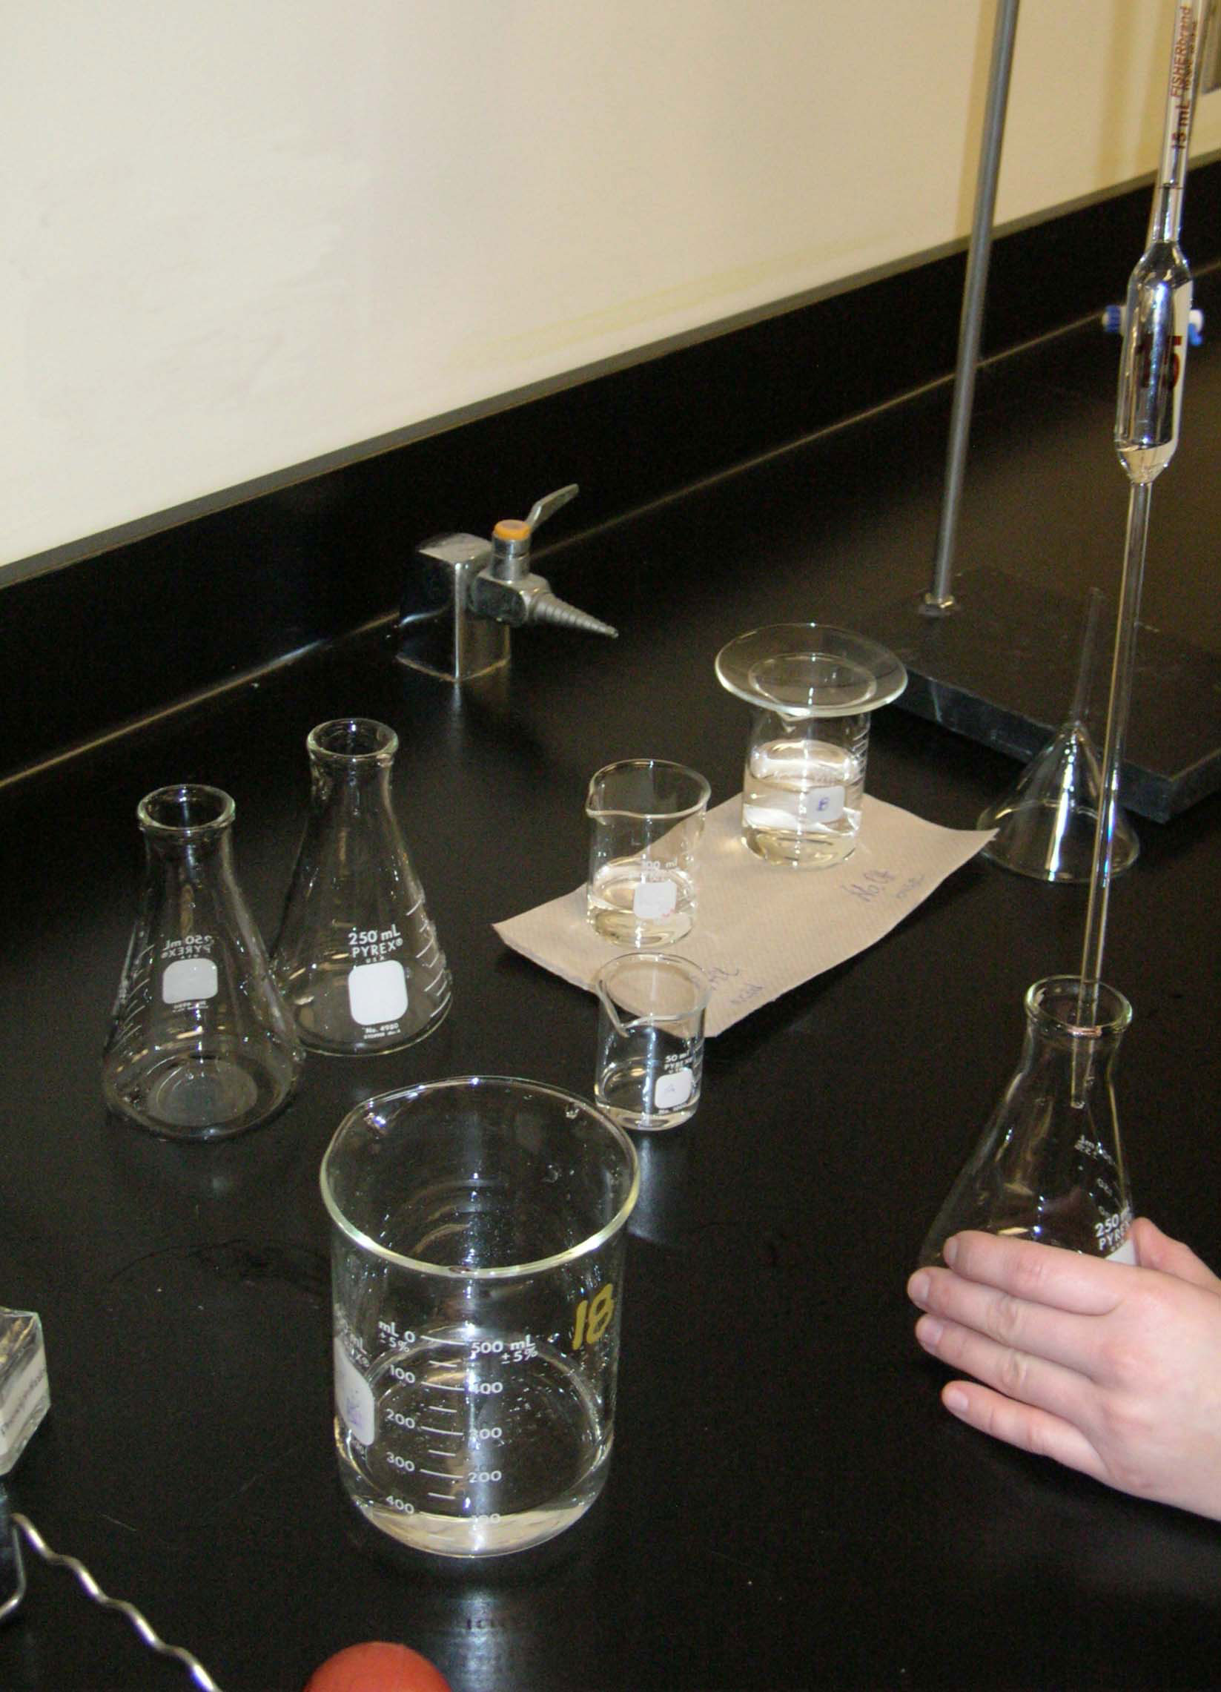
Transfer the 15.00 mL of the acid solution into the clean (rinsed with distilled water) 250 mL Erlenmeyer flask. Repeat the above process (once or twice).

Slide 6
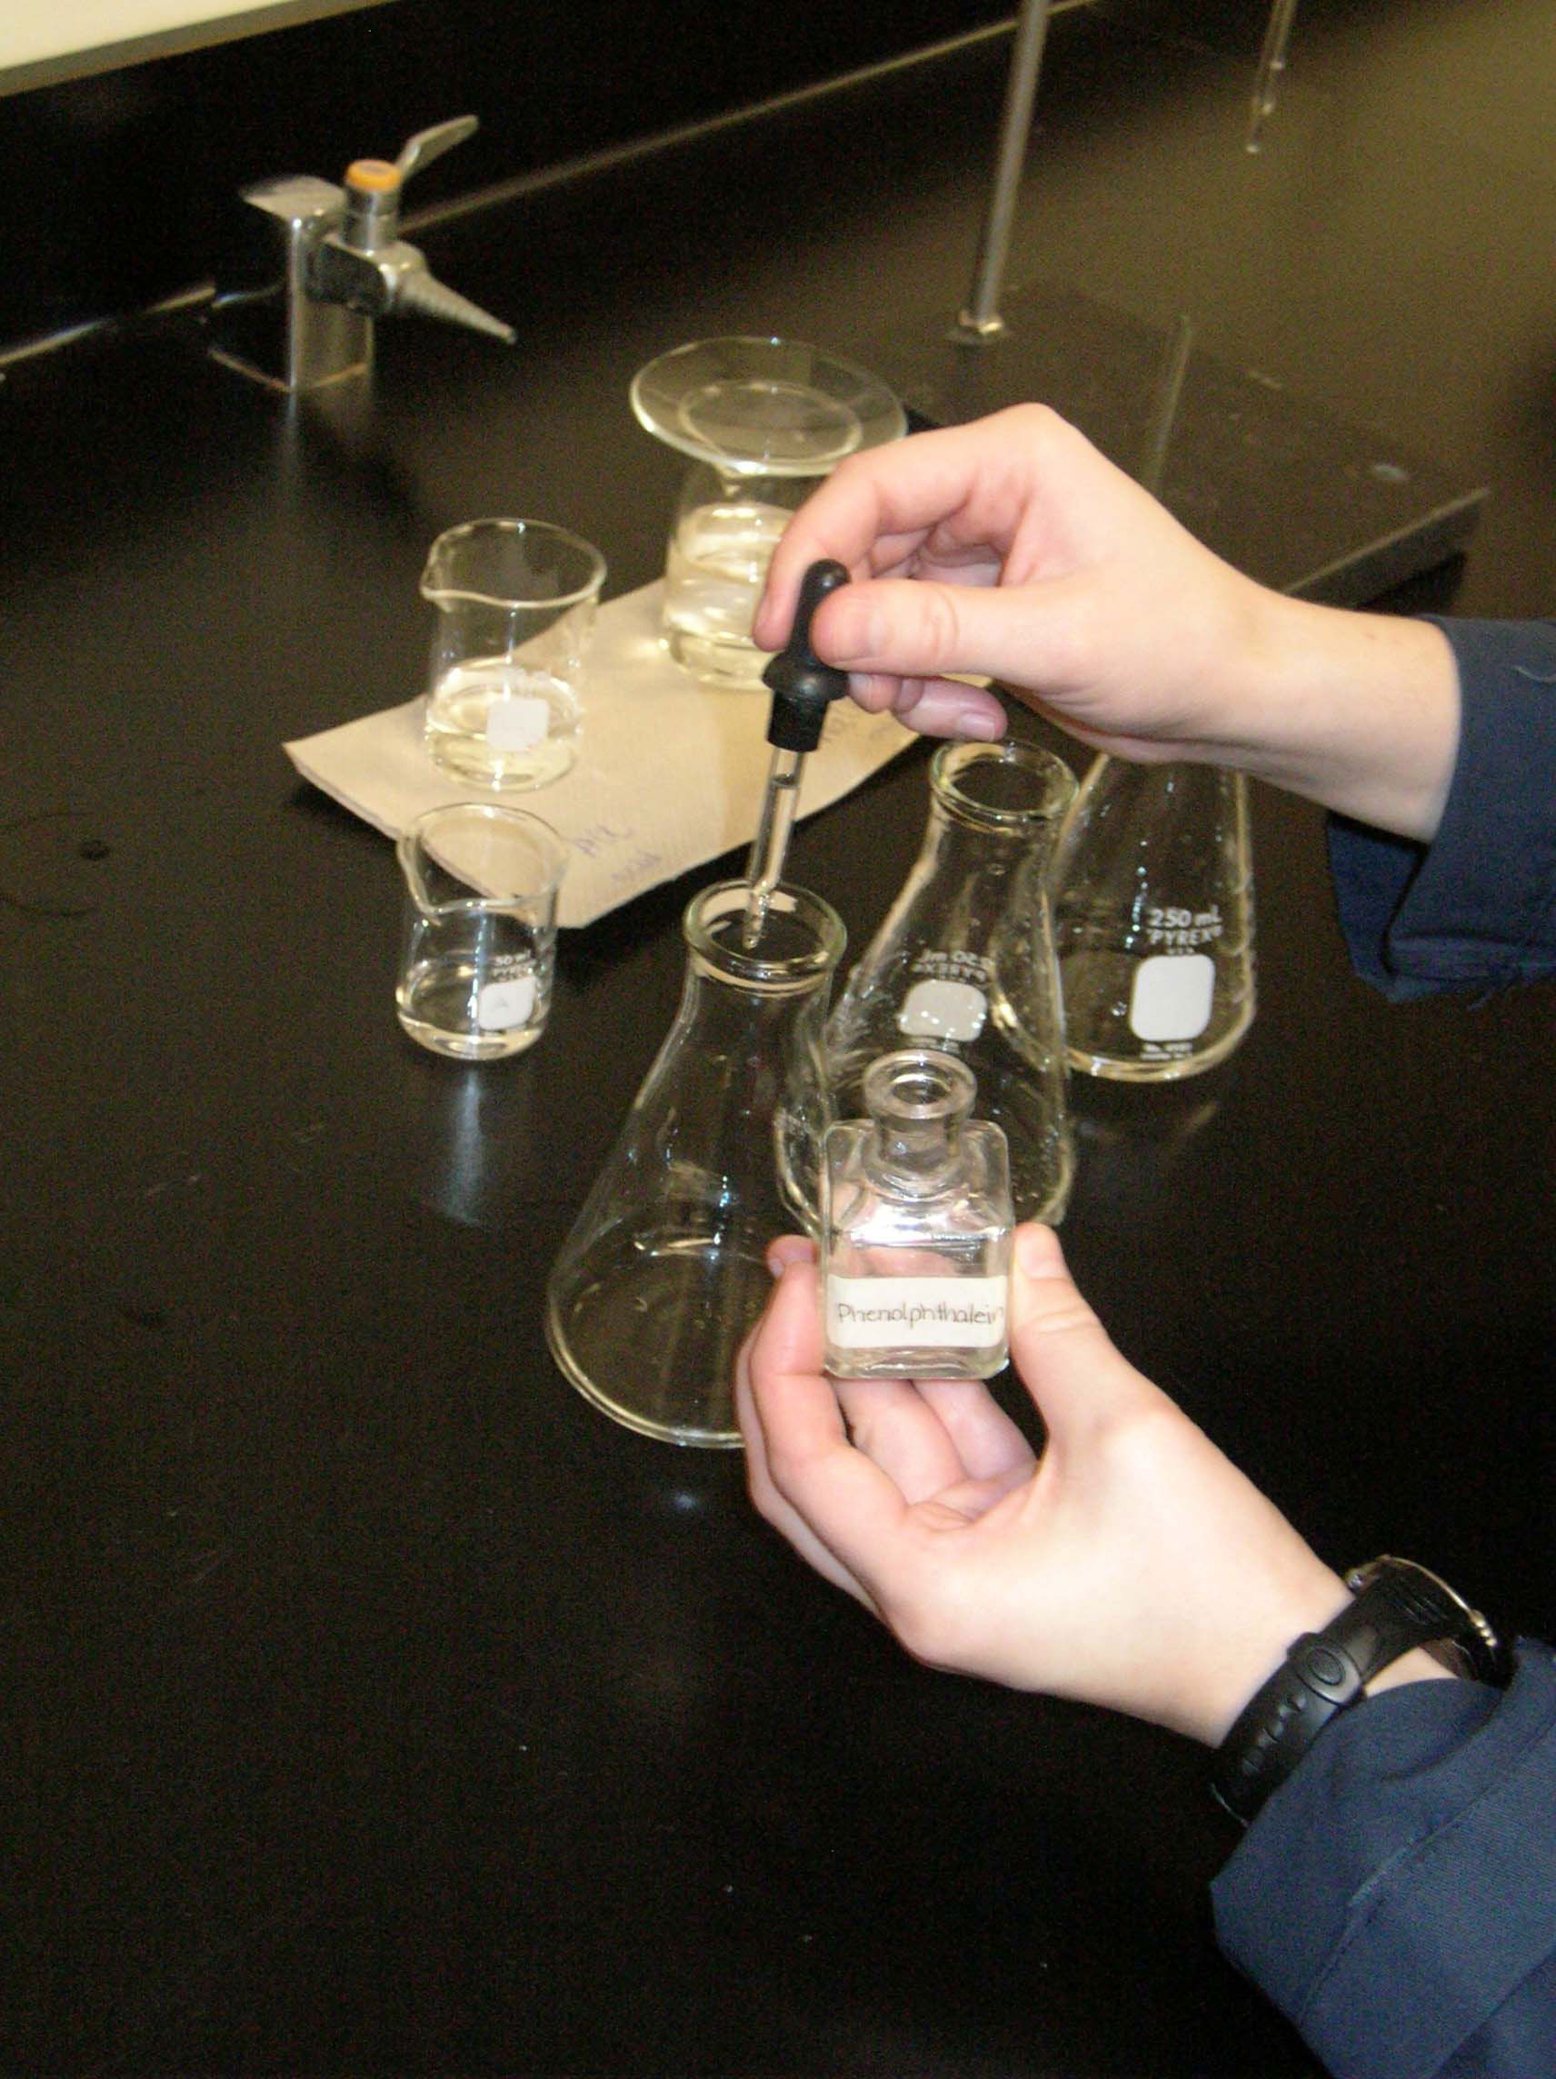
Add 2-3 drops of phenolphthalein indicator to each Erlenmeyer flask.

Slide 7
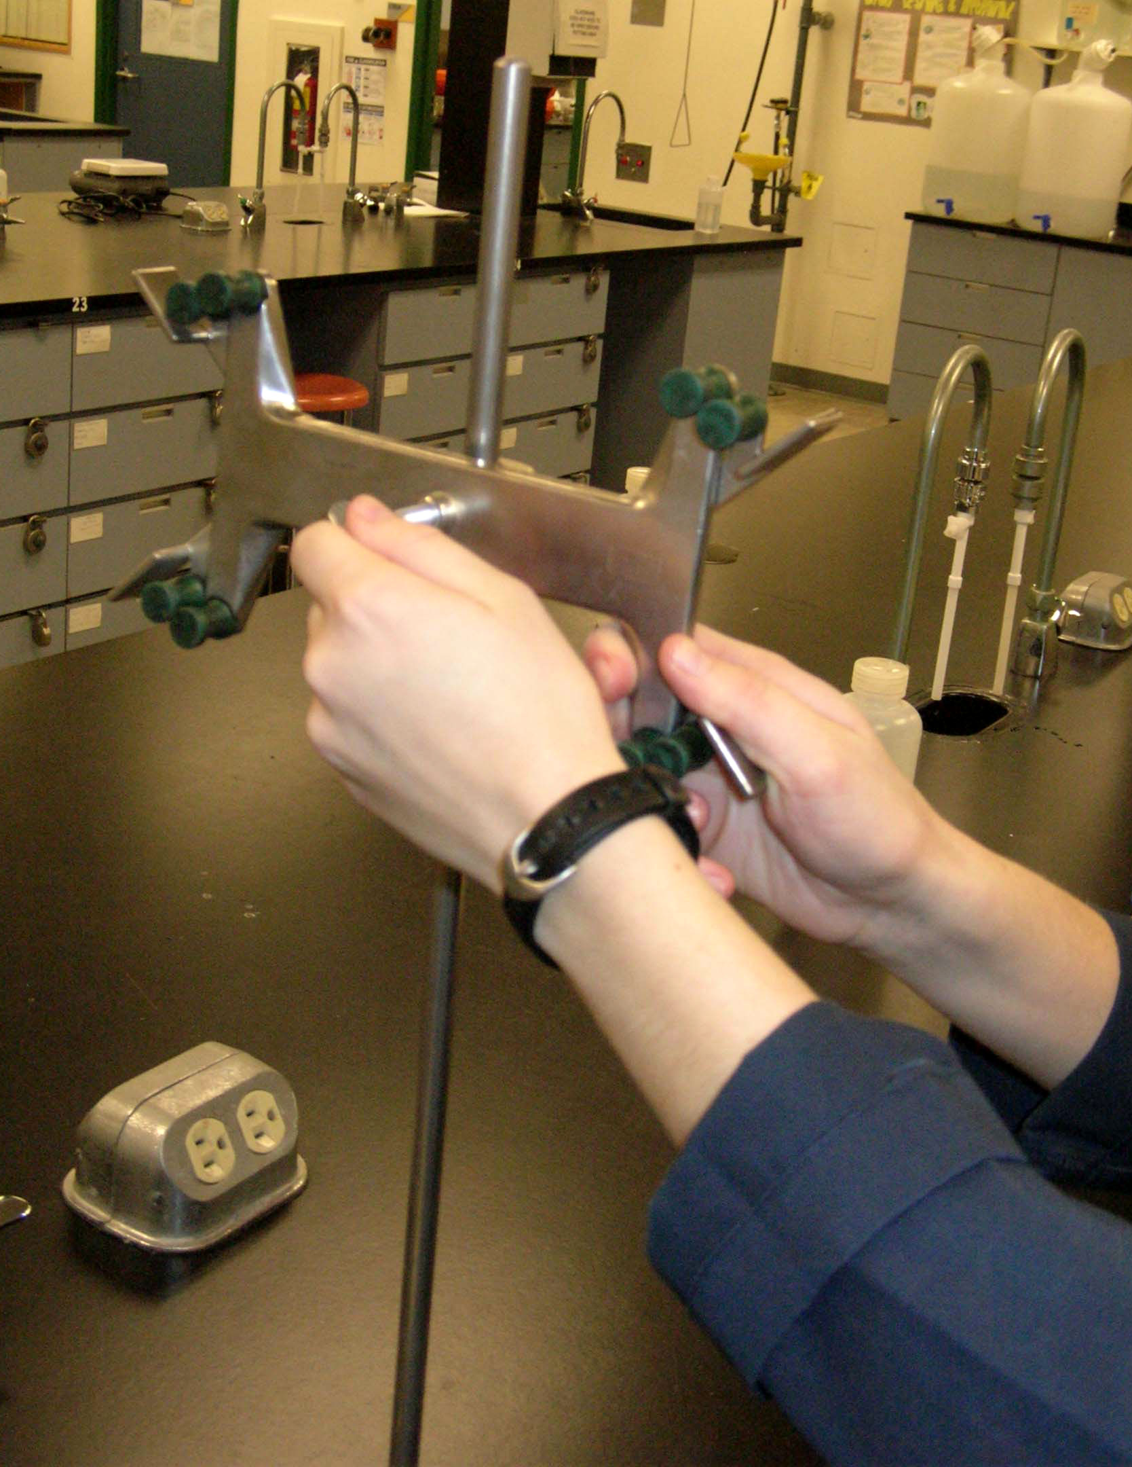
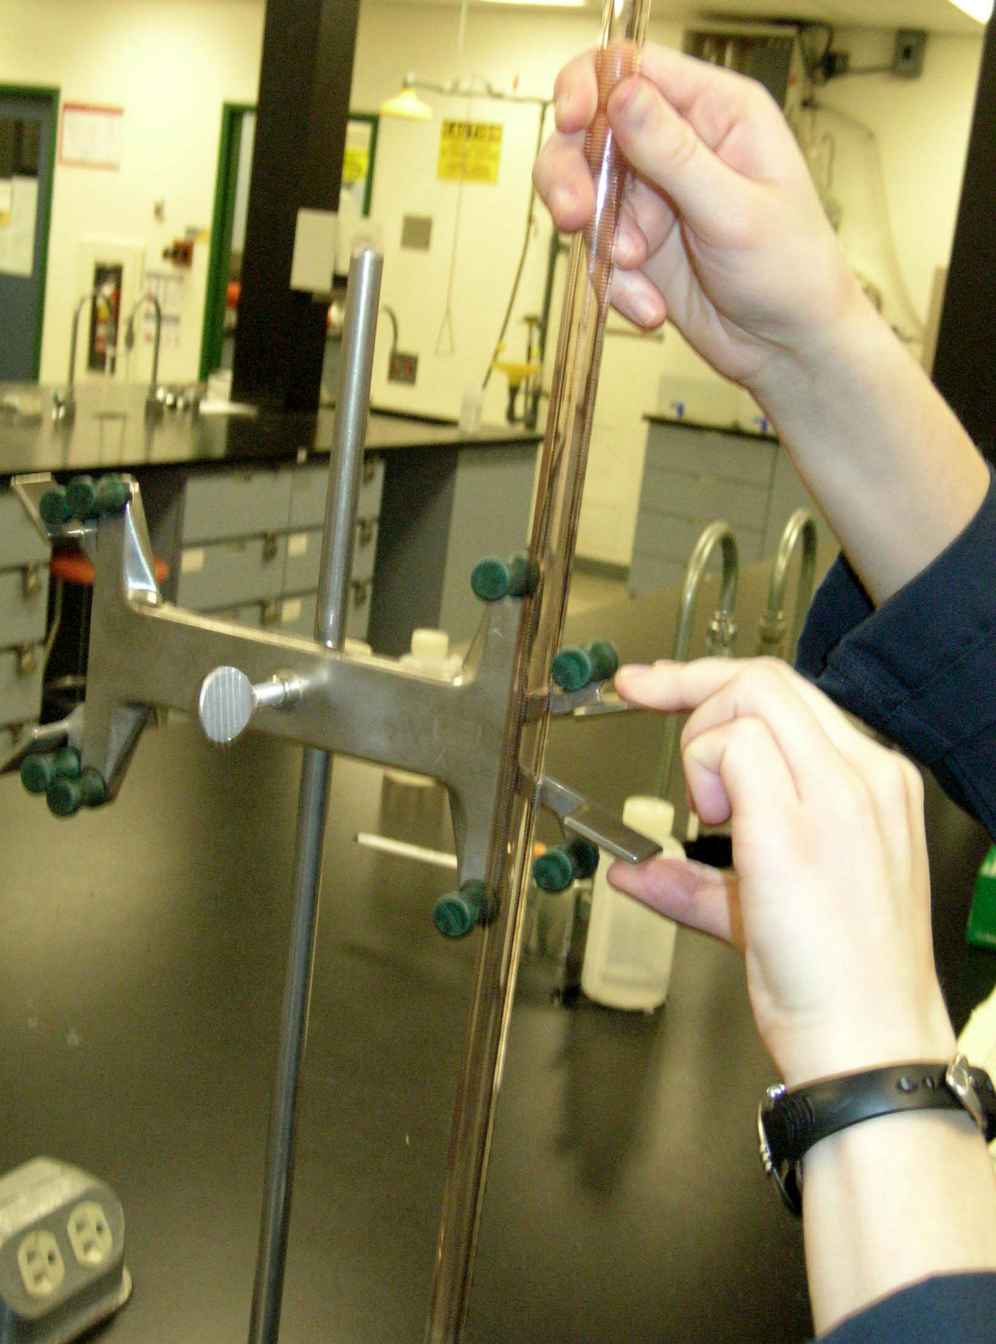
Clamp the buret to the buret stand.

Slide 8
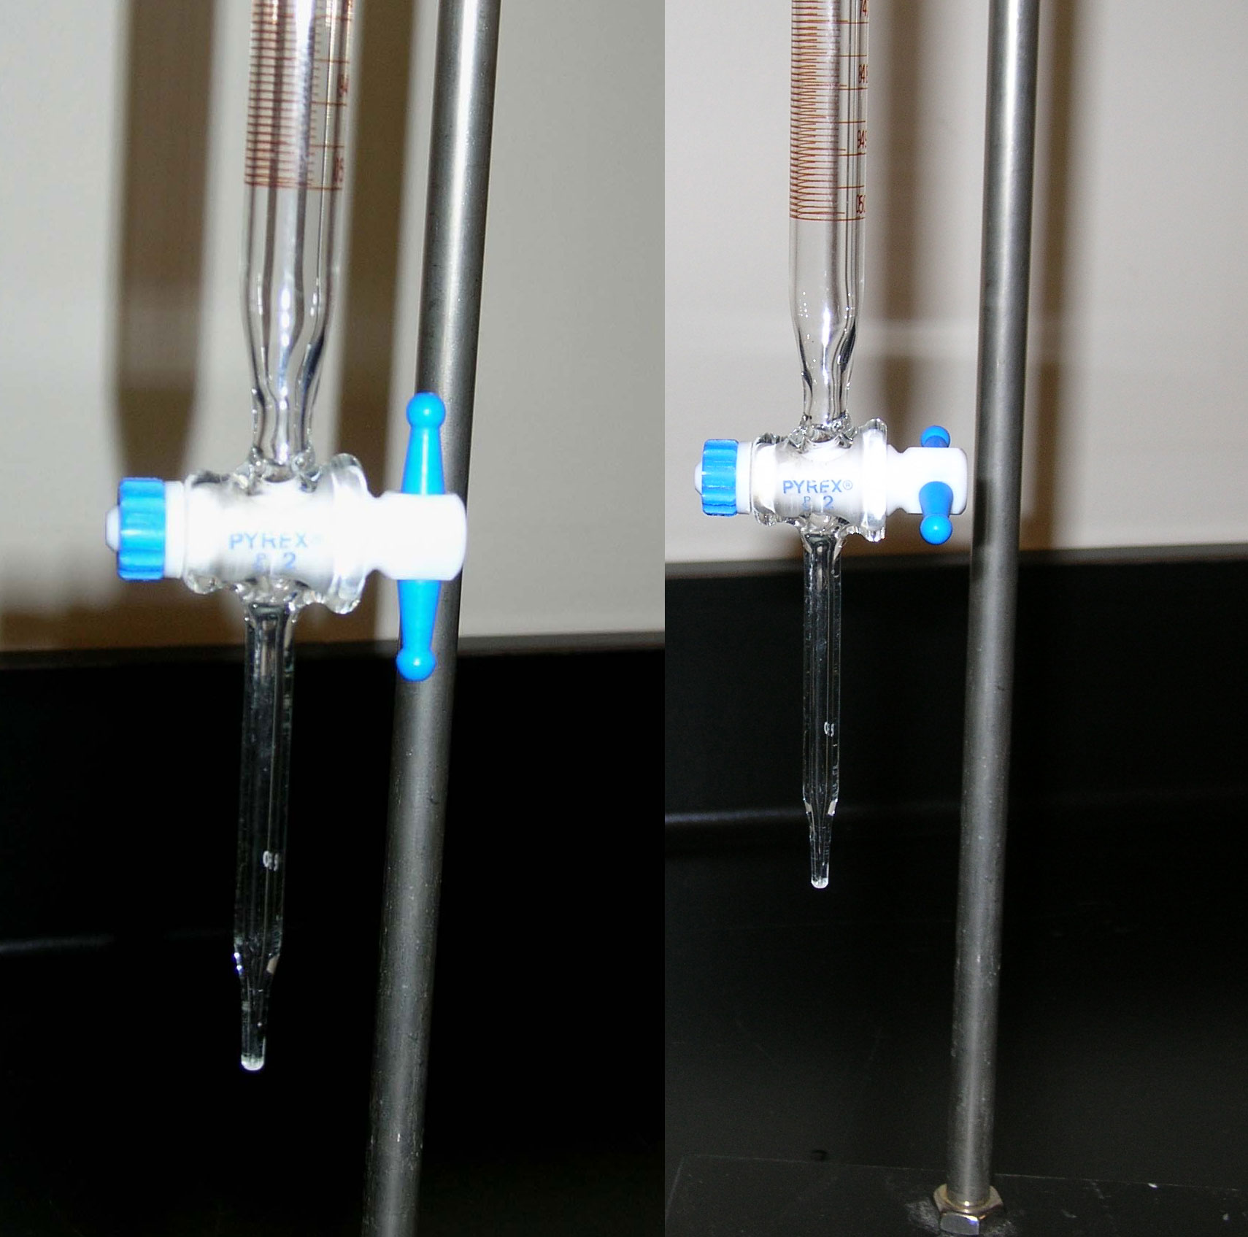
close stopcock
open stopcock

Slide 9
Rinse the 50.00 mL buret using a small quantity of the base solution (use the glass funnel to avoid spillage).

Slide 10
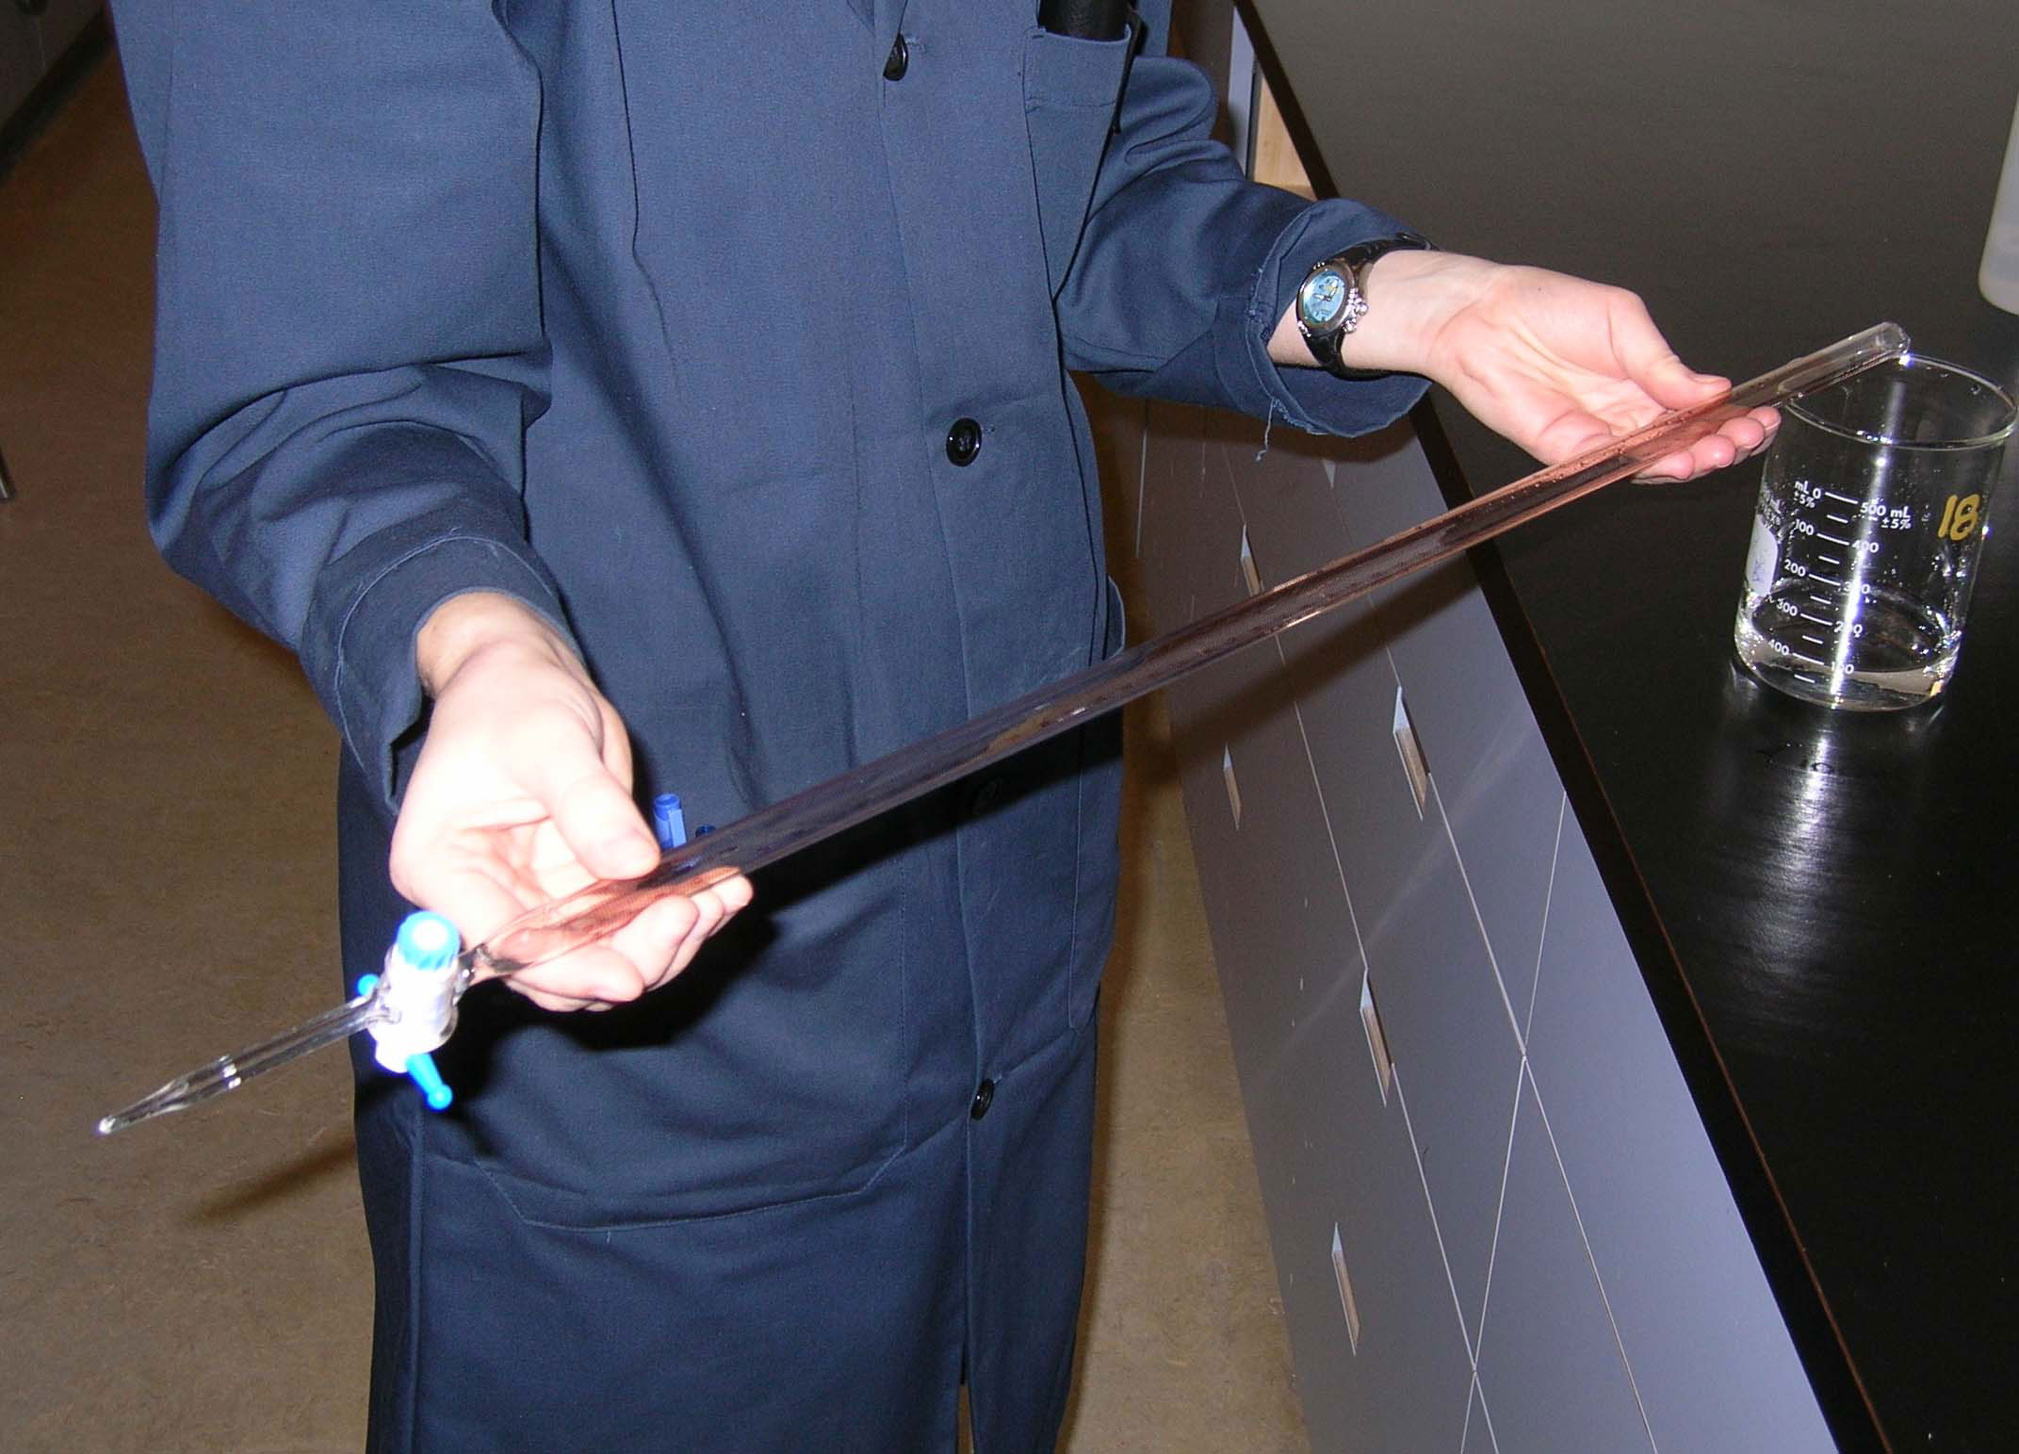
Turn and rotate the buret so all inside surfaces have come into contact with the base solution.

Slide 11
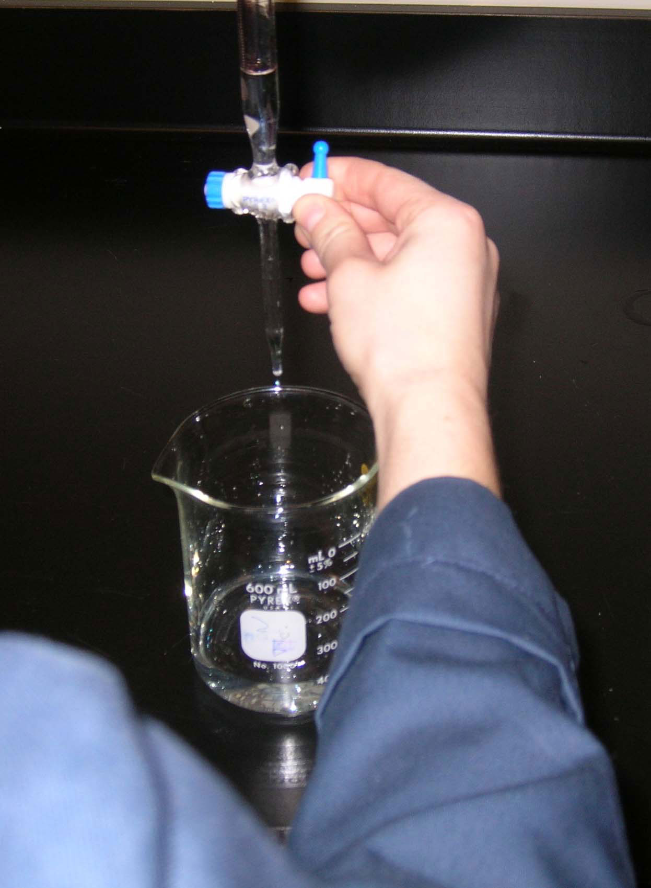
Drain and discard the base solution into the waste beaker. Rinse the buret three times with a small quantity of this solution.
Make sure that the tip of the buret is rinsed!

Slide 12
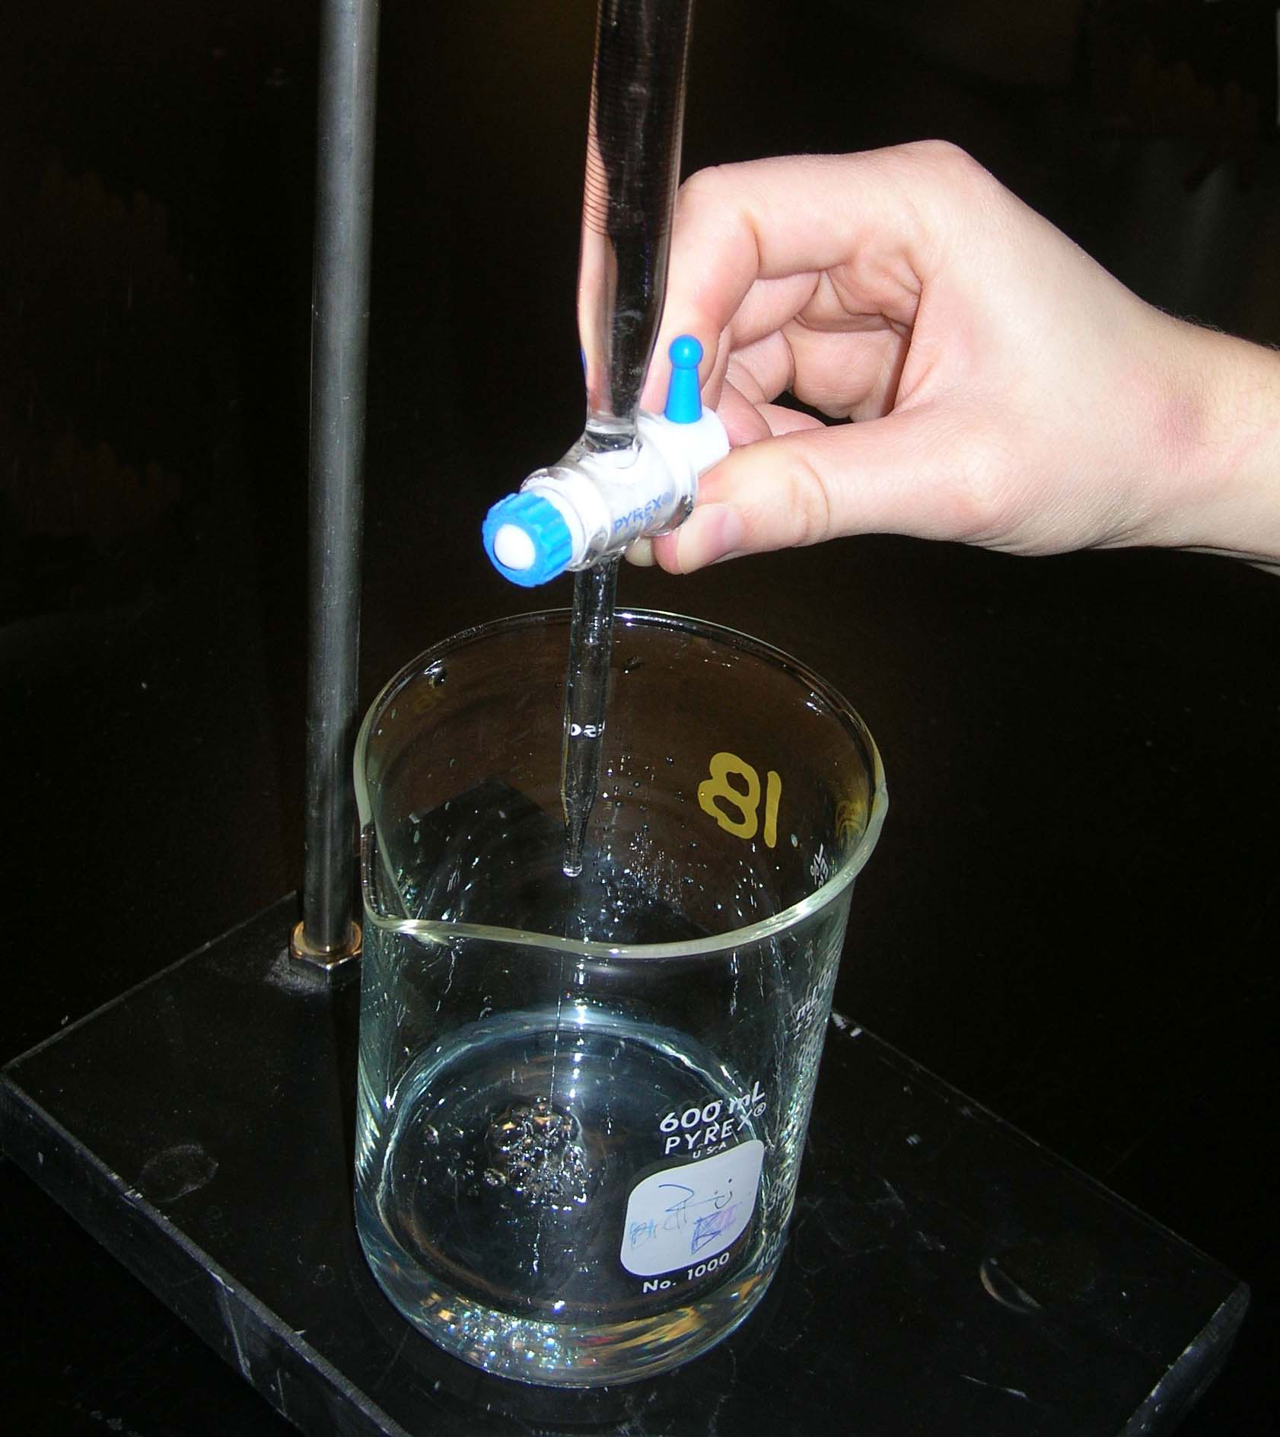
Remove the funnel and put the waste beaker under the tip of the buret. Open the stopcock and allow some solution to run through (ensure that the buret tip is filled with the base solution and contains no air bubbles).
Next, fill the buret with the base solution.

Slide 13
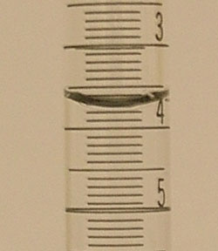
Close the stopcock and wait a few seconds for drainage to be complete, then note the reading on the buret to two decimal places (V_{initial}).
V_{initial} = 3.78 mL

Slide 14
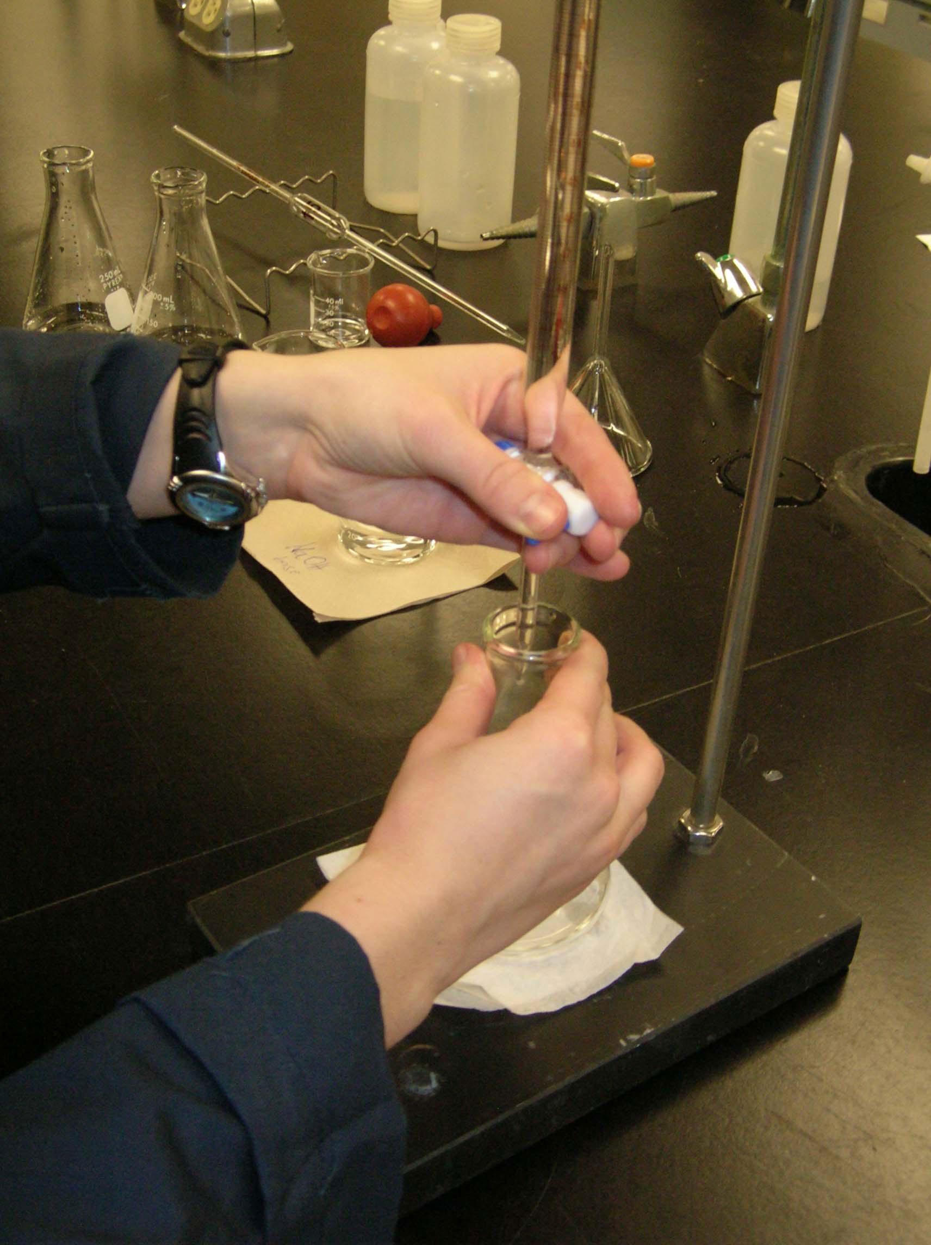
Place the Erlenmeyer flask under the tip of buret and put the Kimwipe under the Erlenmeyer flask (white background).

Slide 15
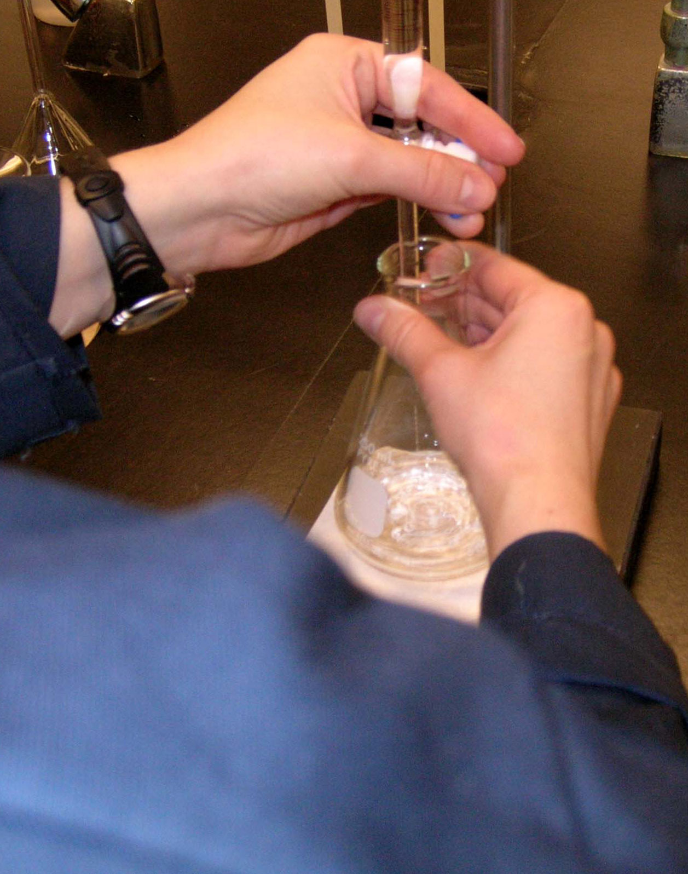
Titrate to the end point.

Slide 16
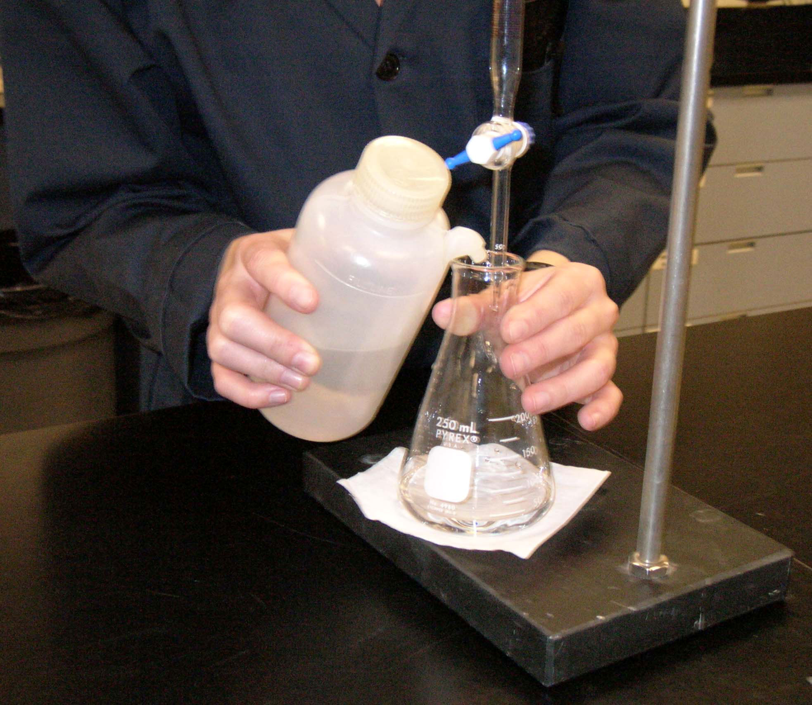
When you are close to the end point use the drop-by-drop approach and rinse the last drop from the tip of the buret at the side of the Erlenmeyer flask with the distilled water.

Slide 17
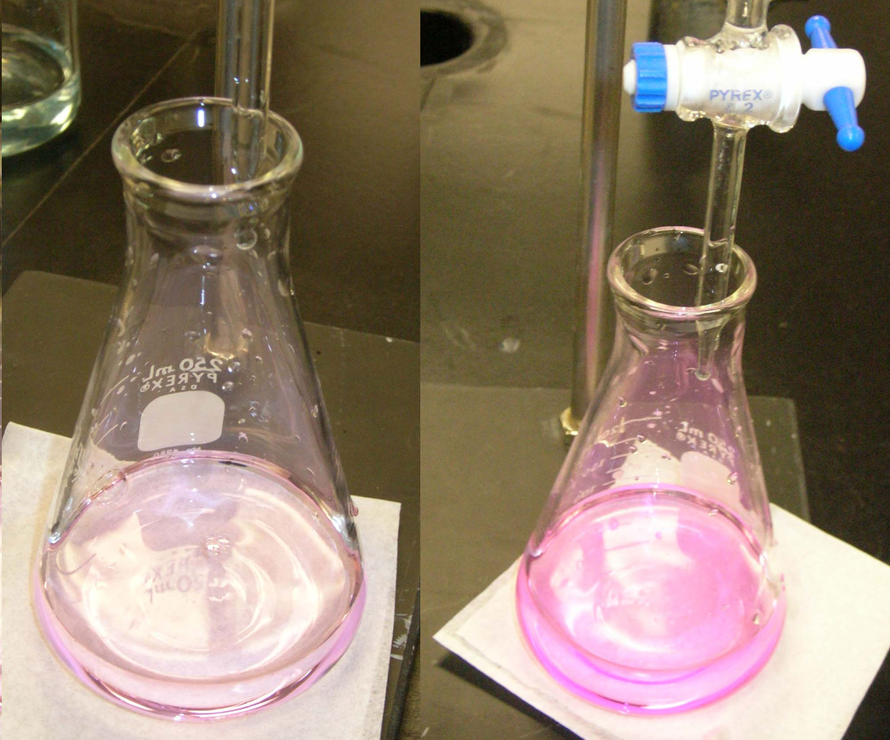
End point – light pink.
Over titrated end point – dark pink.

Slide 18
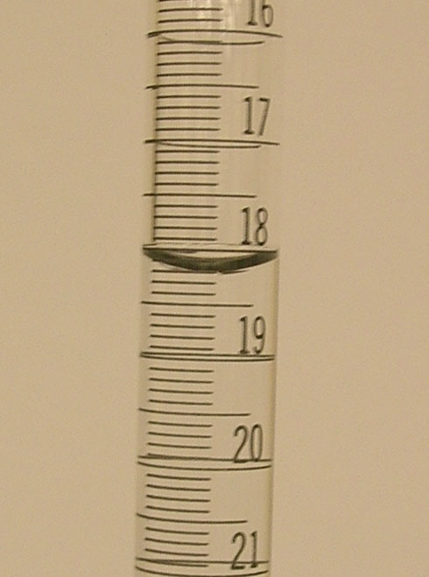
Close the stopcock and wait a few seconds for drainage to be complete, then note the reading on the buret to two decimal places (V_{final}).
V_{final} = 18.20 mL

Slide 19
[NaOH] = __________
± 0.02 | V_{initial} (mL) | V_{final} (mL) | V_{used} (mL) | End-point
Run #1 | 3.78 | 18.20 | 14.42 | light pink
Run#2
Run #3
Rinse the buret with water and clean up your work space.

