Slide 1
WATER OF HYDRATION
Go to browse and the full screen.

Slide 2
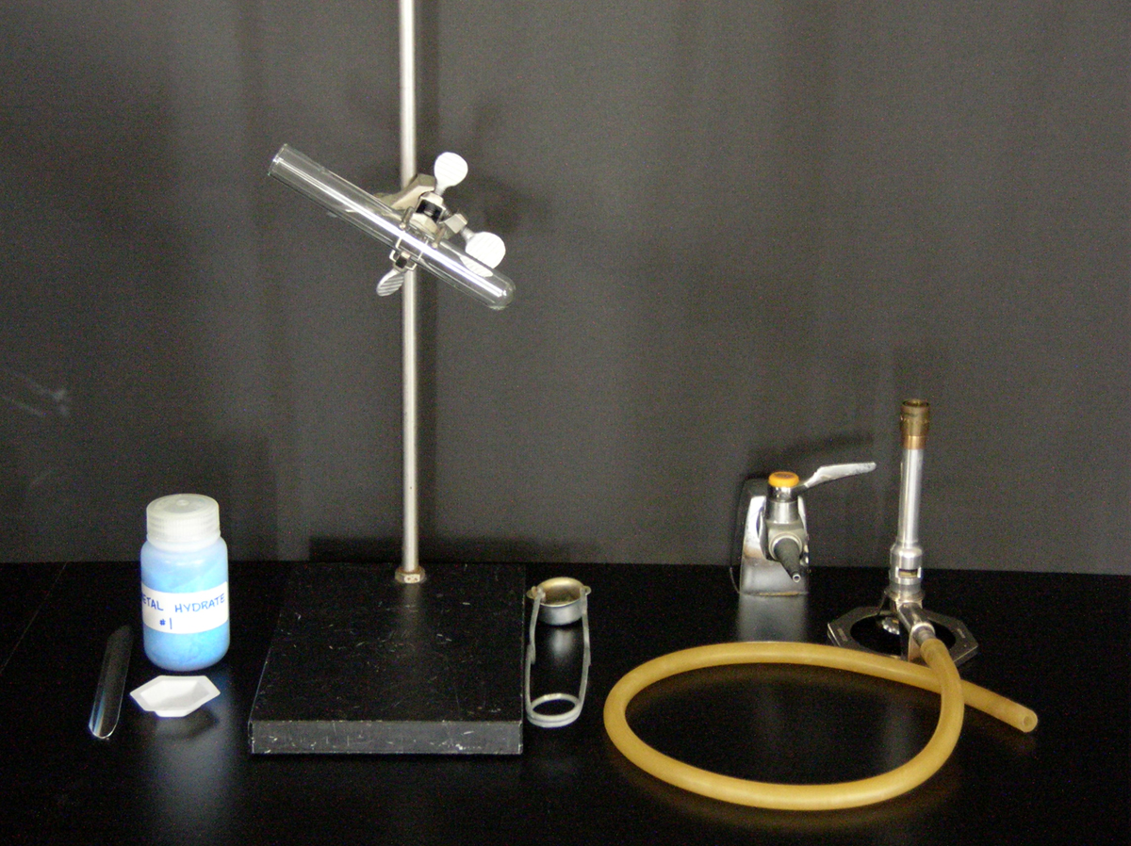
Equipment required
test tube
clamp
gas tap
stand
Bunsen burner
striker
metal hydrate

Slide 3
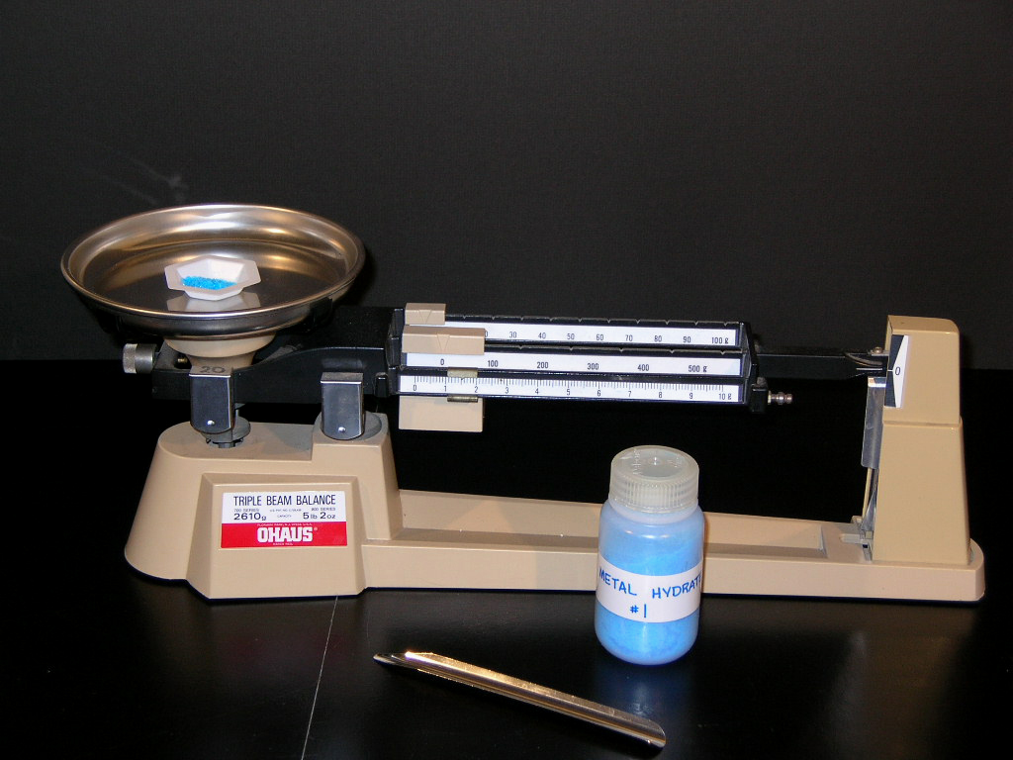
Obtain a sample of about 1 gram of a metal hydrate.

Slide 4
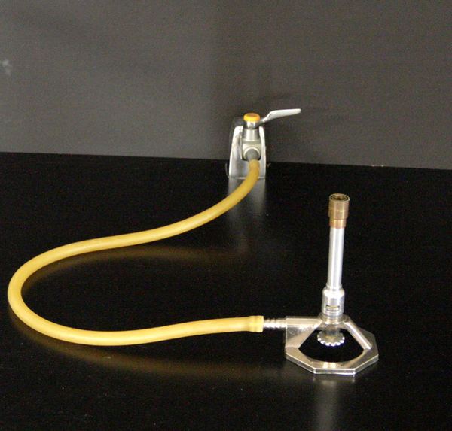
gas tap
Bunsen burner
mixing barrel
air inlet ports
needle valve

Slide 5
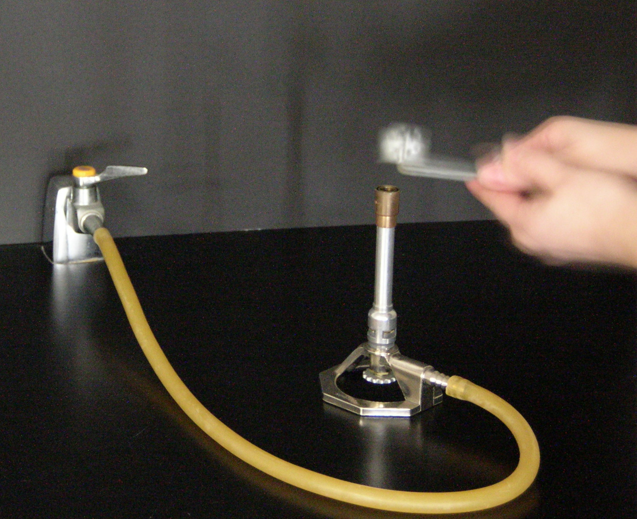
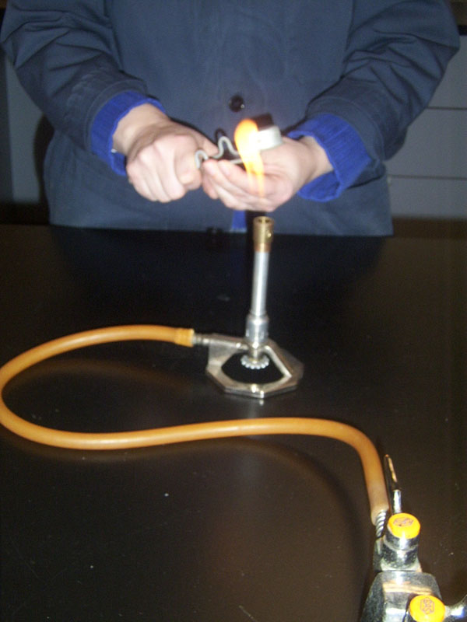
Ignite the Bunsen burner…..

Slide 6
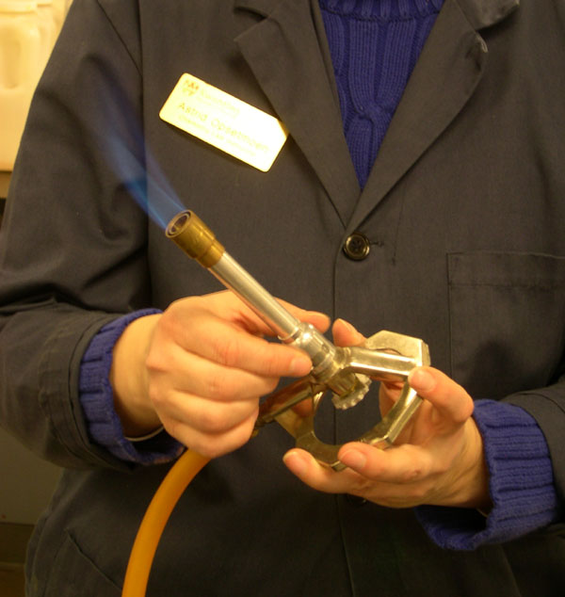
…adjust the Bunsen burner to set appropriate flame (inner blue cone).

Slide 7
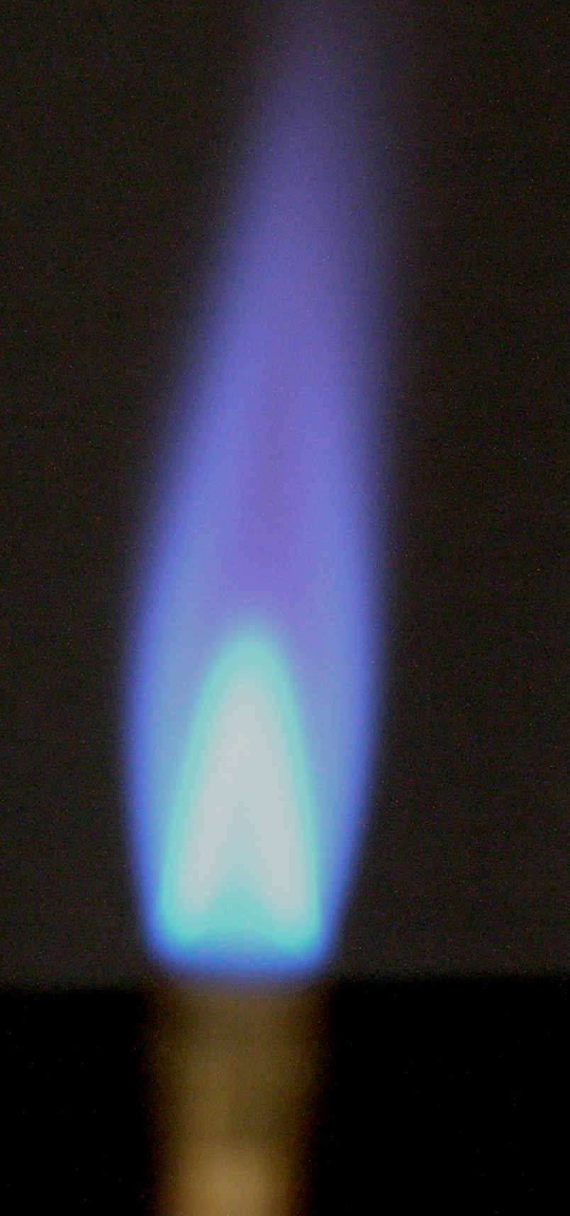
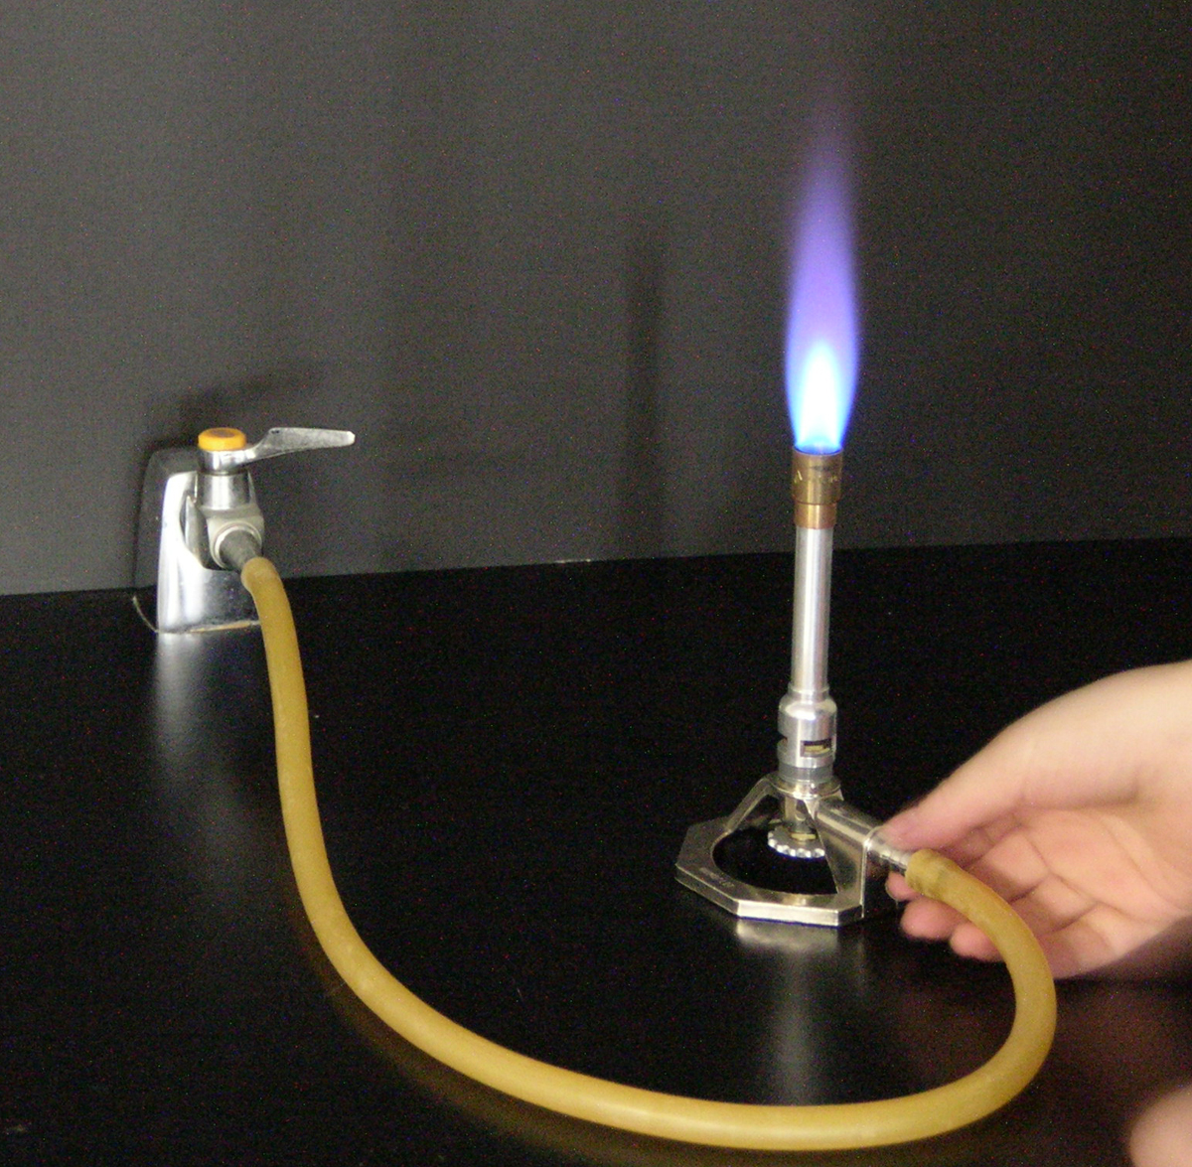
Inner blue cone

Slide 8
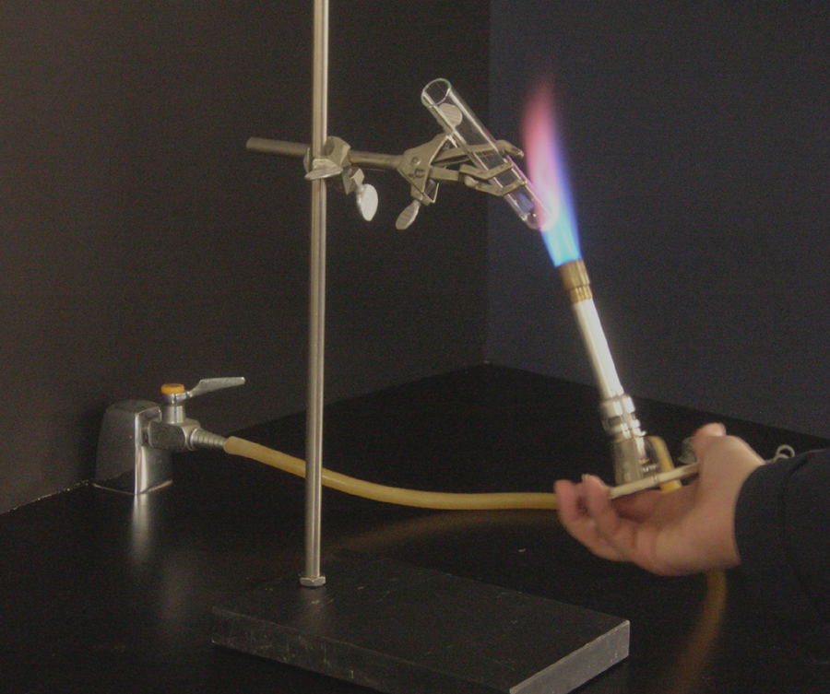
Use the Bunsen burner to dry the test tube.

Slide 9
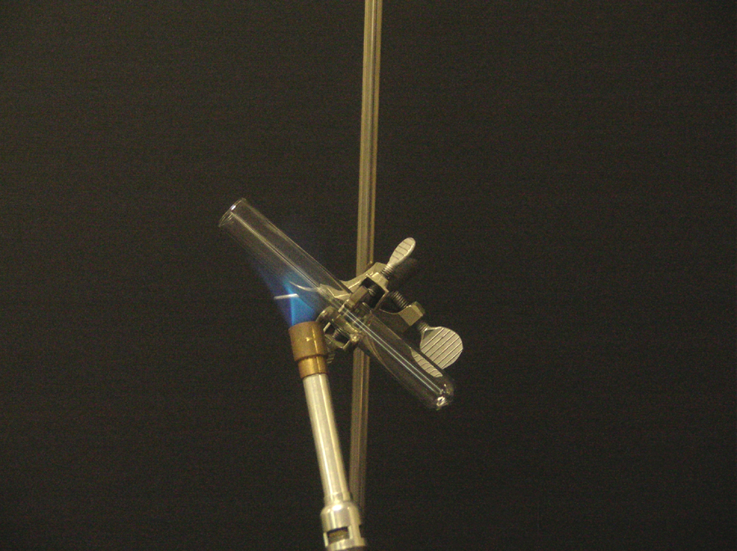
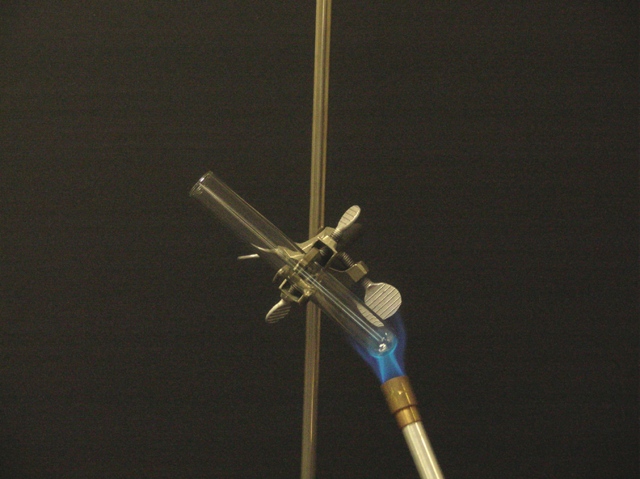
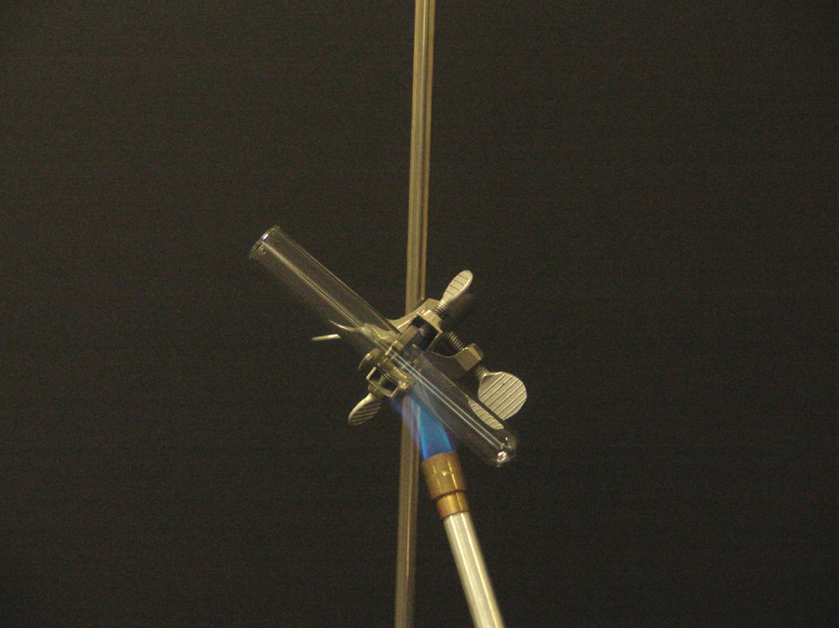

Slide 10
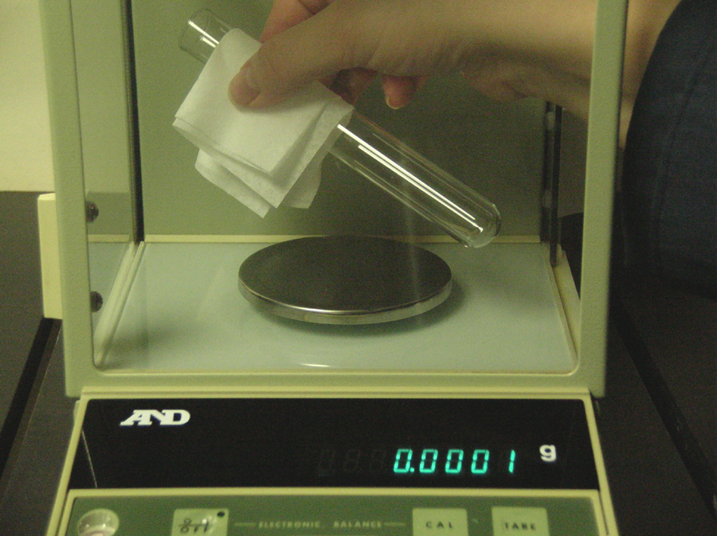
Let the test tube cool to room temperature and …

Slide 11
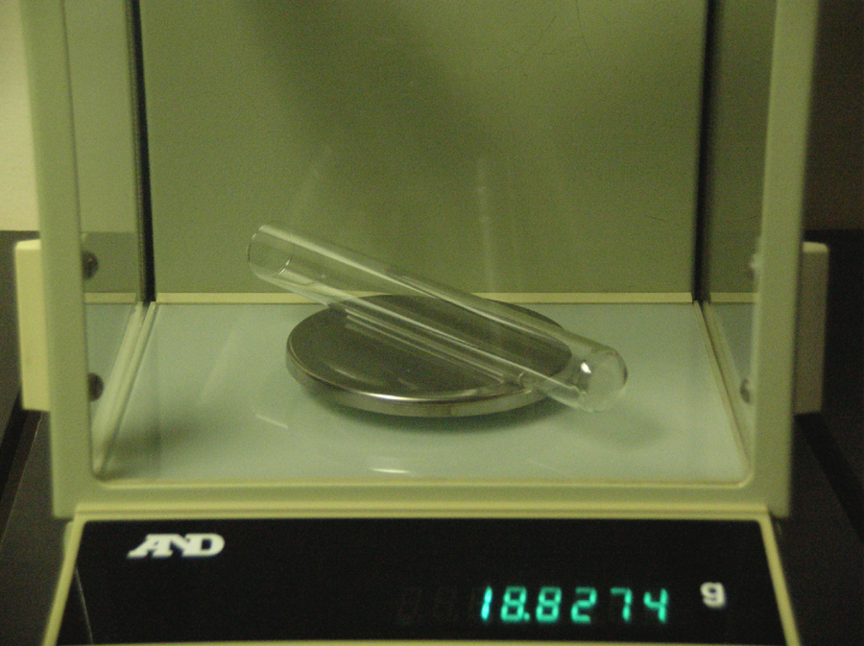
Record the mass of the test tube on the analytical balance.

Slide 12
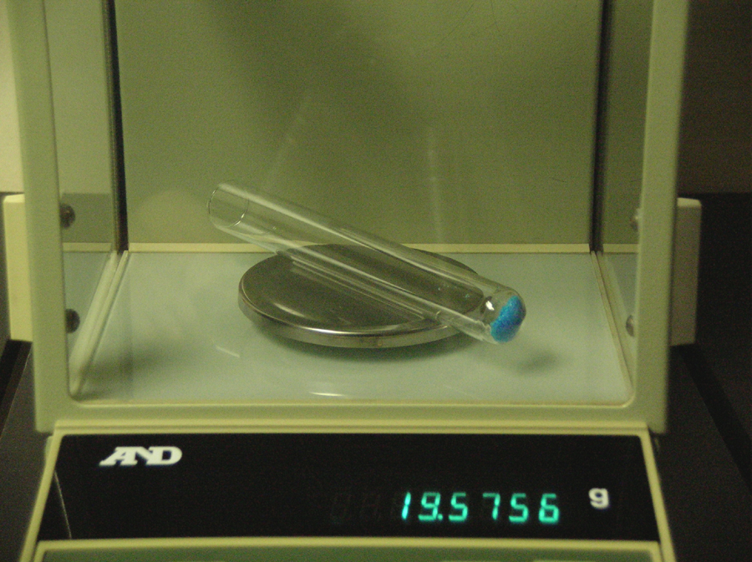
Into the test tube accurately weigh about 0.5 grams of the metal hydrate.

Slide 13
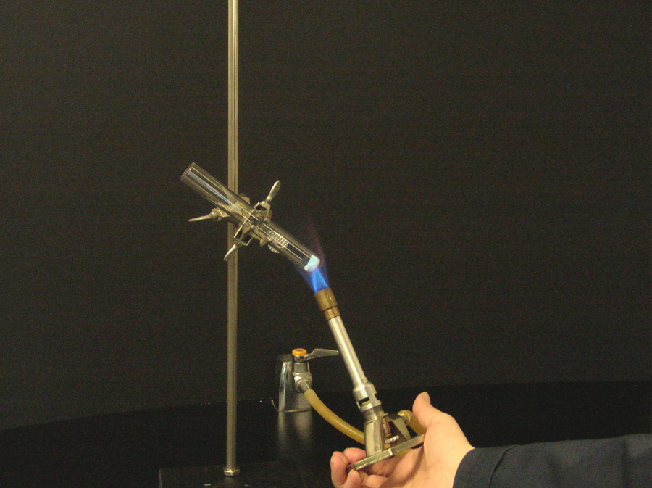
Heat the test tube containing the hydrate for 5 to 6 minutes (gently at first).

Slide 14
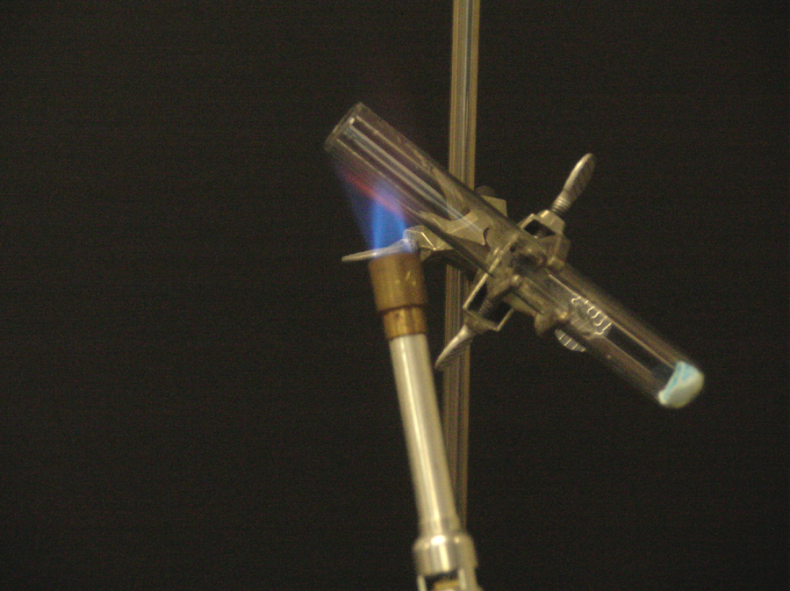
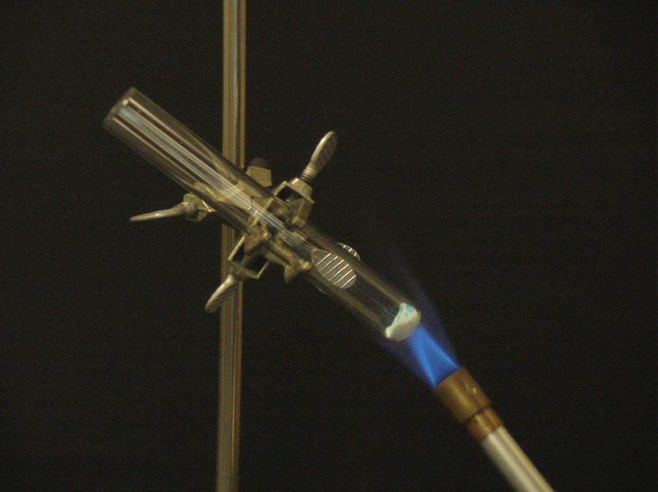
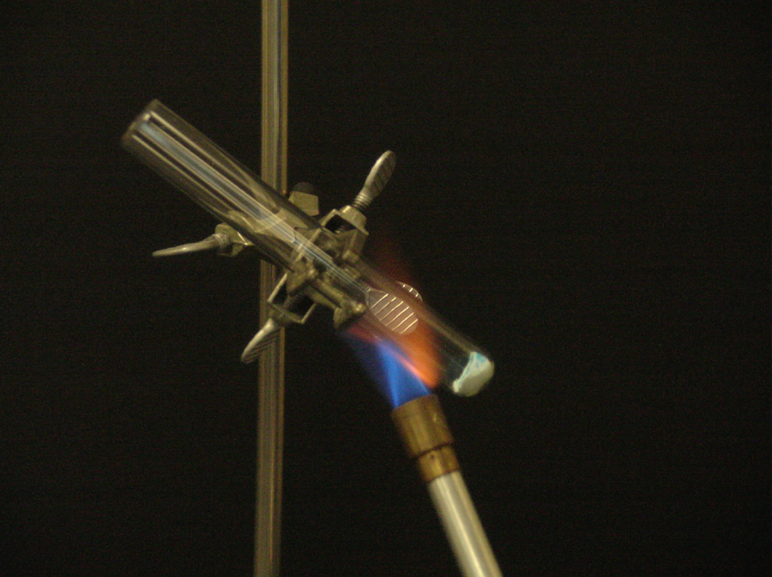
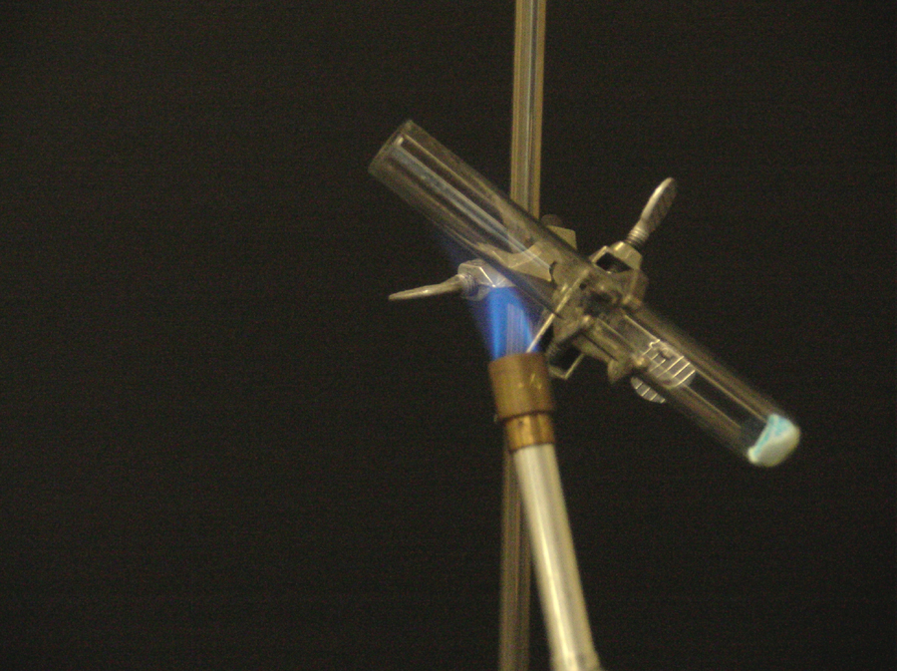

Slide 15
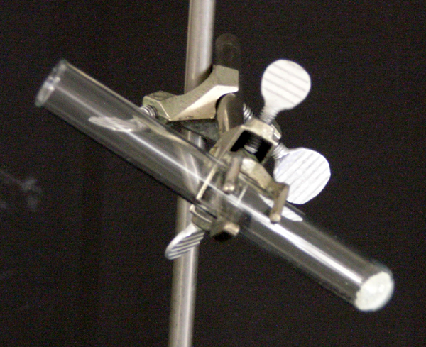
Let the test tube cool to room temperature.

Slide 16
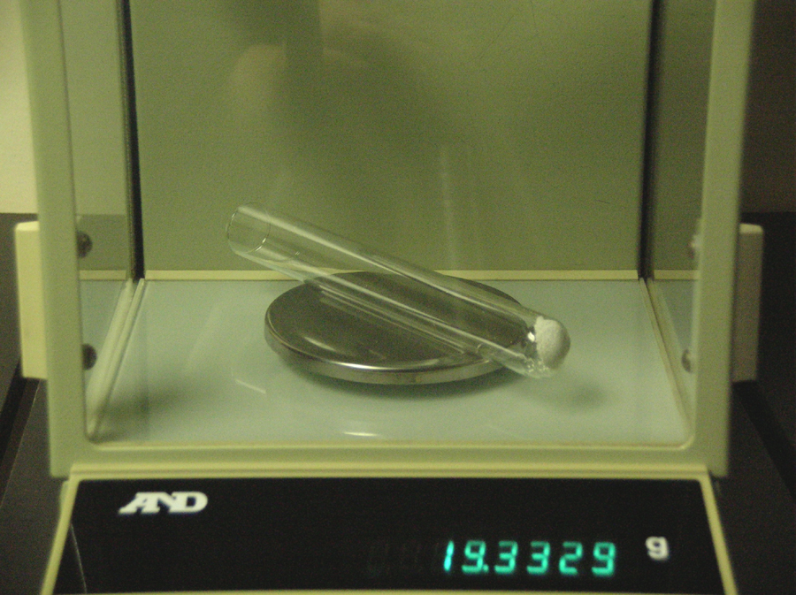
Then weigh the test tube accurately and
record the mass of the test tube.

Slide 17
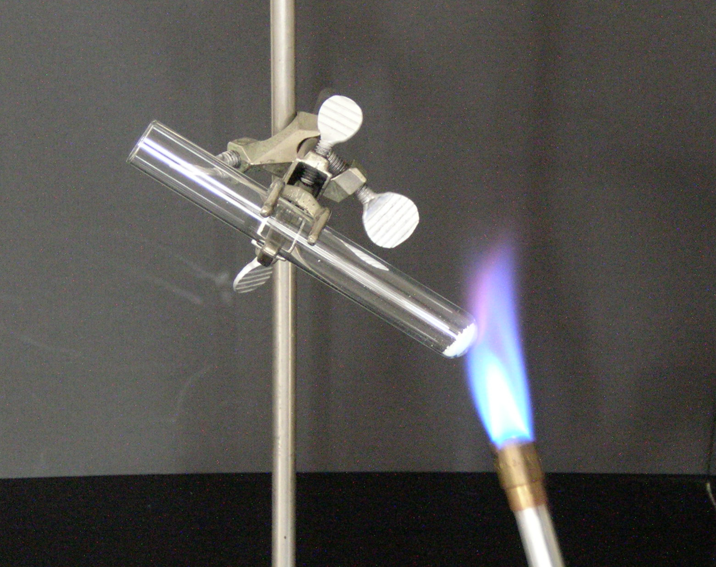
Reheat the test tube for 2-3 minutes, let it cool to room temperature and…

Slide 18
..then reweigh and record the mass of the test tube. If the masses after this step are within 0.005 g, then you have heated the test tube to constant mass.

Slide 19
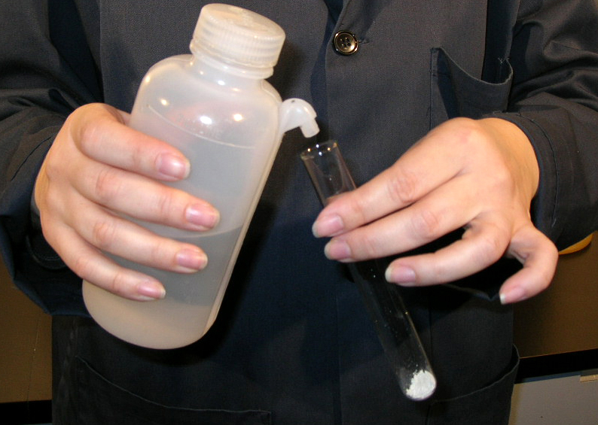
Add water (about 1mL) to the test tube.

Slide 20
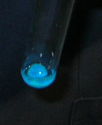
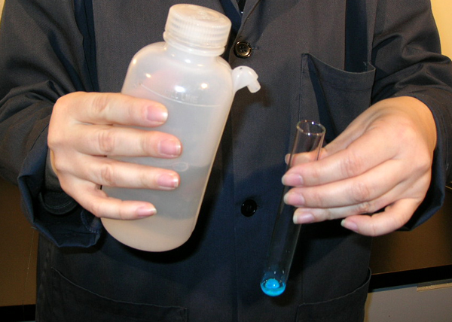
What is going to occur?

