Slide 1
CHEMISTRY 1105
Exploring Boyle’s Law using Vernier Equipment

Slide 2
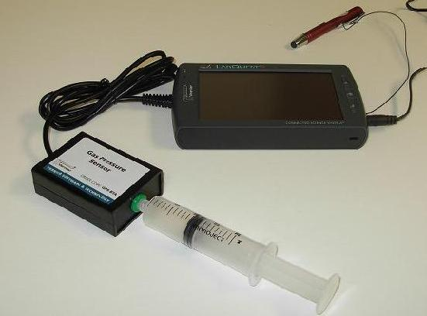
Pressure vs. Volume
CHEMISTRY 1105
VERNIER EQUIPMENT OVERVIEW:
Gas Pressure Sensor connected
to Analog Port at
side of Lab Quest 2
Lab Quest 2
Stylus
Power Connection
Gas Pressure
Sensor
Syringe

Slide 3
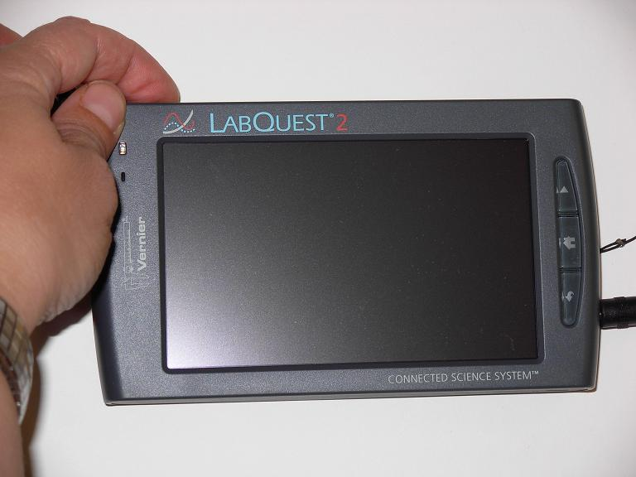
Pressure vs. Volume
CHEMISTRY 1105
CONNECTIONS & POWER:
Power Button
Power Connection

Slide 4
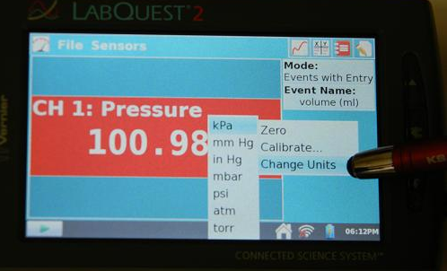
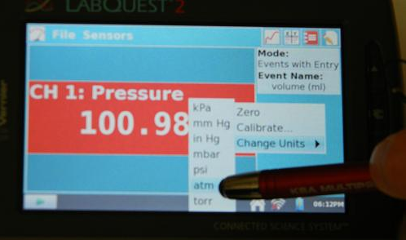
Pressure vs. Volume
CHEMISTRY 1105
Tap on the number shown in the red Pressure box to change the units from the default kPa to atm.

Slide 5
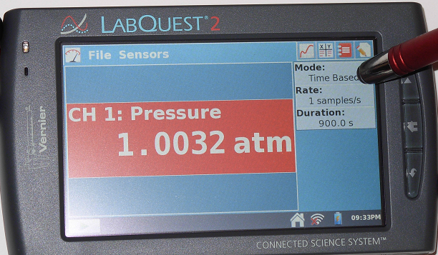
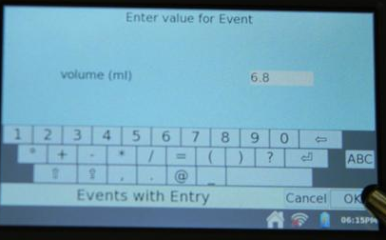
Pressure vs. Volume
CHEMISTRY 1105
Tap on the Mode box to change the setting to Events with Entry.
Name the Event Volume and enter the units as mL.

Slide 6
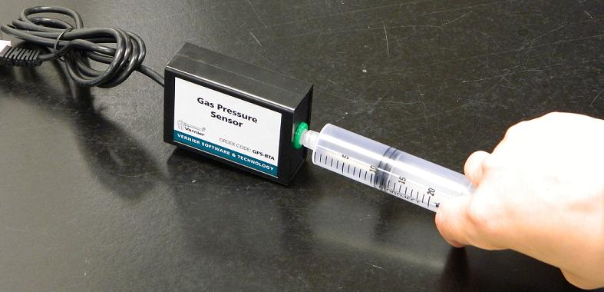
Pressure vs. Volume
CHEMISTRY 1105
Syringe is attached to the pressure sensor with a volume of 10.0mL of AIR.
10.5mL

Slide 7
Pressure vs. Volume
CHEMISTRY 1105
Tap on the Gauge Icon . Push the plunger to 5.0 mL and see that the pressure is stable.
Warning do NOT let the pressure go above 2.0 atm, it will damage the sensor.
Hold the plunger on the syringe throughout the experiment

Slide 8
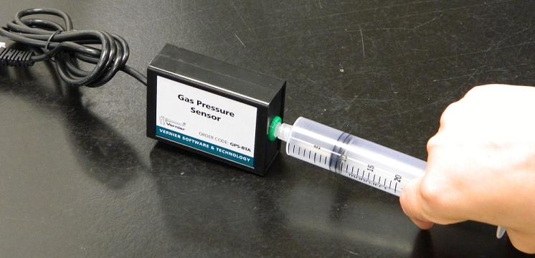
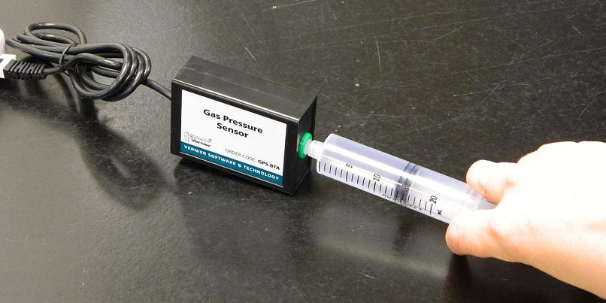
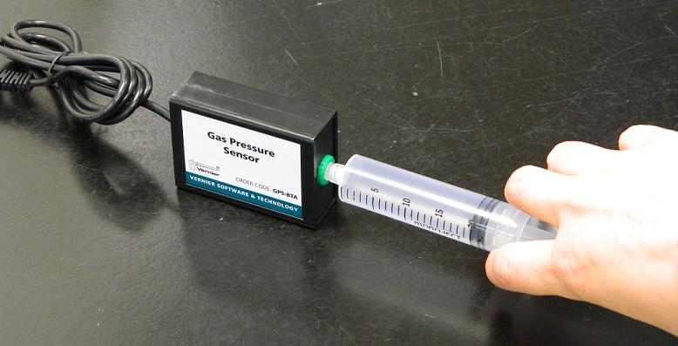
Pressure vs. Volume
CHEMISTRY 1105
Adjust the Syringe to 5.0 mL and press the Start Button on the Lab Quest 2.
Increase the volume in 1 mL stages until you reach 20.0mL. Maintain a steady volume when you are ready and record volume values by pressing the Keep Icon.
13.5mL
20.0mL
10.5mL
20.0mL
8.0mL

Slide 9
Pressure vs. Volume
CHEMISTRY 1105
You should have at least 12 different data points after completing the experiment.
Press the Stop Button to stop collecting data.
Tap on the X/Y Table Icon . Record the data shown in the Run table into your lab notebook.
Click on Graph Icon to view the data points on a grid. Make a rough sketch in your notebook of the graph.

Slide 10
Pressure vs. Volume
CHEMISTRY 1105
Shut down the Lab Quest 2.
Turn the Power Off by pressing the Power button.
Graph your data using Excel.
Graph Pressure (atm) versus Volume (mL) and Pressure (atm) versus 1/Volume (mL⁻¹). Which graph gives a linear relationship?
Create a graph in Excel. Go to http://kwantlen.ca/science/chemistry/chem1210/richsup/excel.pdf

