Slide 1
Chemistry 1105
Gravimetric Analysis of a
Soluble Carbonate
Go to browse and set to full screen.

Slide 2
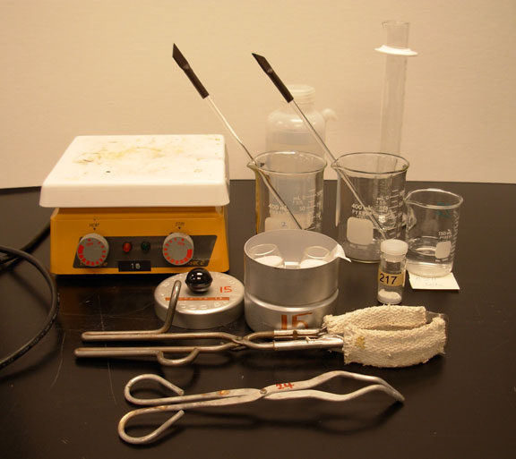
Two 400 mL beakers and two stir rods.
60 mL of 0.55 M CaCl₂
Vial containing the unknown

Slide 3
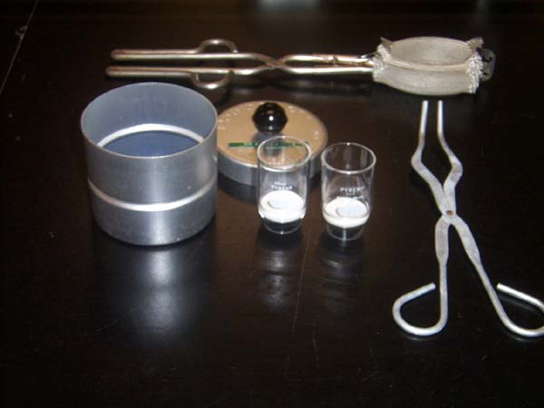
Beaker tongs
Crucibles
Desicooler
Crucible tongs

Slide 4
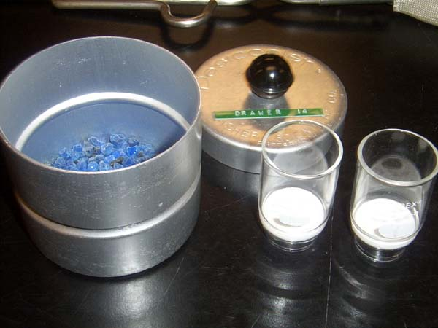
Drying agent

Slide 5
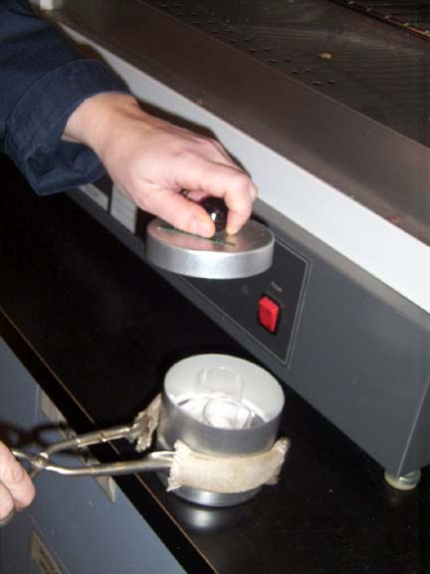
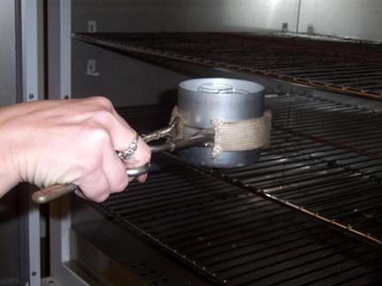
Obtain two crucibles from the oven, put the lid on and let them cool on the bench top for 20 min. Then weigh them accurately on the analytical balance.

Slide 6
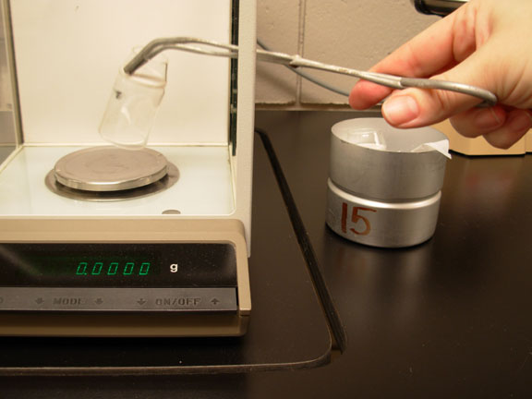
Use crucible tongs to transfer crucible to analytical balance.
Record the mass in your notebook.

Slide 7
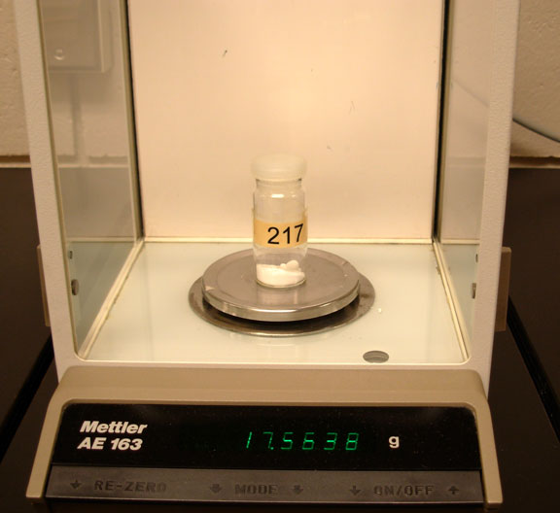
Accurately determine the mass of the vial, contents and lid. Record this mass and unknown #.

Slide 8
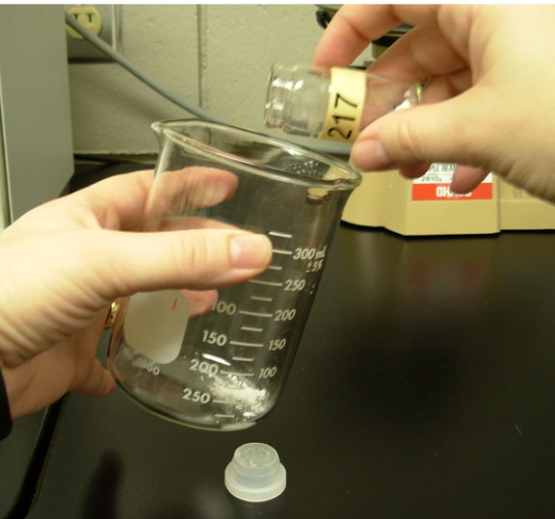
Tap out about half of the unknown into one of the 400 mL beakers. (Label this beaker)

Slide 9
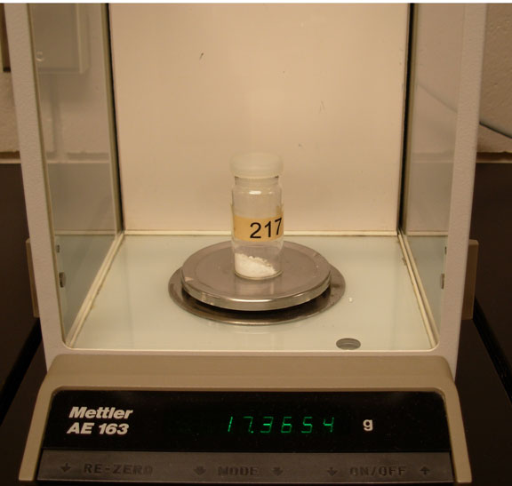
Reweigh accurately the vial with the lid and record this mass.

Slide 10
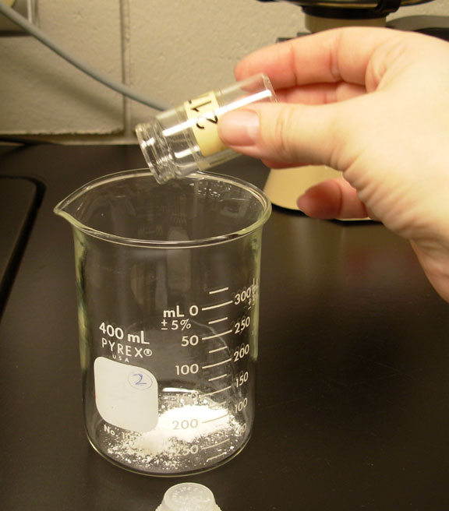
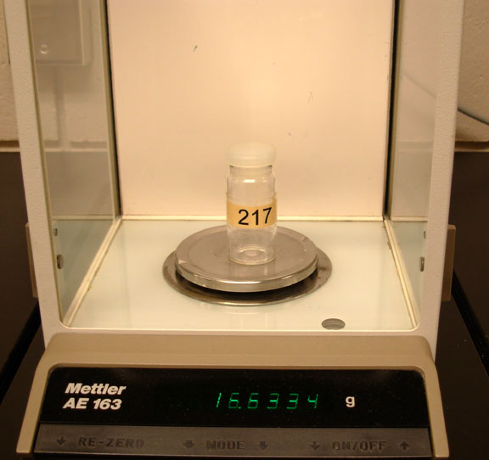
Tap the remaining unknown into the other 400 mL beaker (label it).
Reweigh accurately the vial.

Slide 11
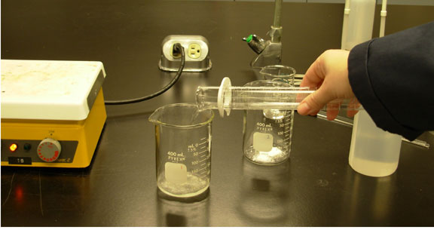
Pour about 20 mL of distilled water into each of the 400 mL beakers. Swirl (gently) to dissolve the unknown sample, and warm the beakers a little if you’re having trouble dissolving the sample.

Slide 12
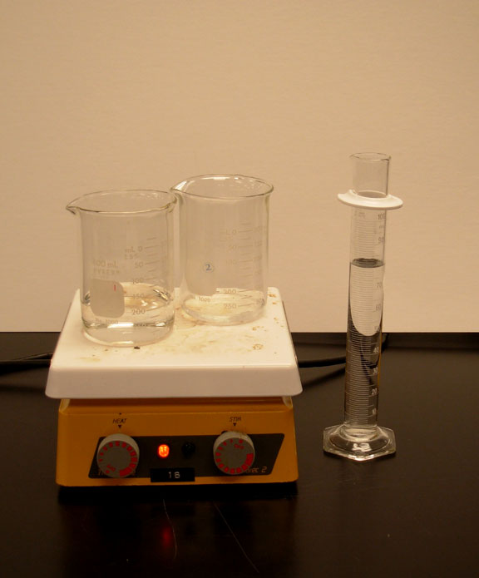
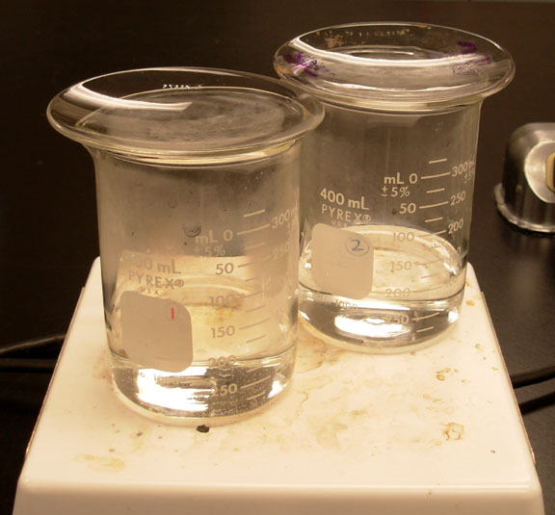
Once the unknown samples have dissolved, add about 80 mL more distilled water to each beaker and cover each beaker with a watch glass and warm them to steaming.
Steaming

Slide 13
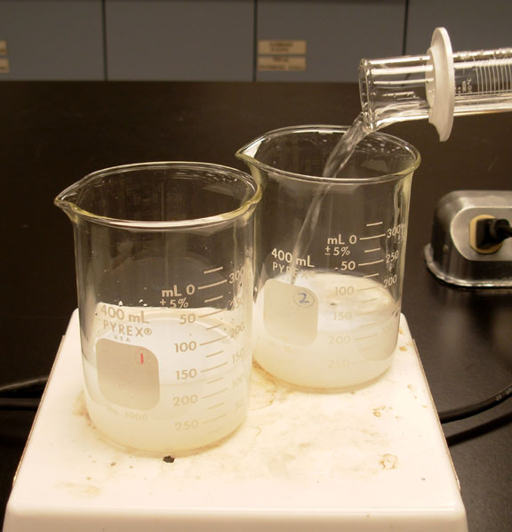
Once solutions have started steaming, reduce the heat to medium- low and add 30 mL of 0.55 M CaCl₂ to each solution.

Slide 14
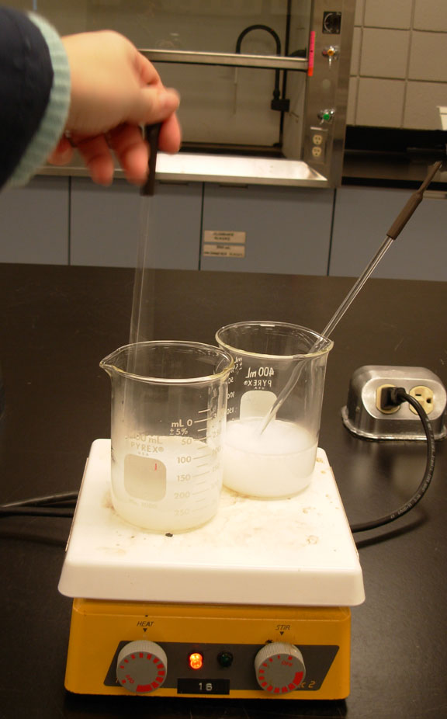
Stir each solution with its own stir rod for a few seconds, then leave the stir rod in the solutions and allow them to heat for another 30 min.

Slide 15
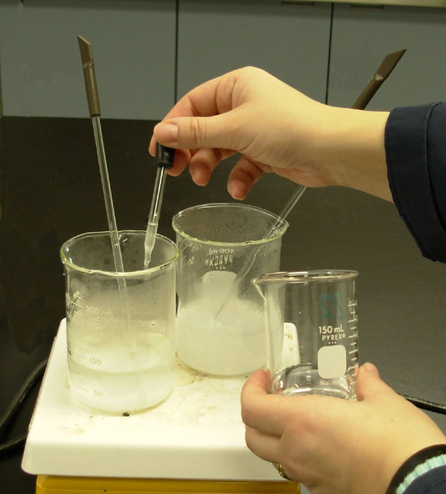
When about 30 minutes is up and the precipitated has settled, add one or two drops of CaCl₂ to the supernatant liquid. If no additional precipitate forms take the beakers and put them in an ice water bath to cool.

Slide 16
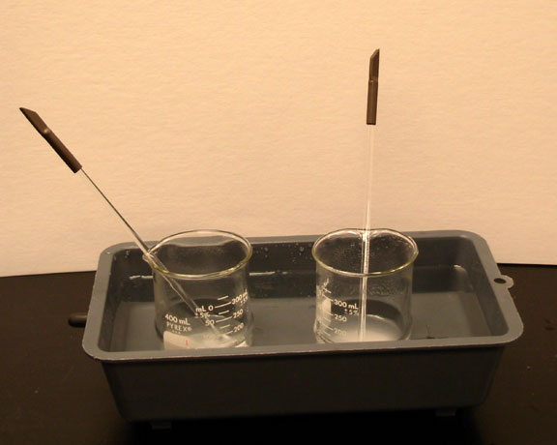
Ice water bath.

Slide 17
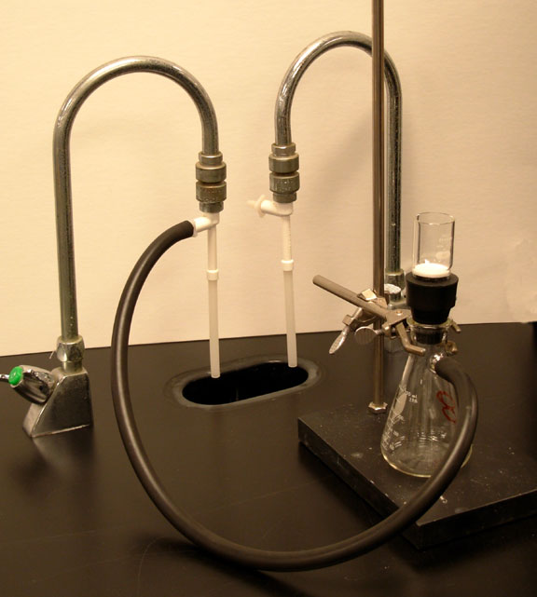
Suction cone
Aspirator
Crucible
Utility clamp
Vacuum filter flask
Stand
Black vacuum (rubber) tubing

Slide 18
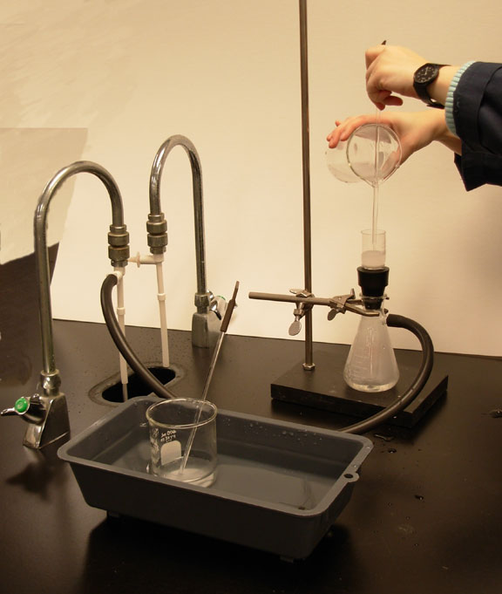
Filter the solution through one of the pre-weighed crucibles.

Slide 19
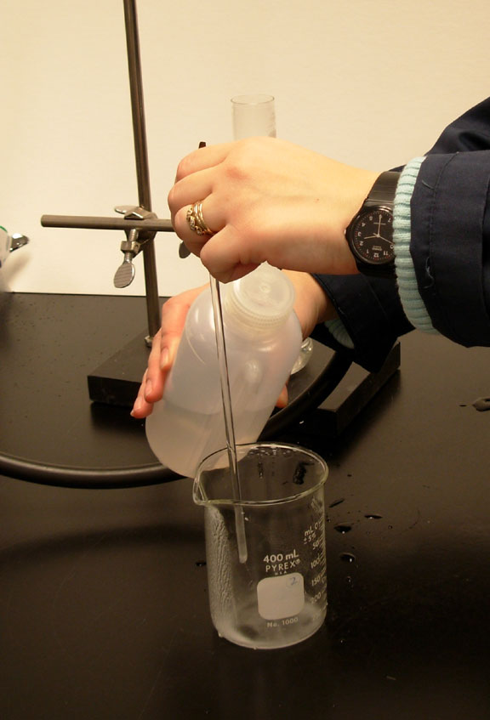
Rinse and filter the precipitate in the beaker several times with a small quantity of cold distilled water.

Slide 20
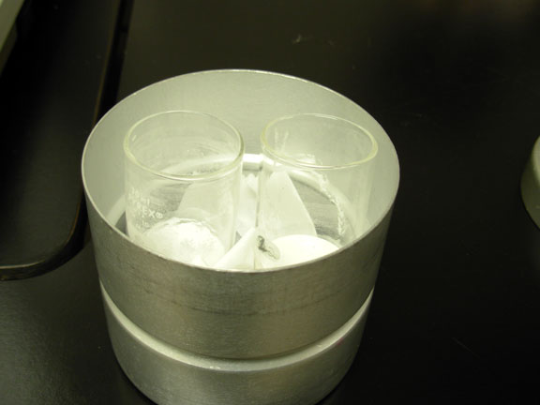
Place the crucibles in the desicooler.

Slide 21
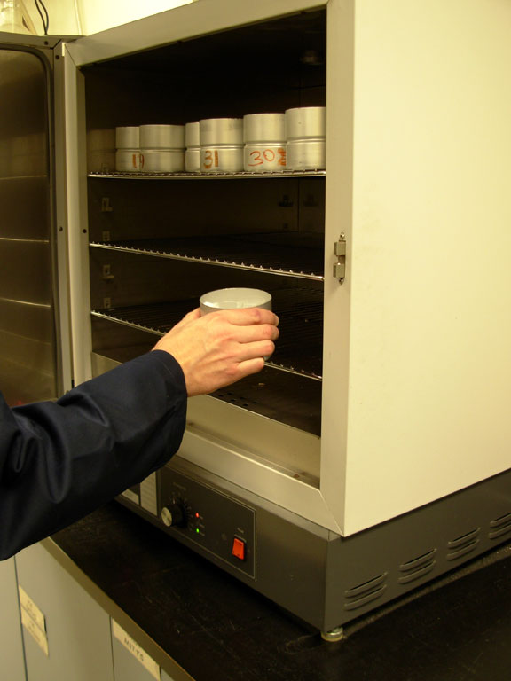
And in the oven overnight to dry.

Slide 22
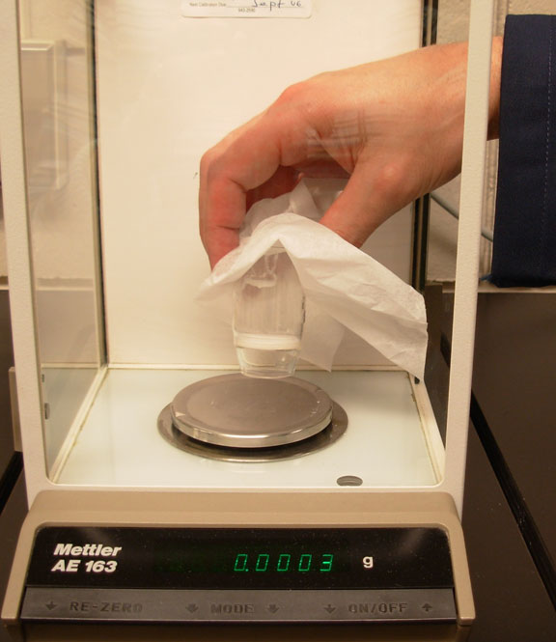
The next day come and weigh the crucibles. Record their masses.

