Slide 1
Introduction to Titration
Go to browse and set to full screen.

Slide 2
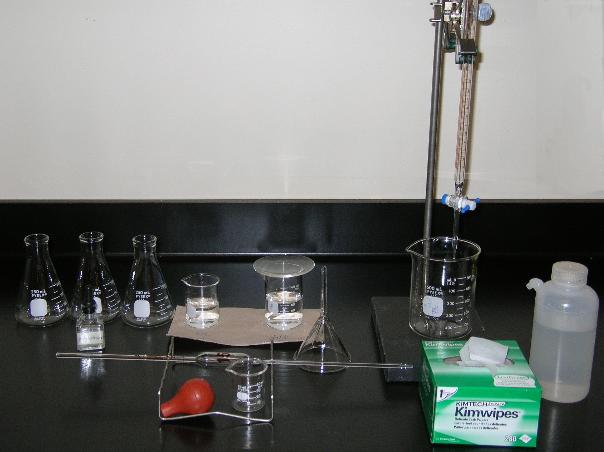
buret clamp
buret
three 250 mL Erlenmeyer flasks
150 mL beaker (80 mL of base)
100 mL beaker (60 mL of acid)
waste beaker
stand
indicator
glass funnel
15.00 mL volumetric pipet
bulb
50 mL beaker

Slide 3
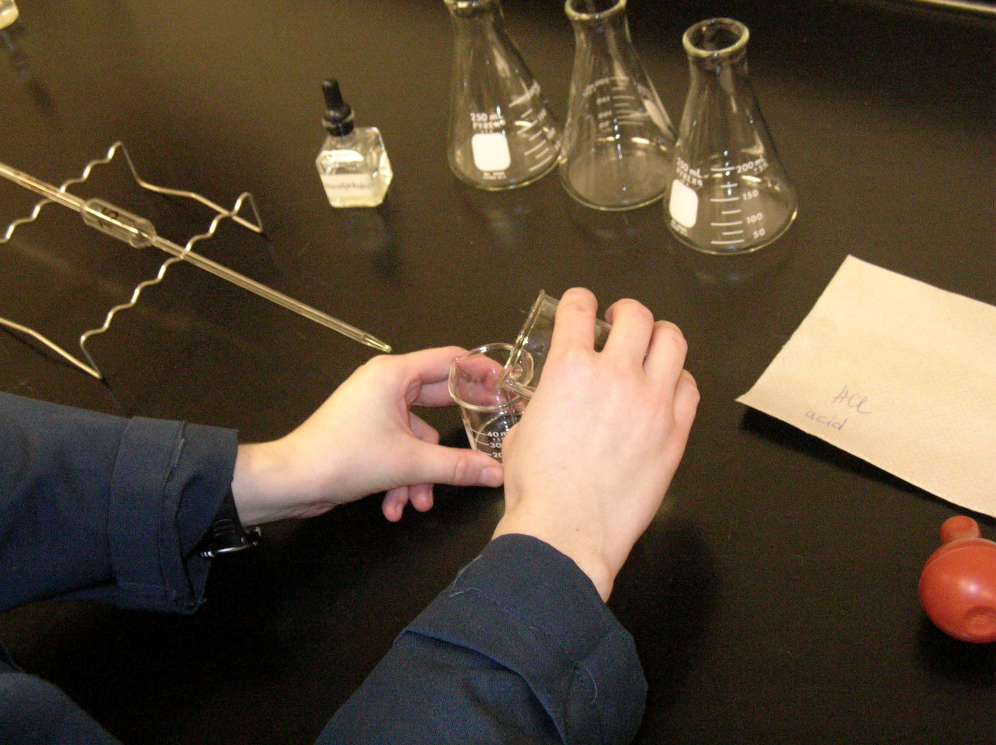
Pour 20 mL of acid solution into the 50 mL beaker and rinse the 15.00 mL volumetric pipet with it.

Slide 4
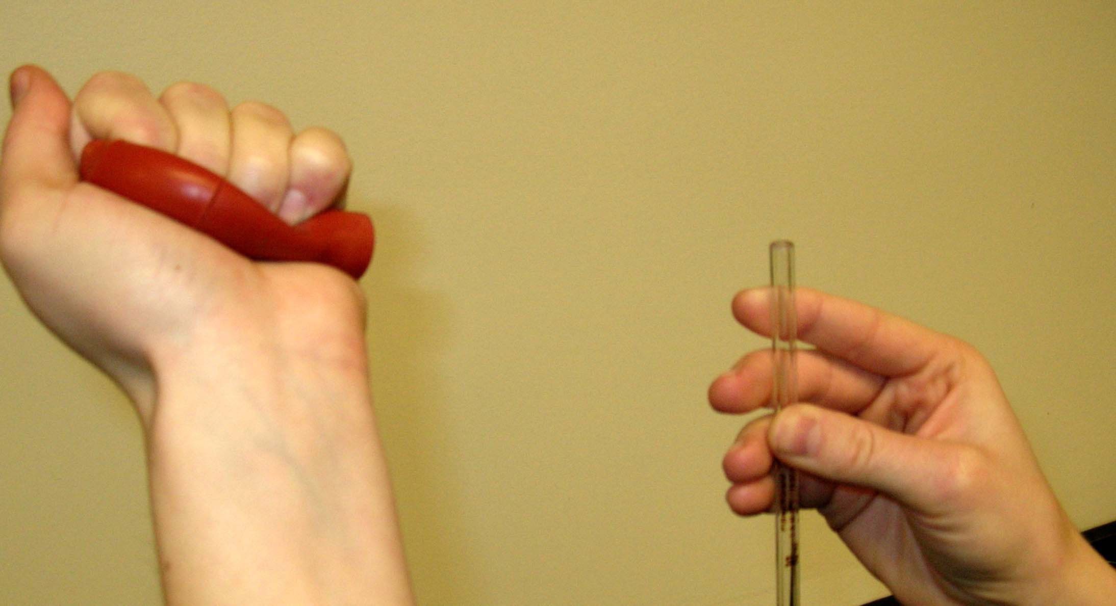
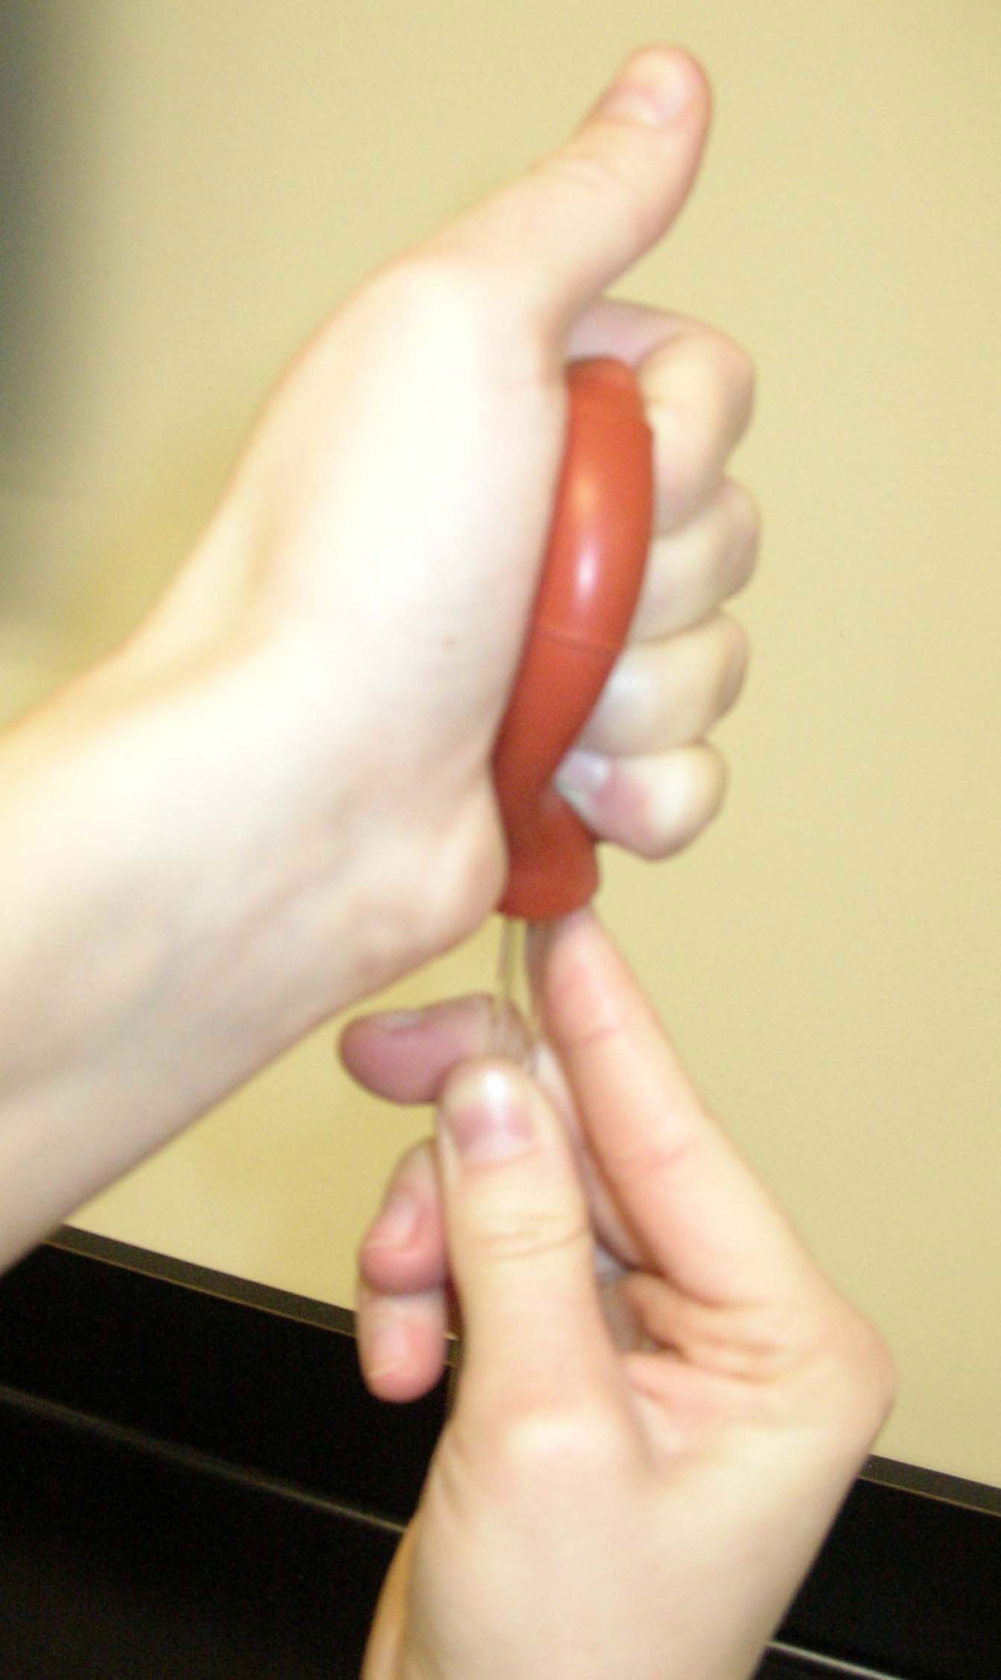
Place the pipet bulb on the end of the pipet. Squeeze the bulb to empty out the air.

Slide 5
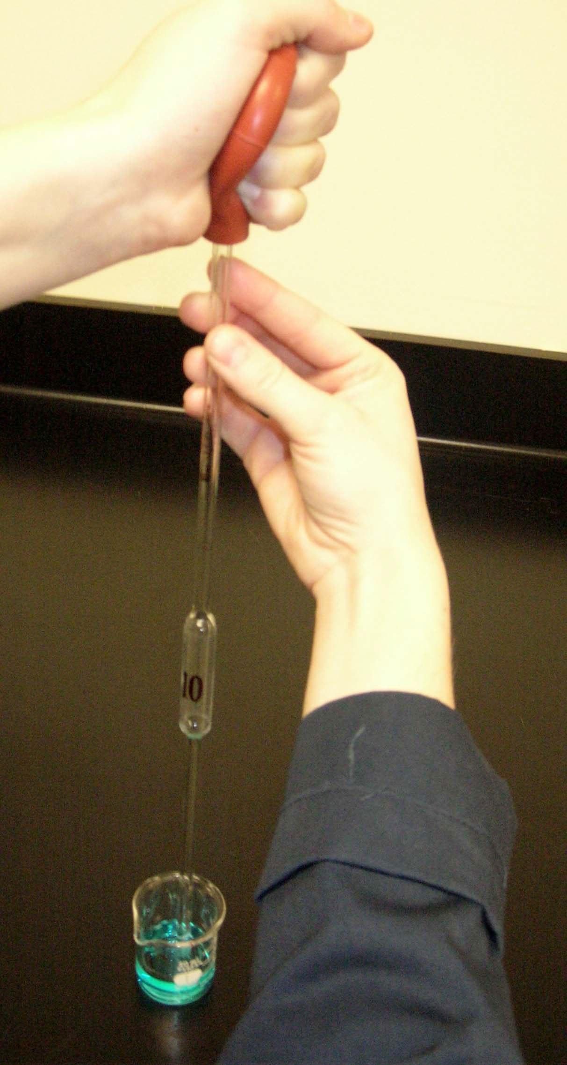
A blue solution was used just for demonstration purpose.
Place the pipet into the acid solution, slowly releasing the pressure on the bulb.With a pipet bulb withdraw a small quantities of the acid solution.
Watch the solution rise in the pipet, do not let any solution get into the bulb.

Slide 6
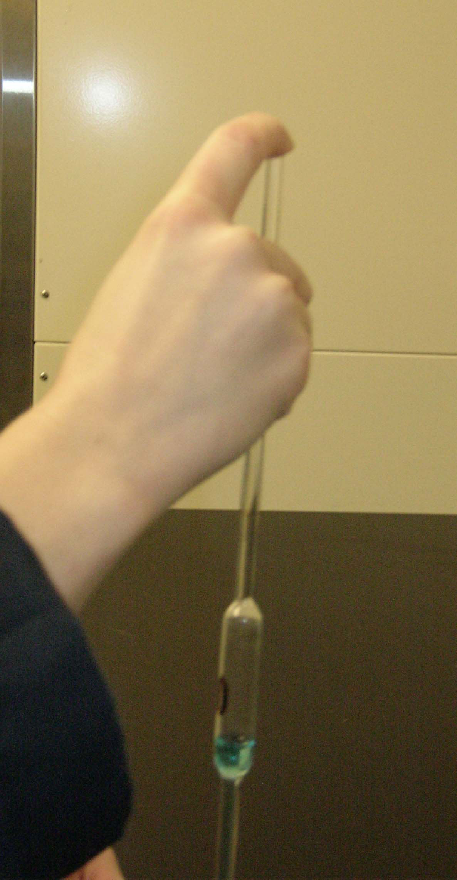
Make sure to place your index finger on the end of the pipet.
Once a small quantity of the acid solution is in the pipet, quickly remove the bulb and press down on the end of the pipet with your index finger.

Slide 7
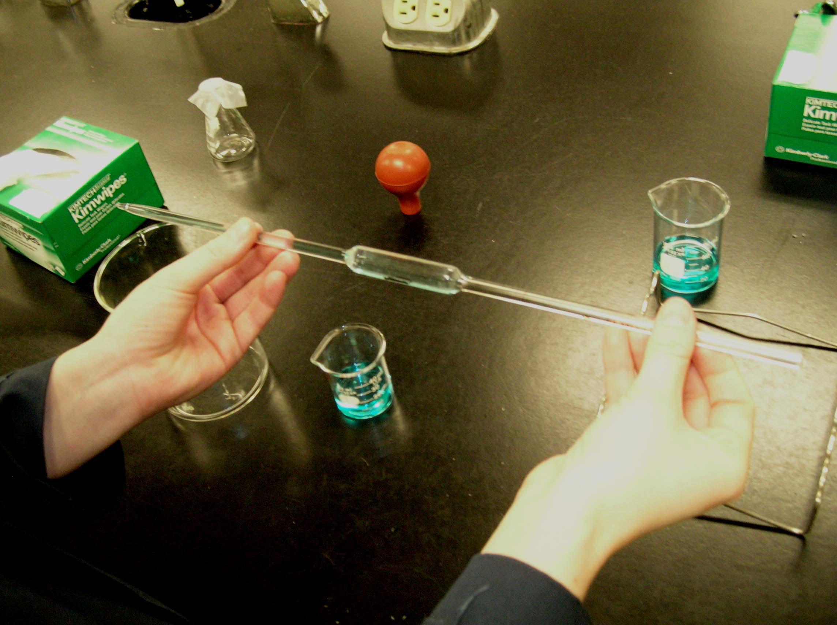
Invert the pipet to a horizontal position. Turn and rotate the pipet so all inside surfaces have come into contact with the solution.

Slide 8
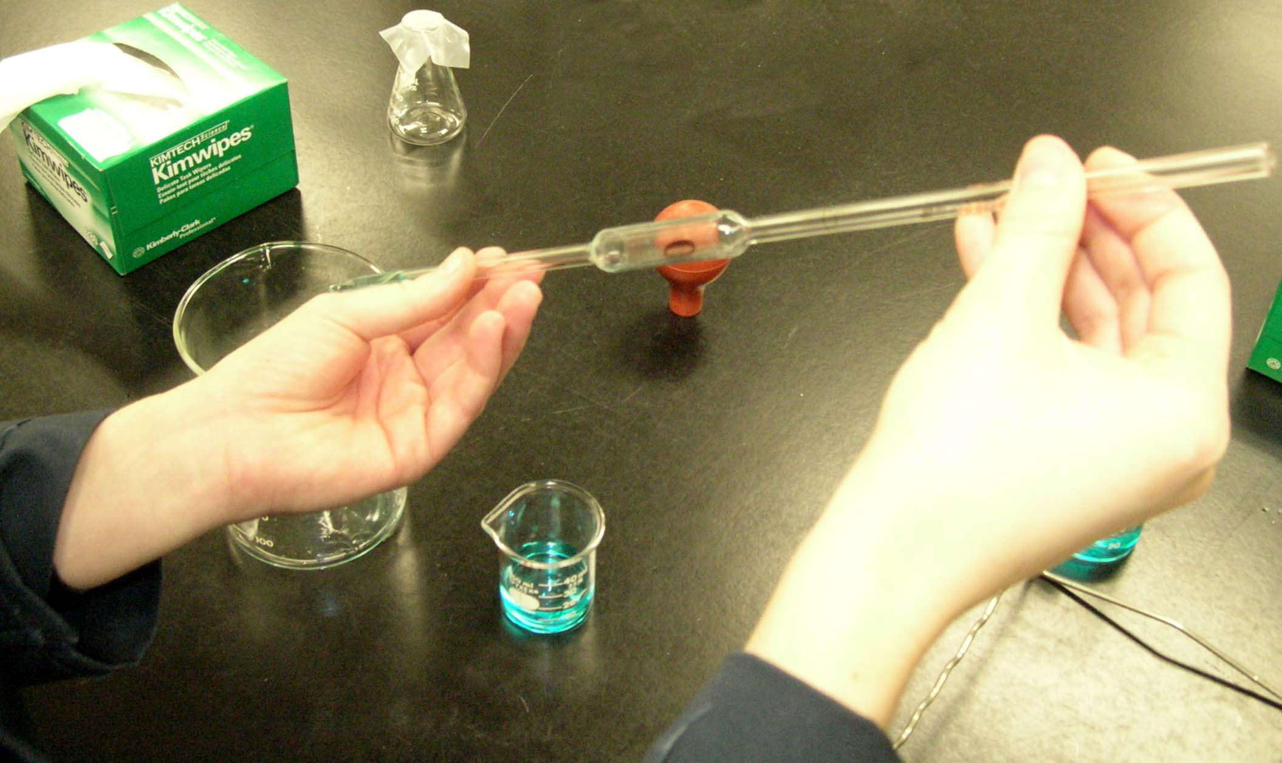
Drain and discard this solution into the waste beaker. Rinse the 15.00 mL volumetric pipet three times with a small quantities of the acid solution.

Slide 9
Discard the remaining solution from the 50 mL beaker into the waste beaker and pour the 30 mL of fresh acid solution.
Place the pipet into the acid solution and once the solution is above the calibration mark on the pipet, remove the bulb and press down on the end of the pipet with your index finger.

Slide 10
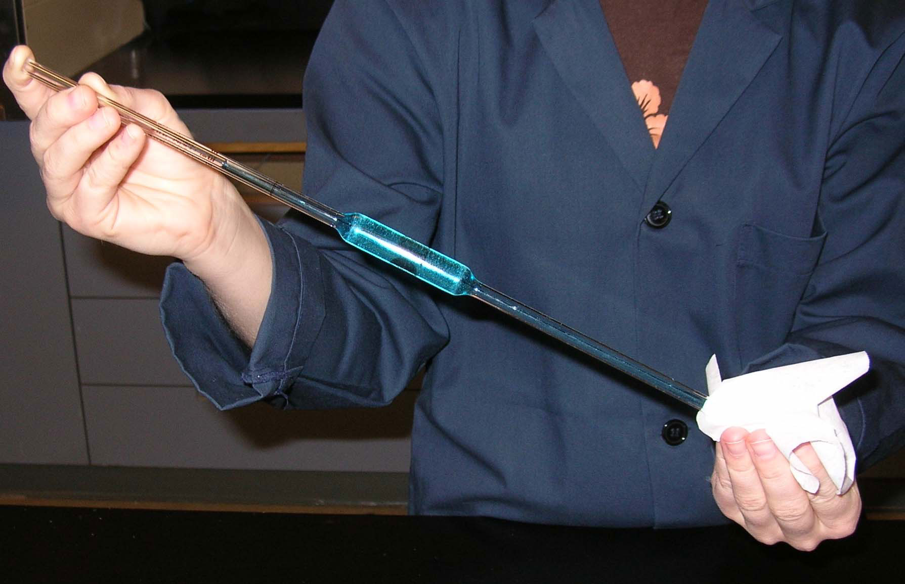
Dry the outside of the volumetric pipet with a Kimwipe.

Slide 11
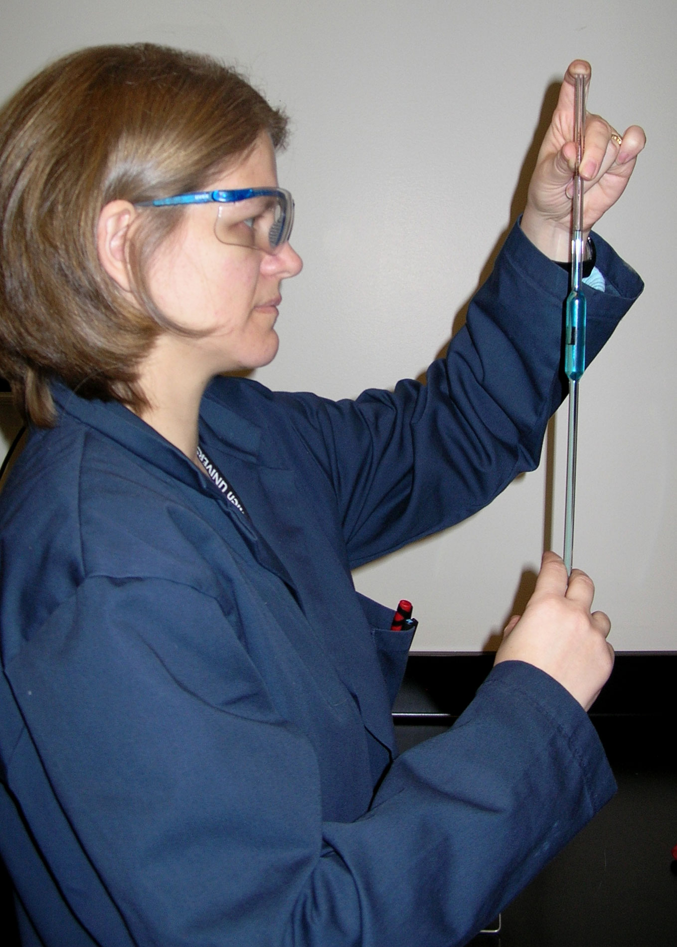
To obtain an accurate reading, you should have the calibration mark (meniscus) at eye level, i.e., your line of sight should be parallel with the mark.

Slide 12
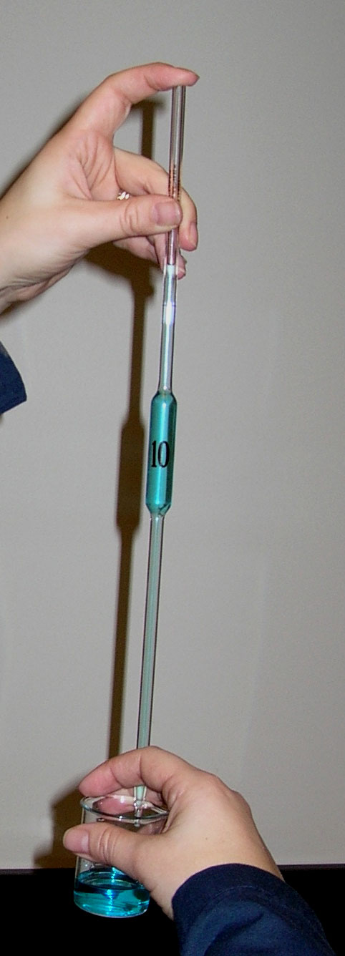
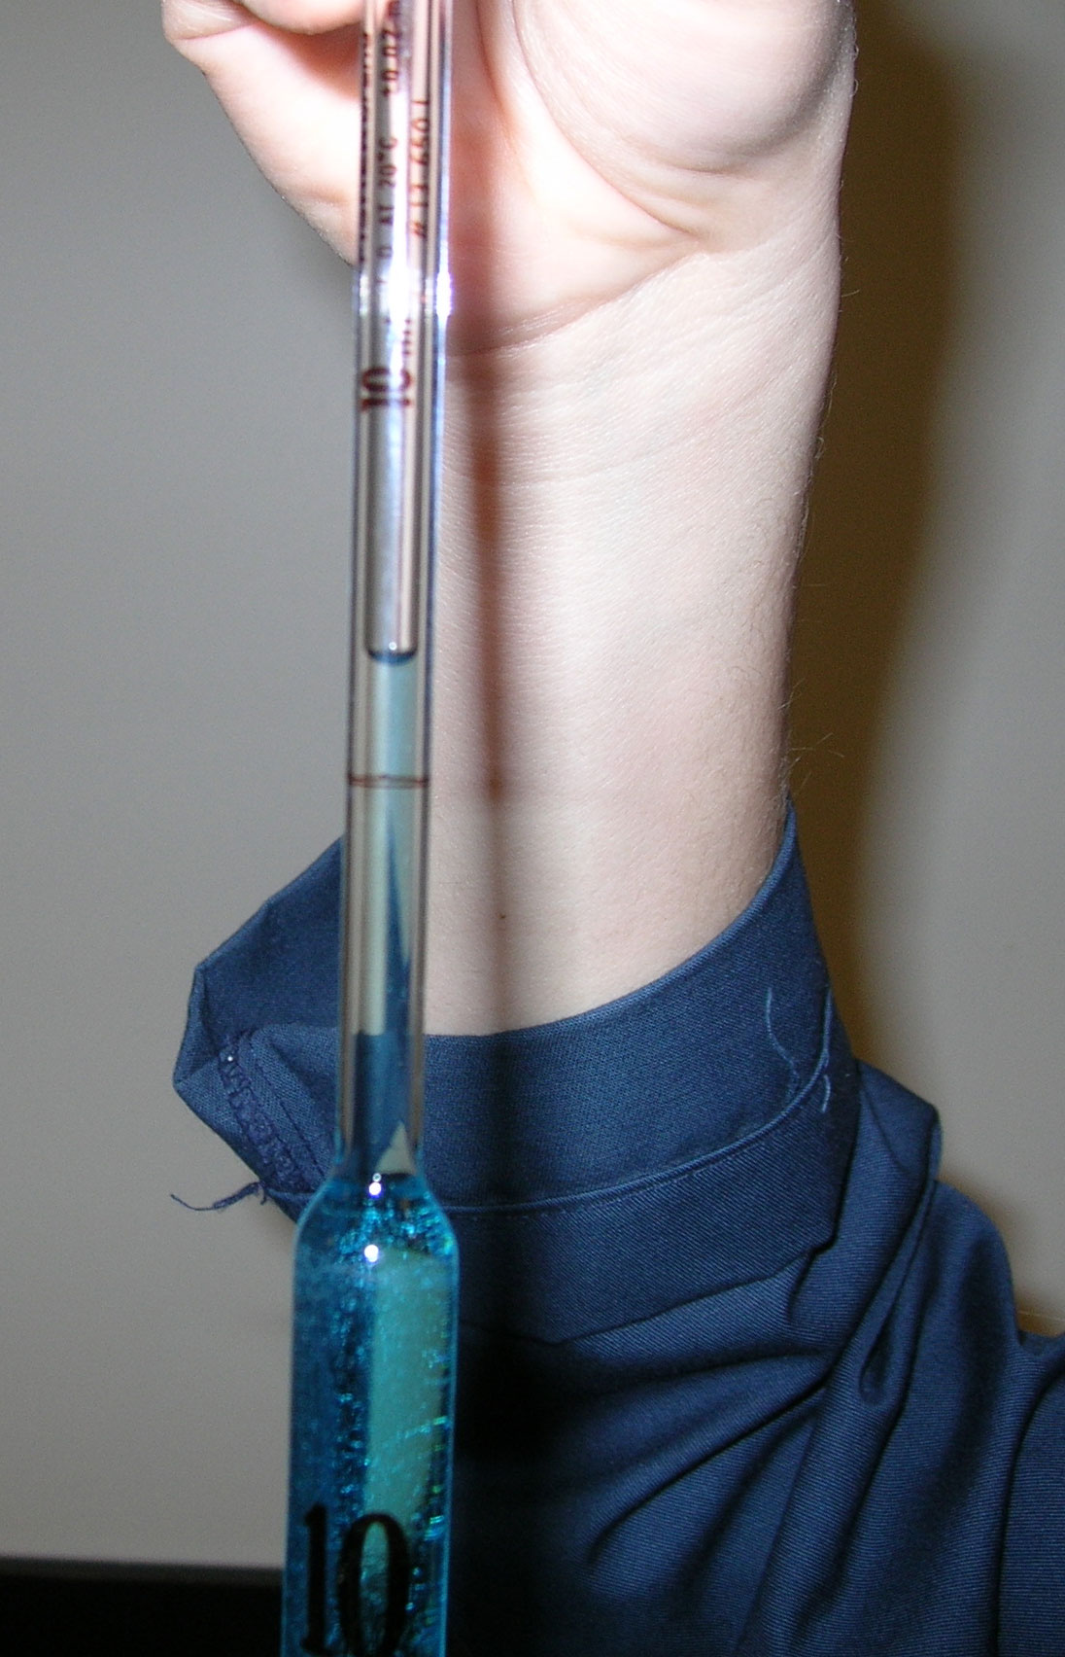
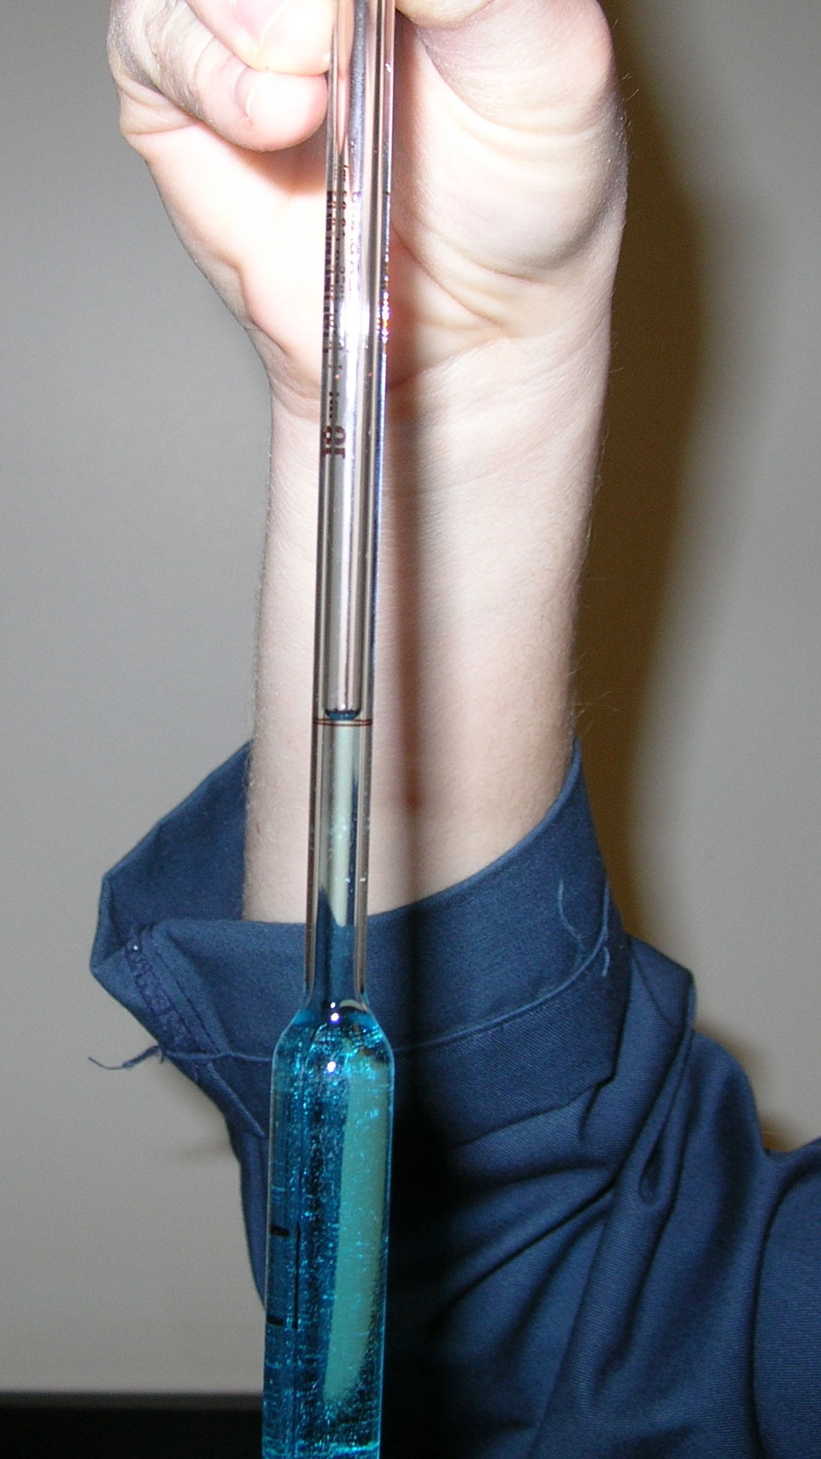
Release pressure from your finger very slightly so that the liquid level slowly drops (this may take some practice).
Once the bottom of the meniscus has reached the calibration mark on the pipet, press down firmly with your finger.

Slide 13
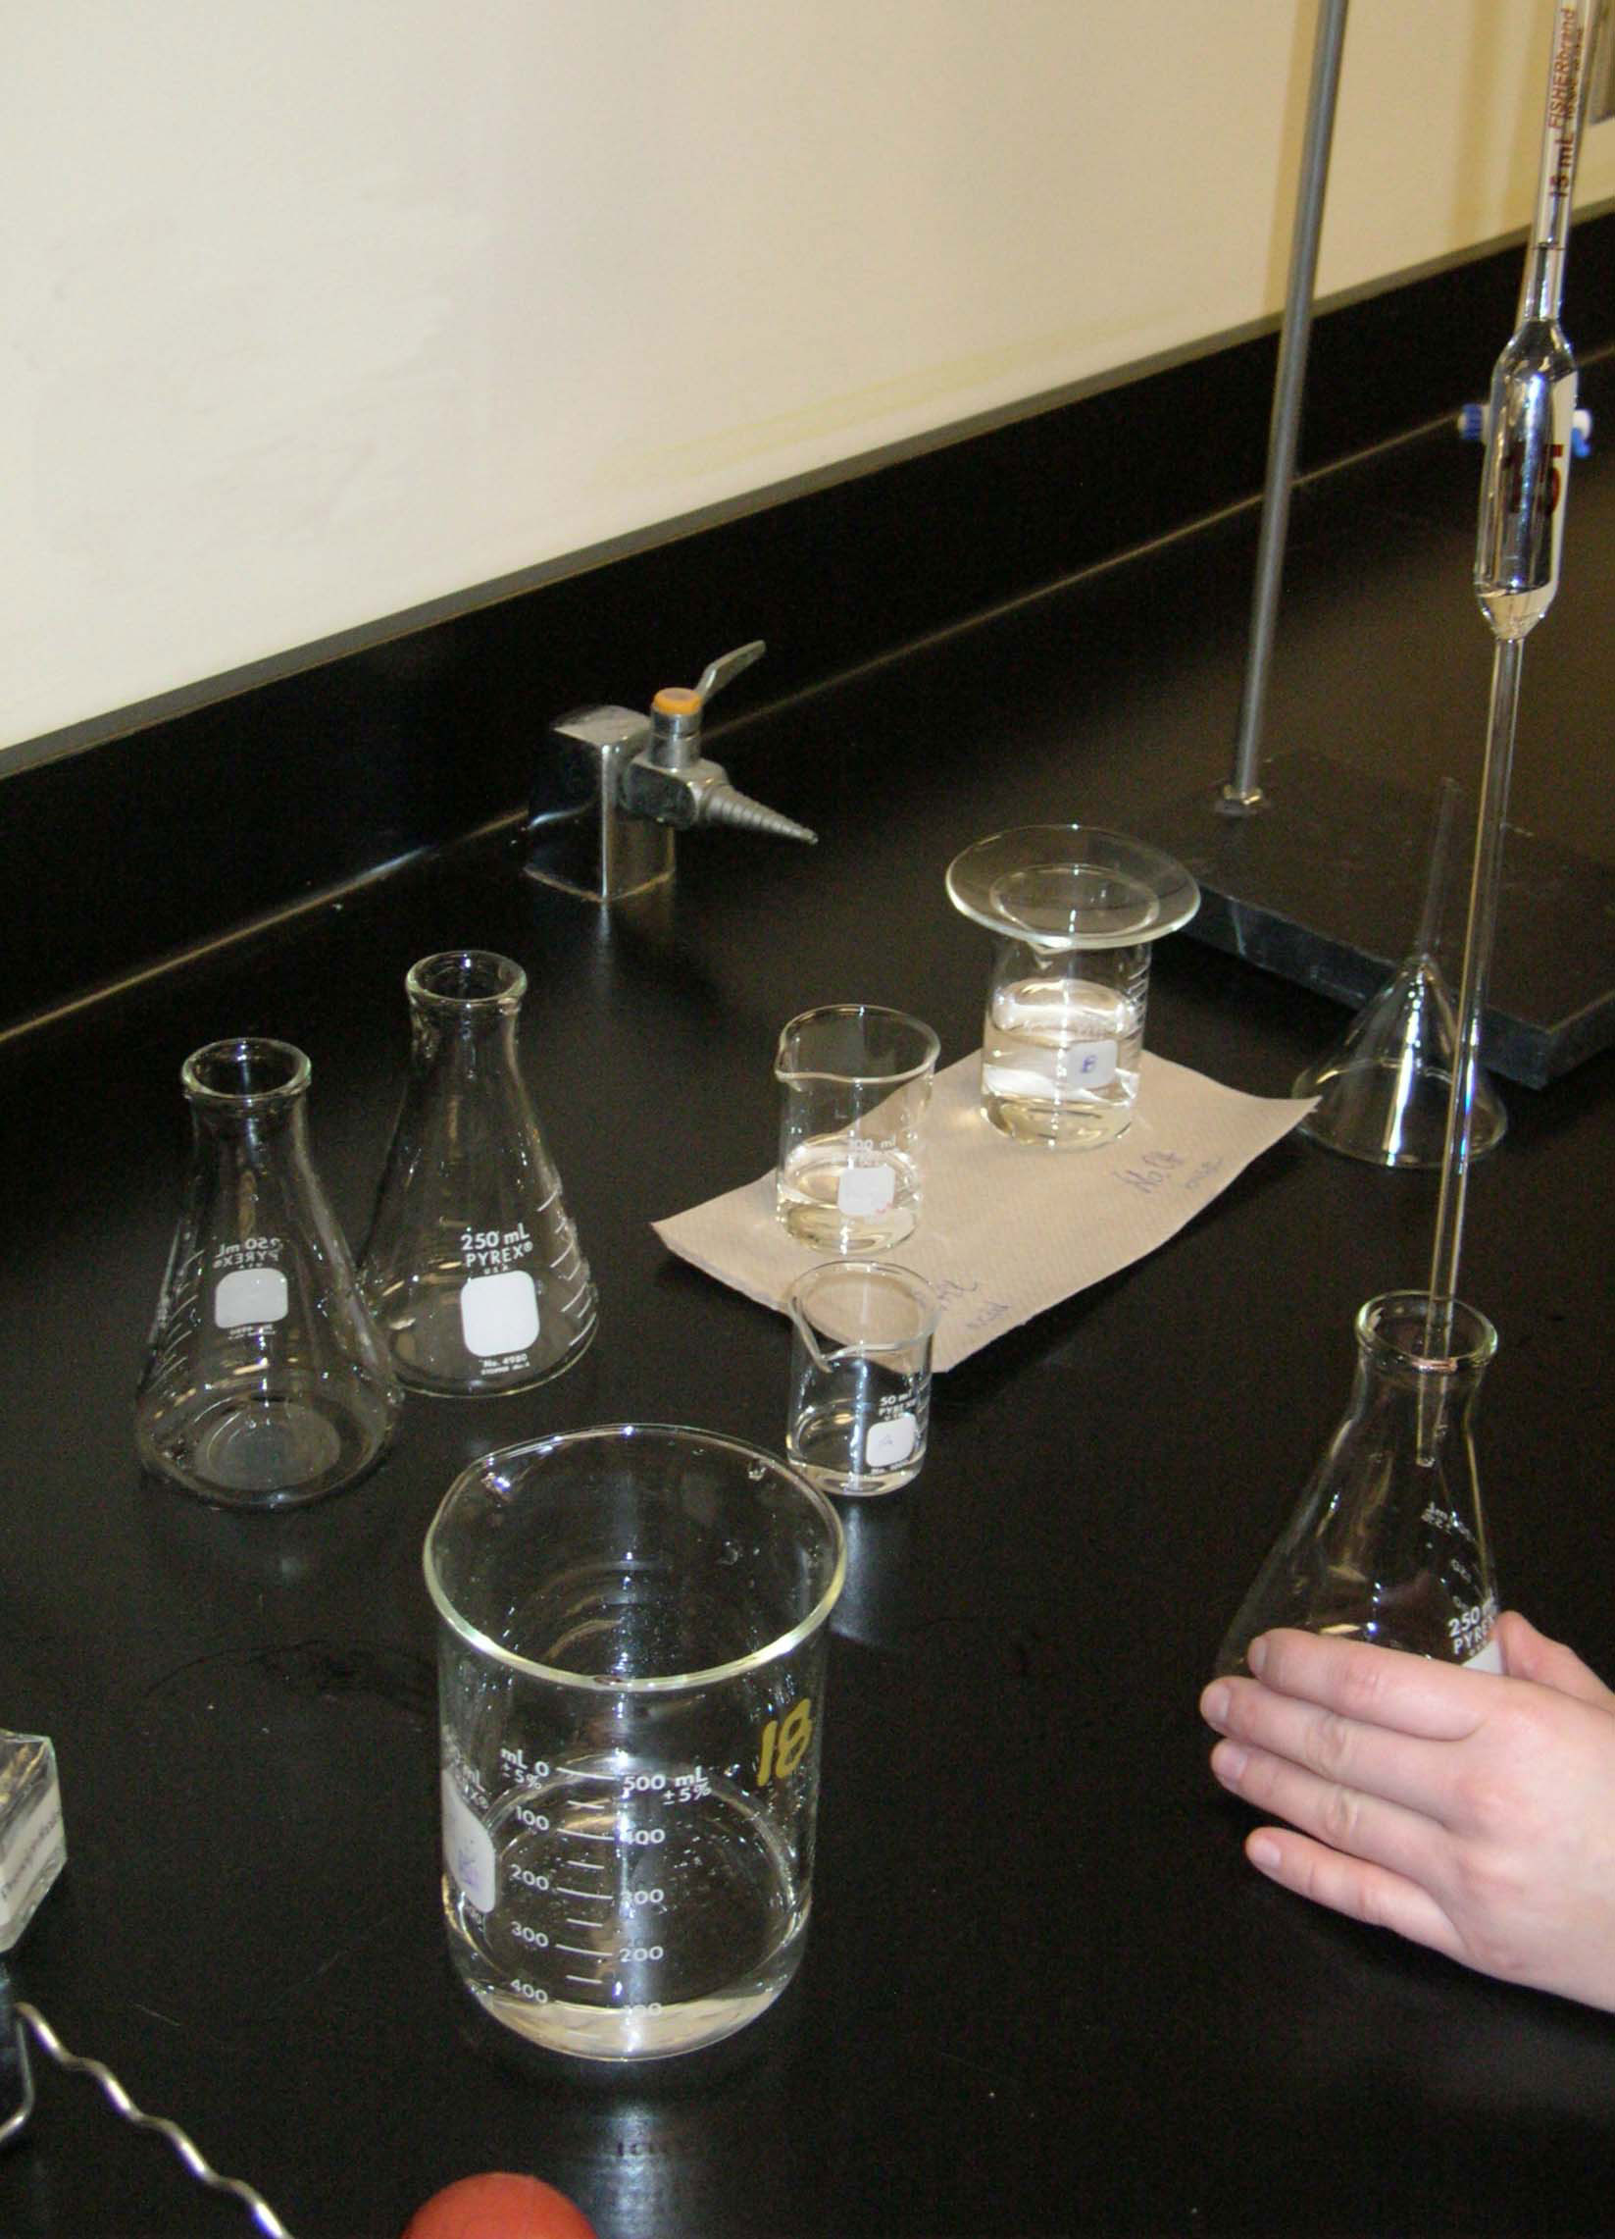
Transfer the 15.00 mL of the acid solution into the clean (rinsed with distilled water) 250 mL Erlenmeyer flask. Repeat the above process two more times.

Slide 14
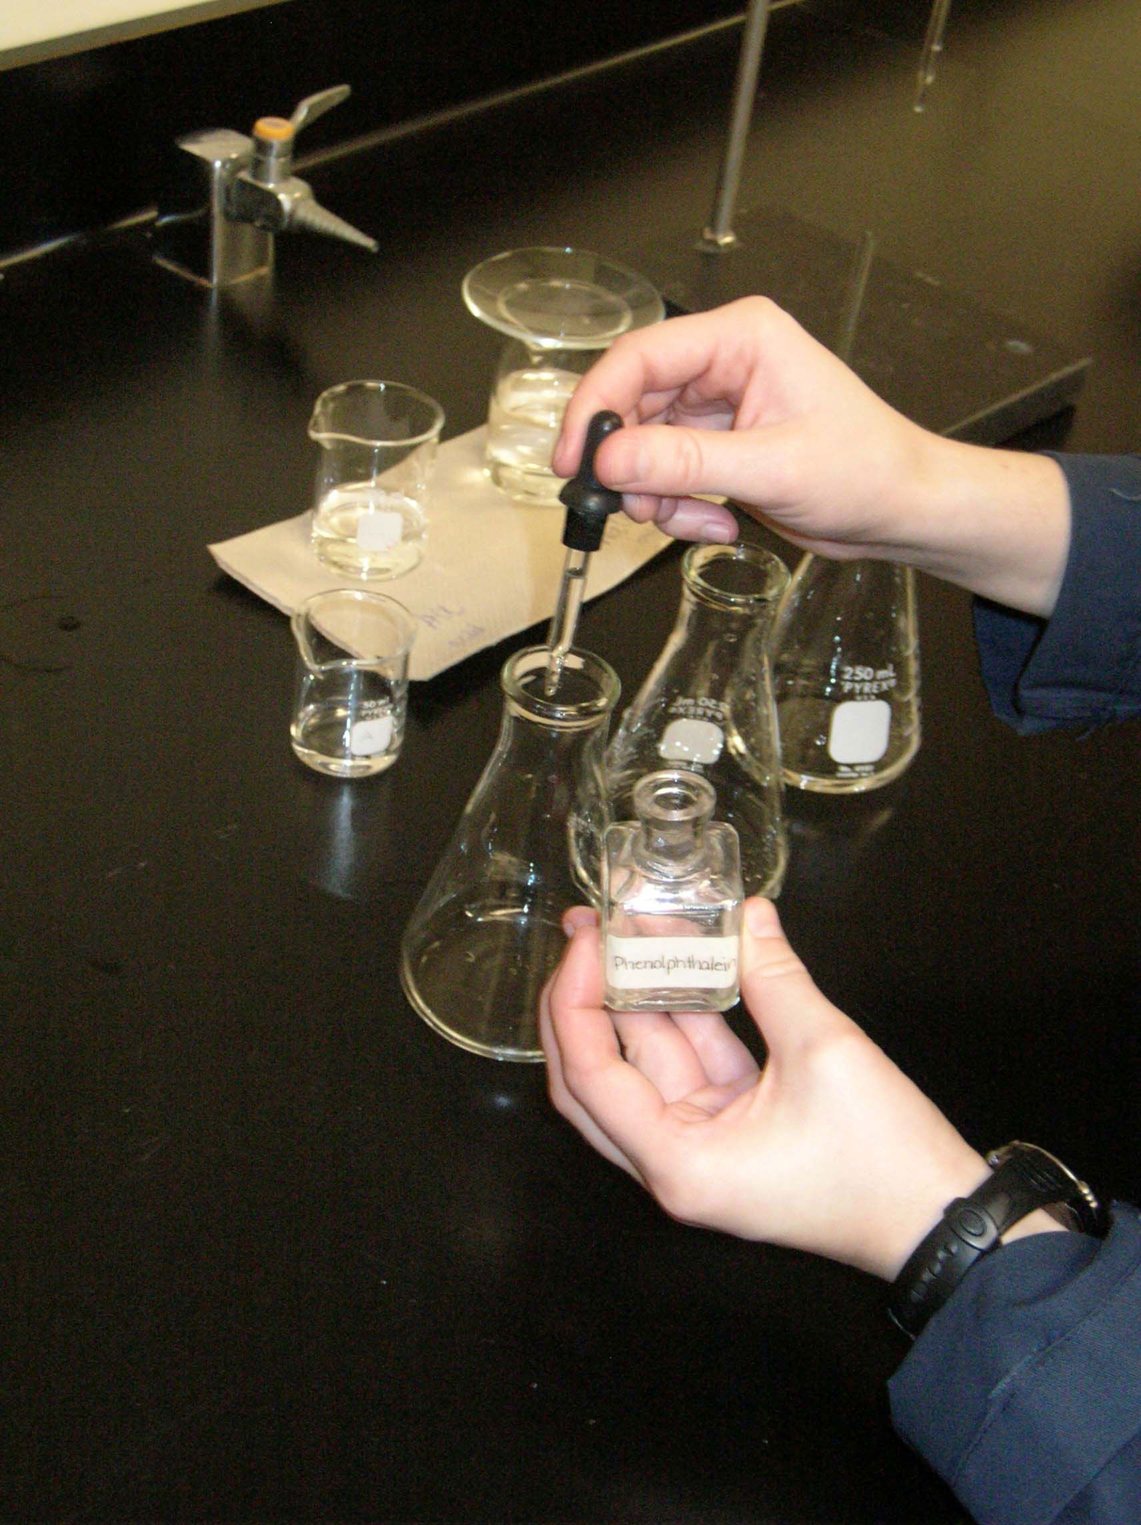
Add 2-3 drops of phenolphthalein indicator to each Erlenmeyer flask.

Slide 15
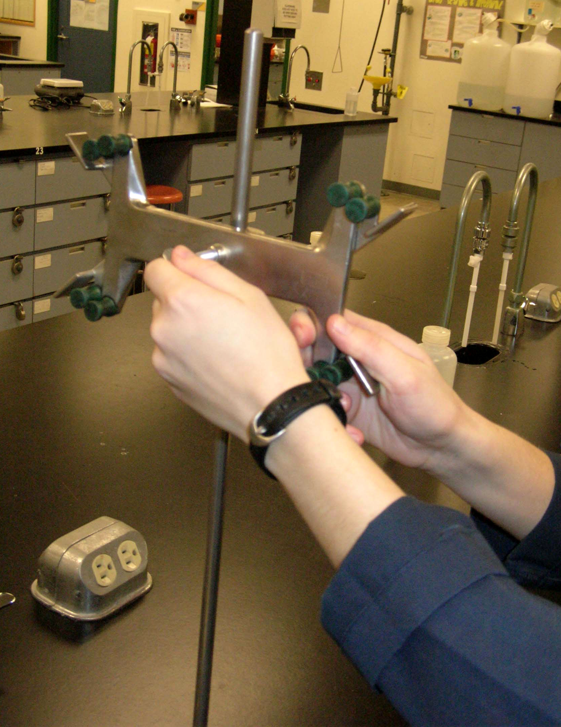
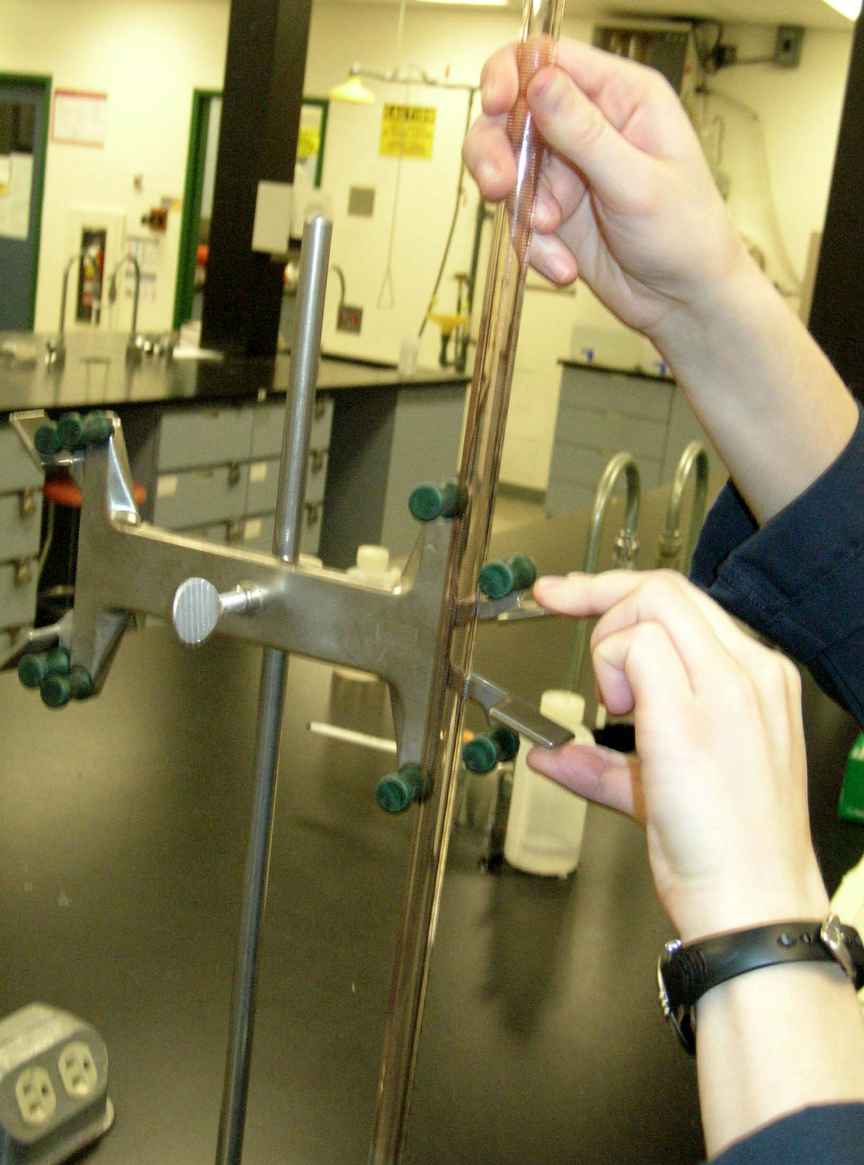
Clamp the buret to the buret stand.

Slide 16
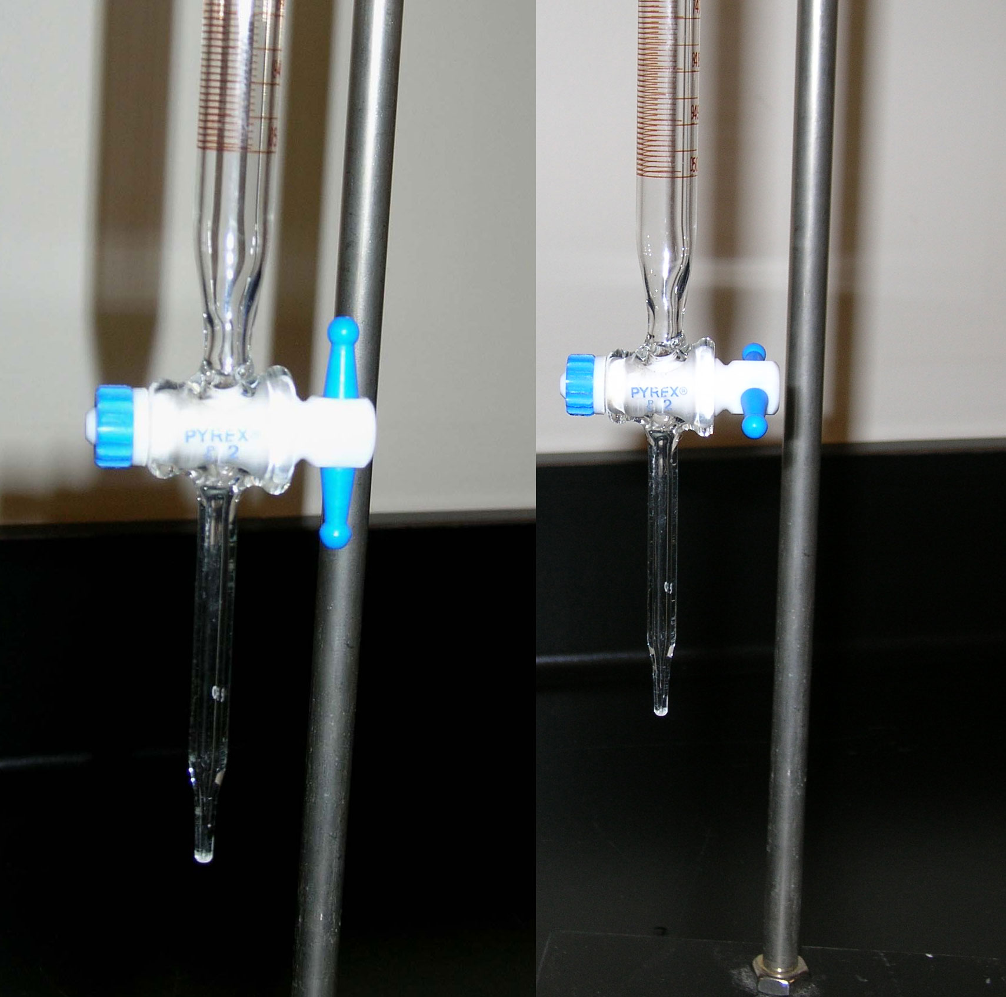
close stopcock
open stopcock

Slide 17
Rinse the 50.00 mL buret using a small quantity of the base solution (use the glass funnel to avoid spillage).

Slide 18
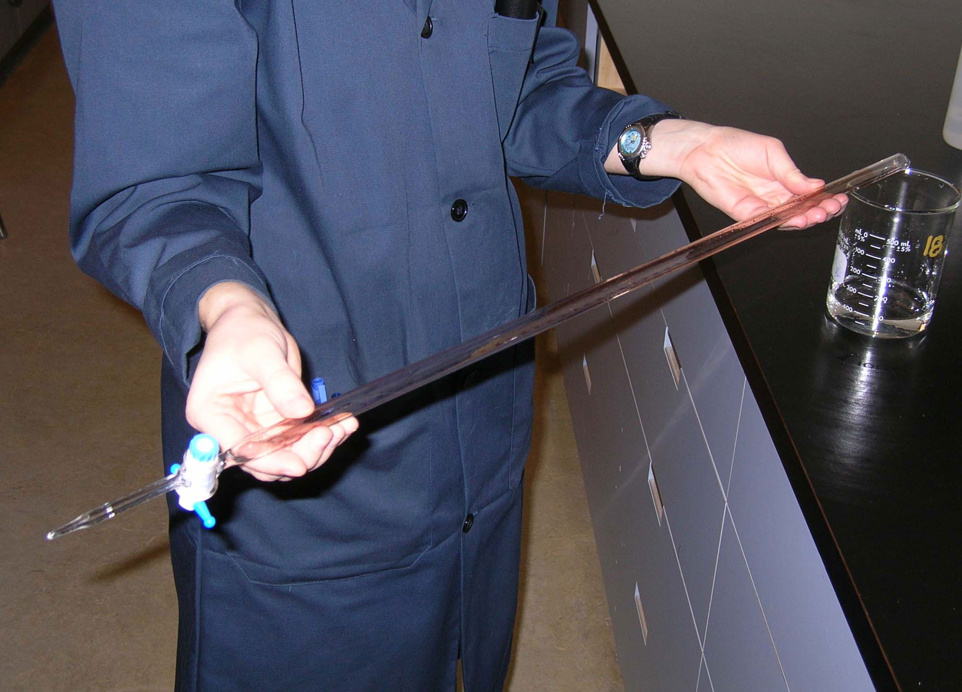
Turn and rotate the buret so all inside surfaces have come into contact with the base solution.

Slide 19
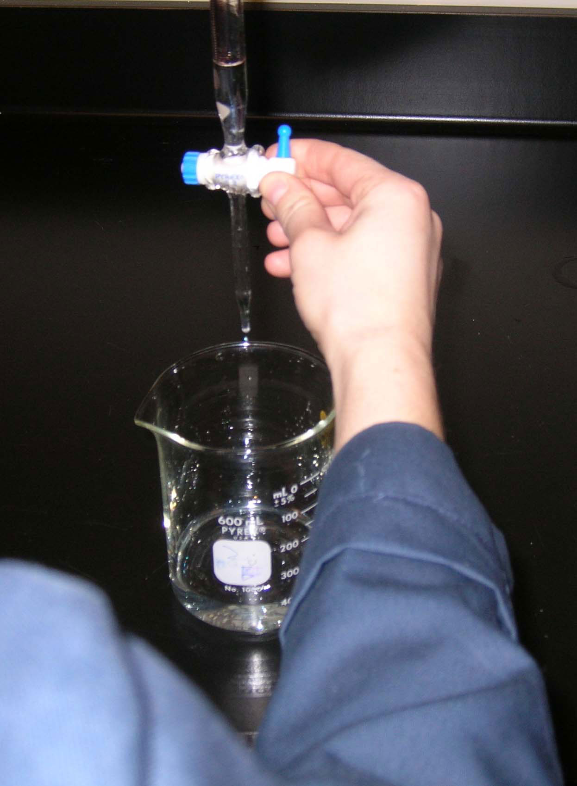
Drain and discard the base solution into the waste beaker. Rinse the buret three times with a small quantities of this solution.
Make sure that the tip of the buret is rinsed!

Slide 20
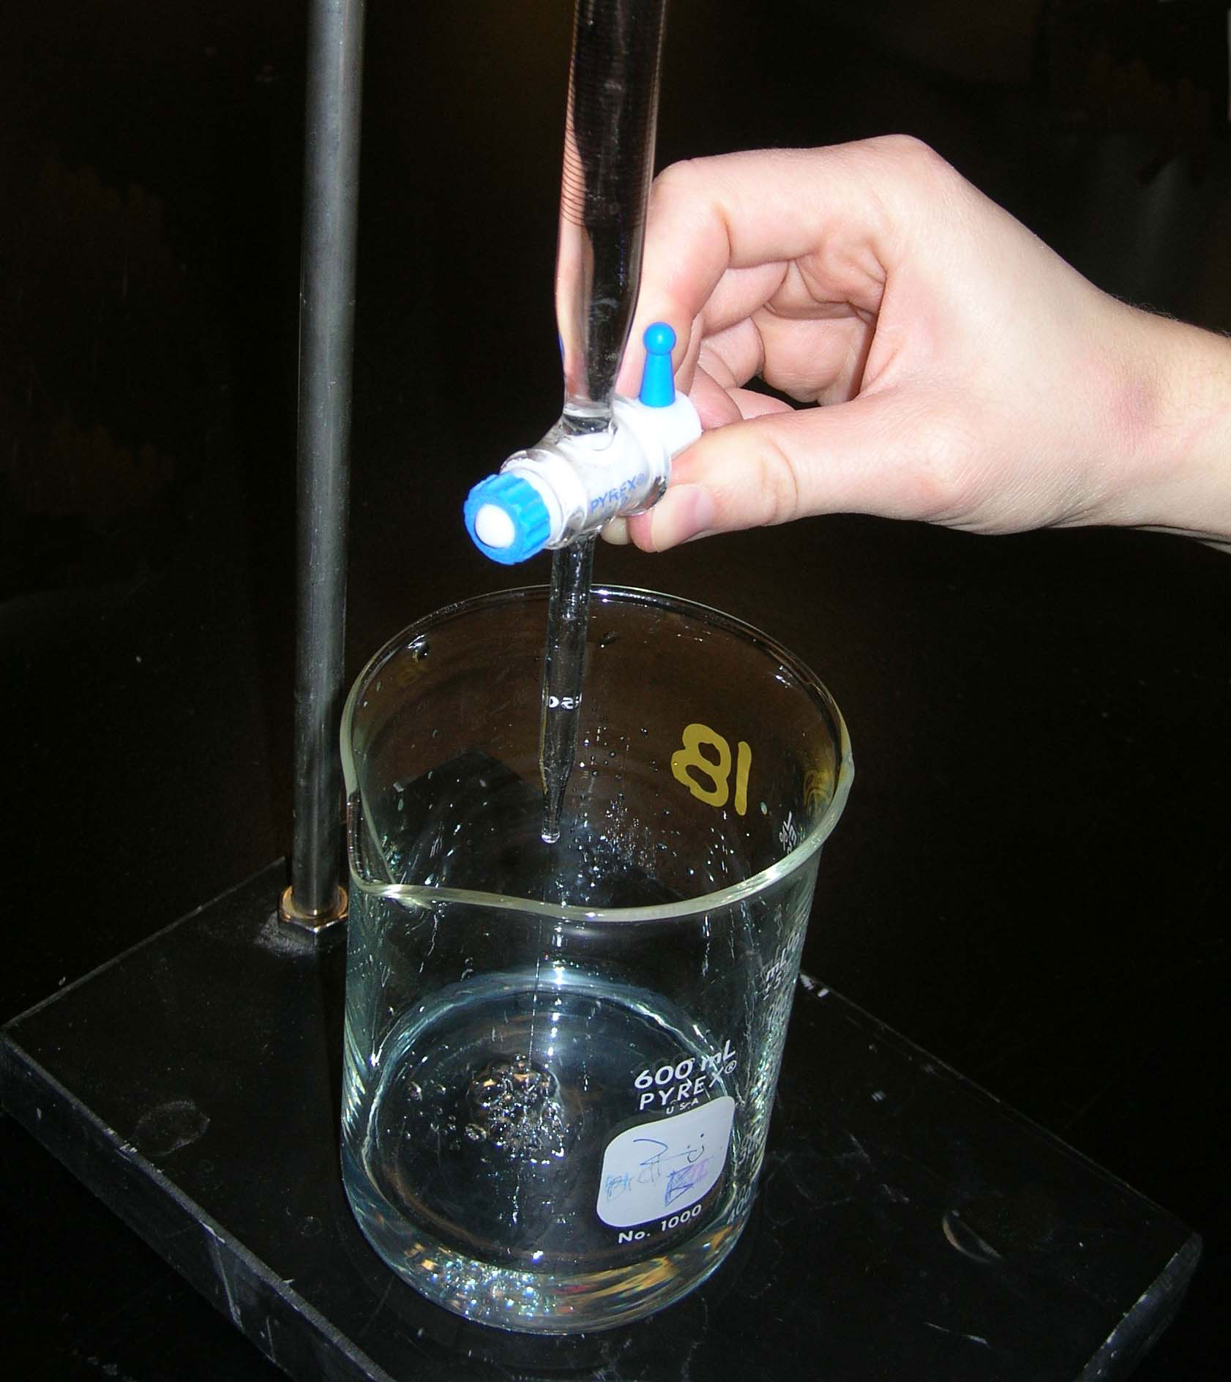
Remove the funnel and put the waste beaker under the tip of the buret. Open the stopcock and allow some solution to run through (ensure that the buret tip is filled with the base solution and contains no air bubbles).
Next, fill the buret with the base solution.

Slide 21
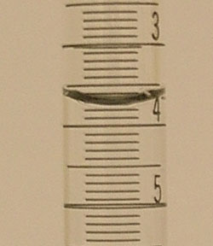
Close the stopcock and wait a few seconds for drainage to be complete, then note the reading on the buret to two decimal places (V_{initial}).
V_{initial} = 3.78 mL

Slide 22
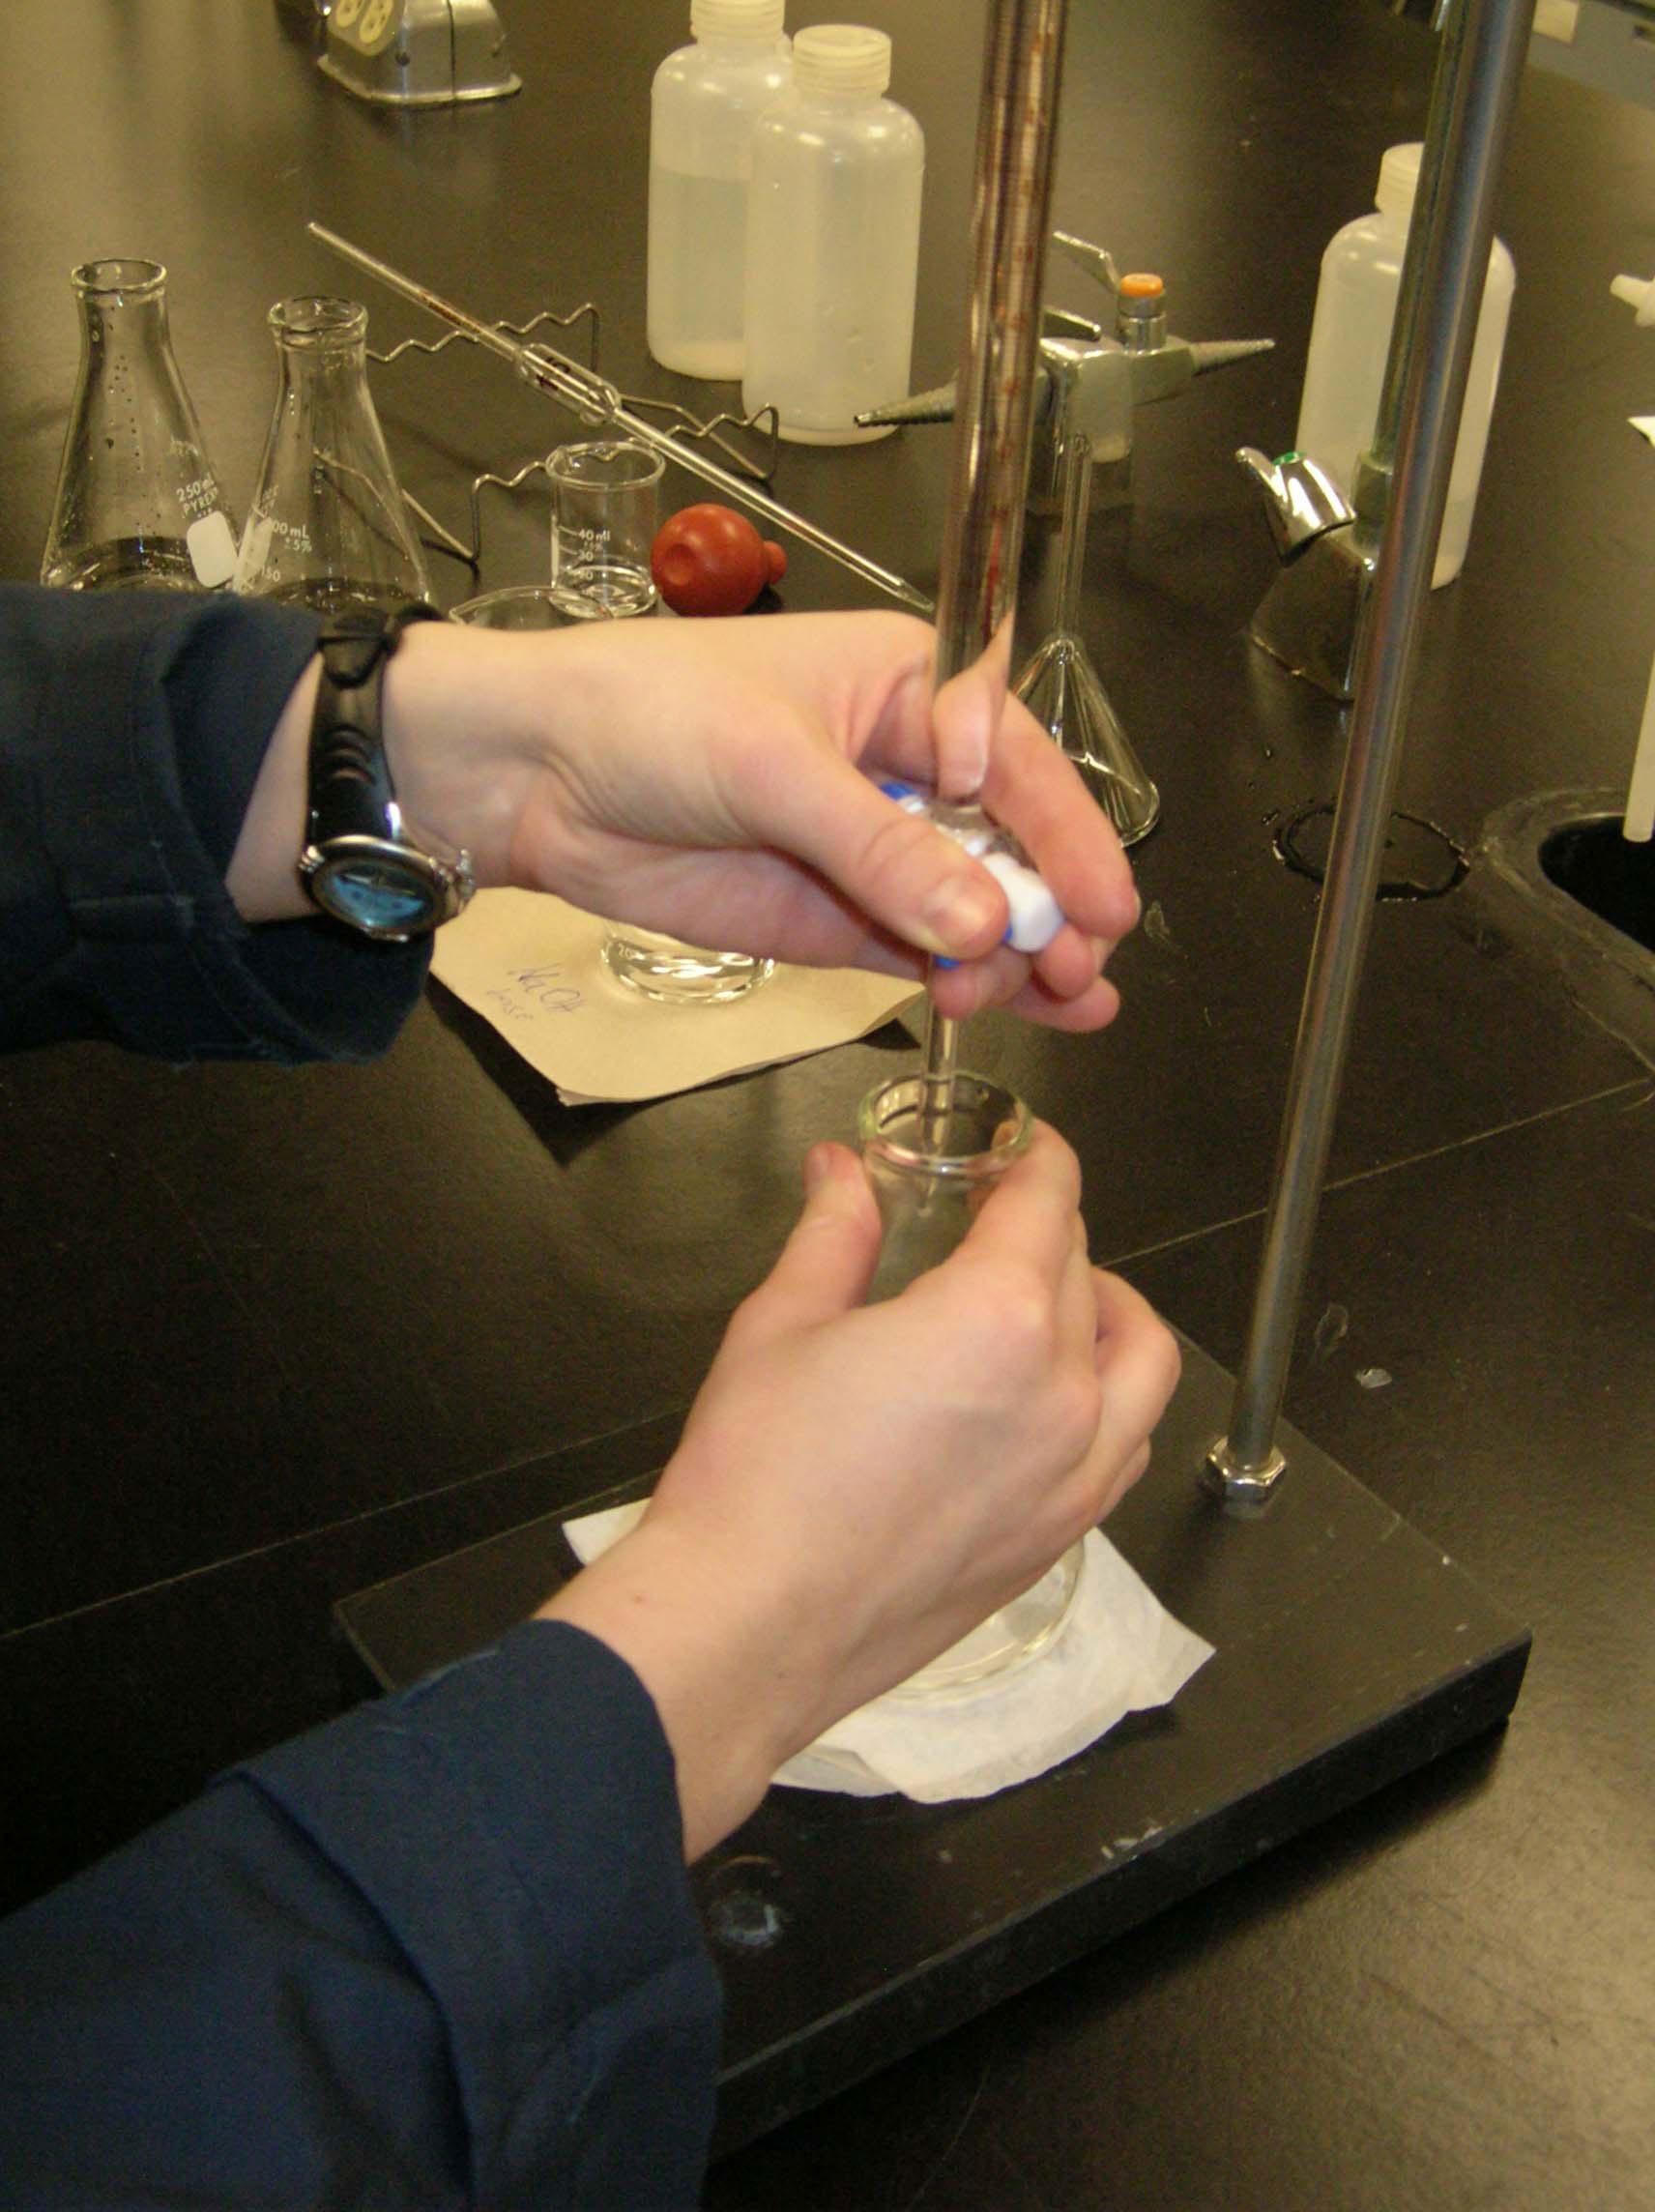
Place the Erlenmeyer flask under the tip of buret and put the Kimwipe under the Erlenmeyer flask (white background).

Slide 23
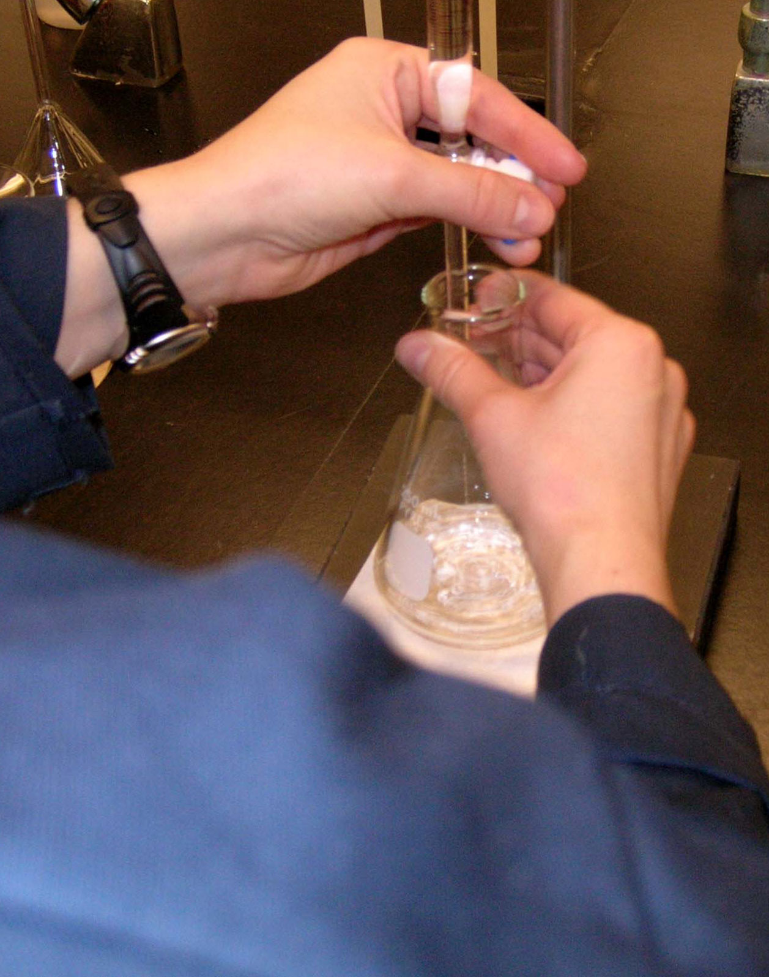
Titrate to the end point.

Slide 24
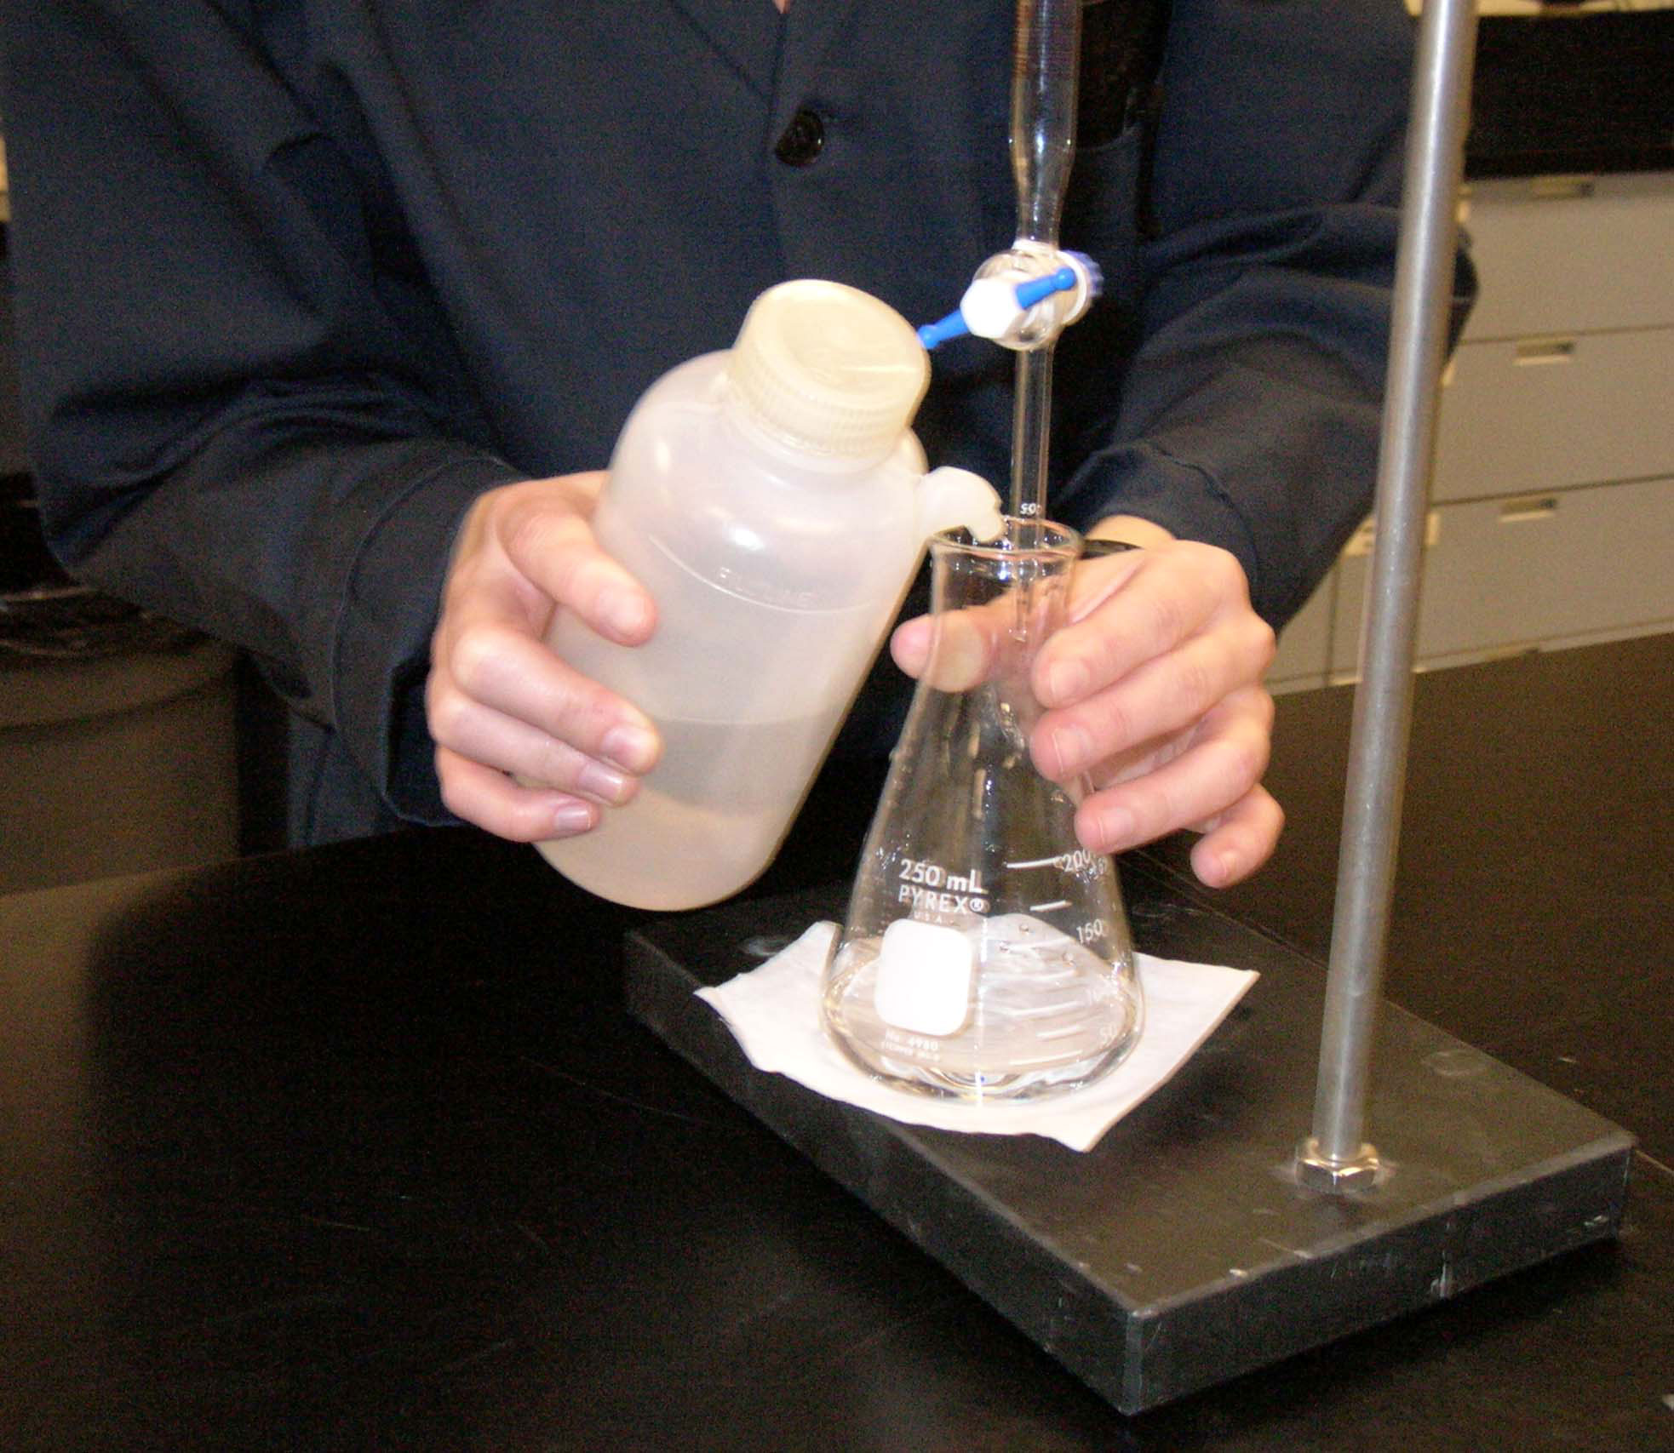
When you are close to the end point use the drop-by-drop approach and rinse the last drop from the tip of the buret at the side of the Erlenmeyer flask with the distilled water.

Slide 25
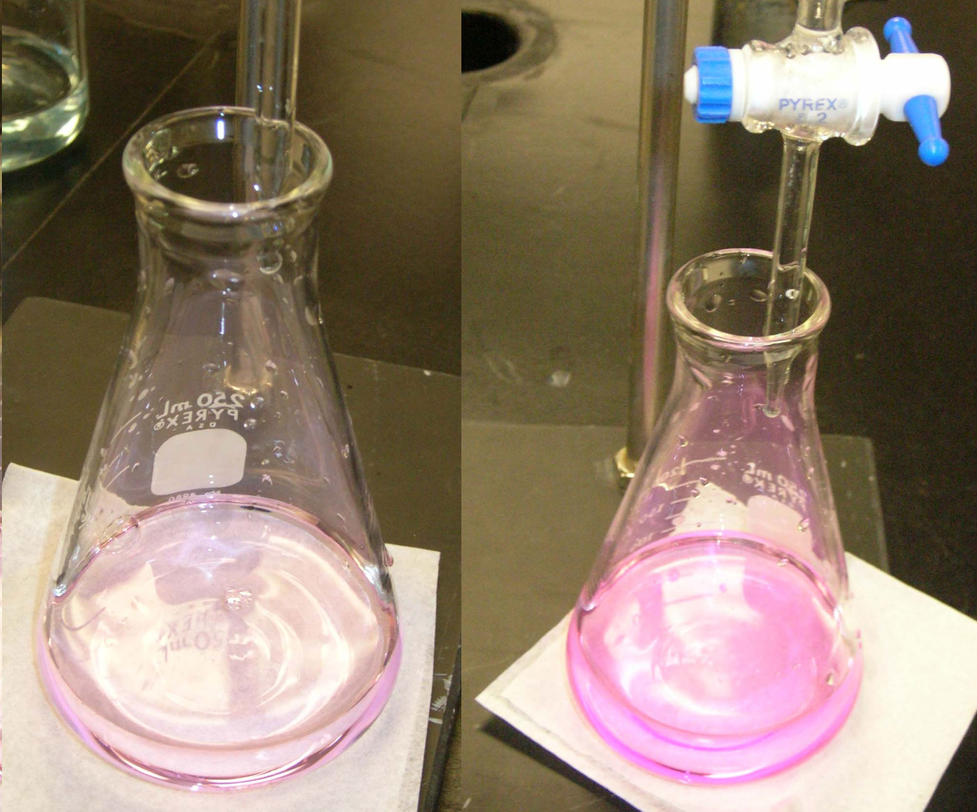
End point – light pink.
Over titrated end point – dark pink.

Slide 26
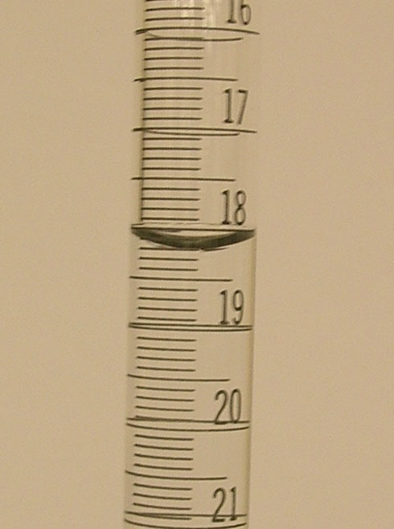
Close the stopcock and wait a few seconds for drainage to be complete, then note the reading on the buret to two decimal places (V_{final}).
V_{final} = 18.20 mL

Slide 27
[NaOH] = __________
± 0.02 | V_{initial} (mL) | V_{final} (mL) | V_{used} (mL) | End-point
Run #1 | 3.78 | 18.20 | 14.42 | light pink
Run#2
Run #3
Rinse the buret with water and clean up your work space.

