Slide 1
Molar Mass of Magnesium
Go to browse and set to full screen.

Slide 2
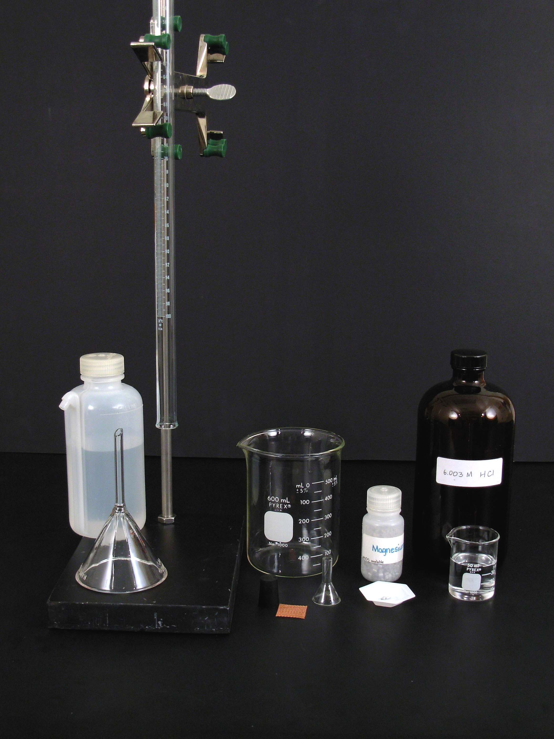
Stand and buret clamp
100 mL Gas buret
40 mL 6 M HCl
600 mL beaker
Copper gauze
Magnesium turnings

Slide 3
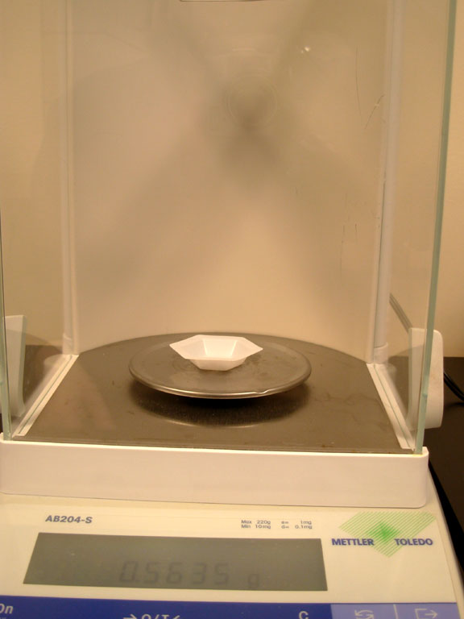
Accurately weigh by difference between 50 and 70 mg of magnesium turnings.

Slide 5
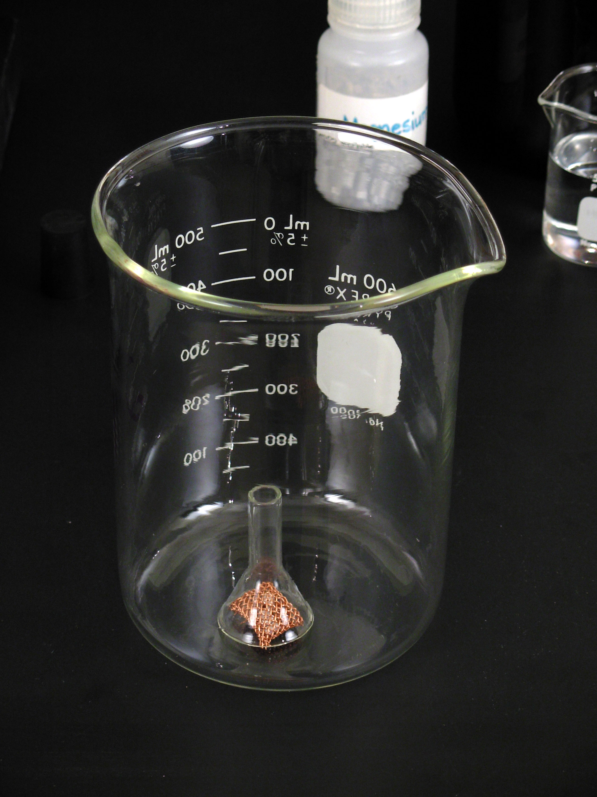
Place the magnesium turnings in a copper gauze under a small funnel inverted on the bottom of 600 mL beaker.

Slide 6
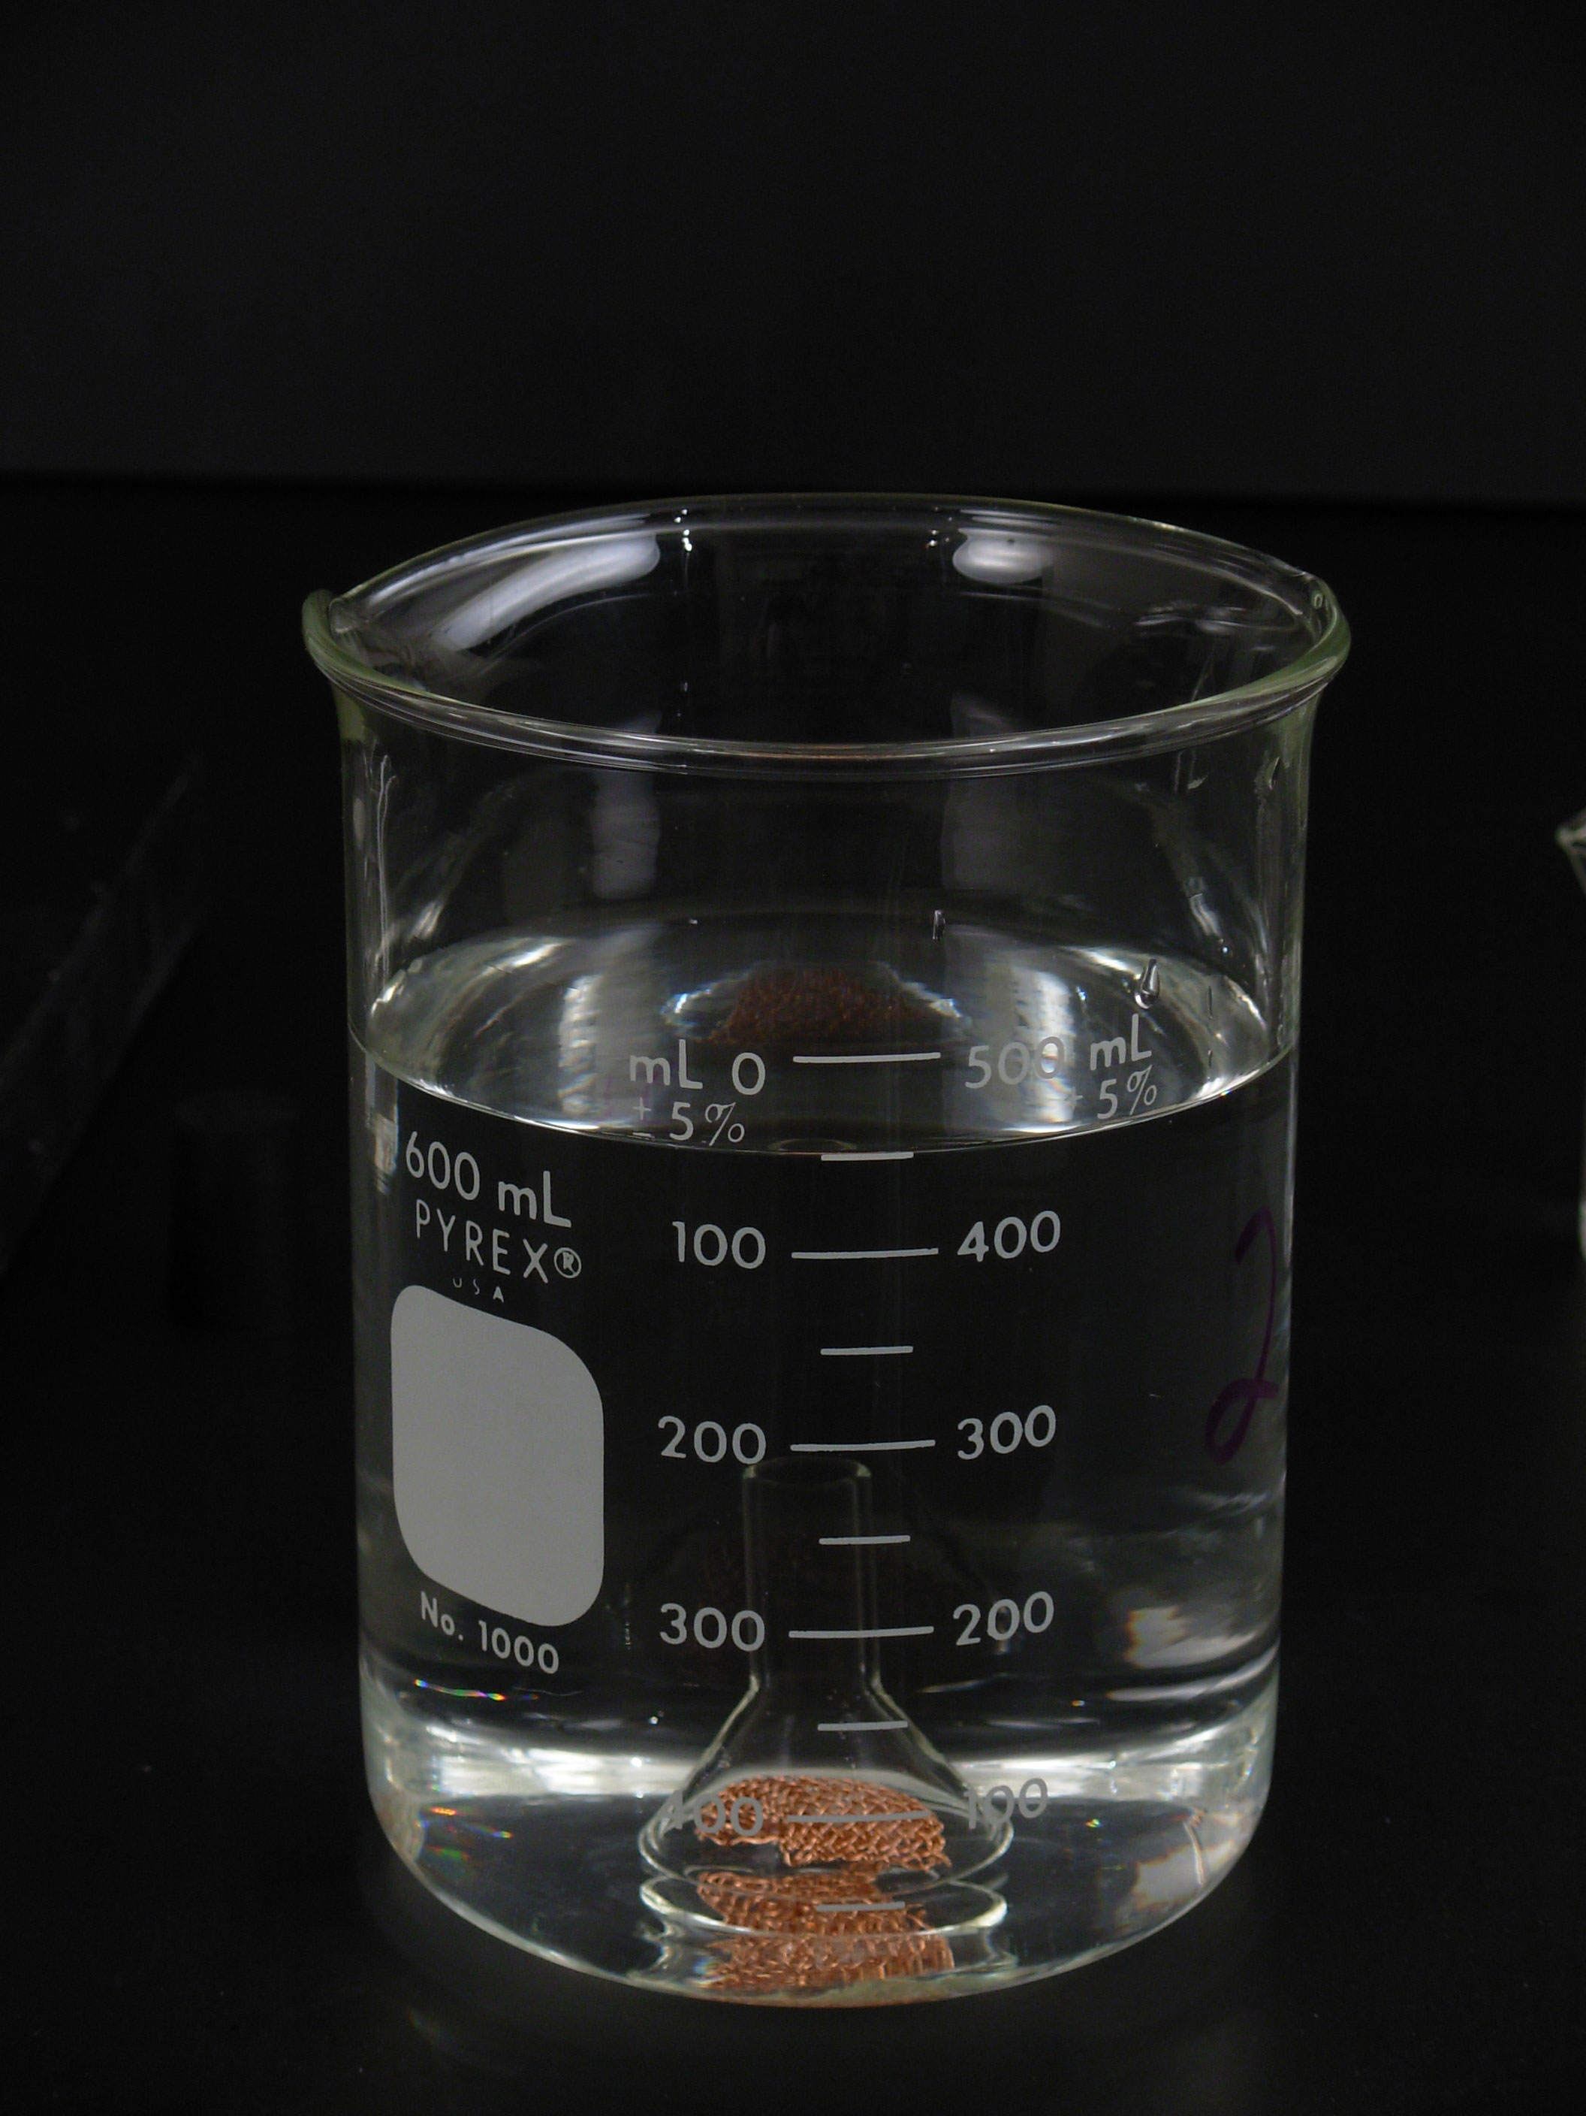
Add 450 mL of tap water to the beaker.

Slide 7
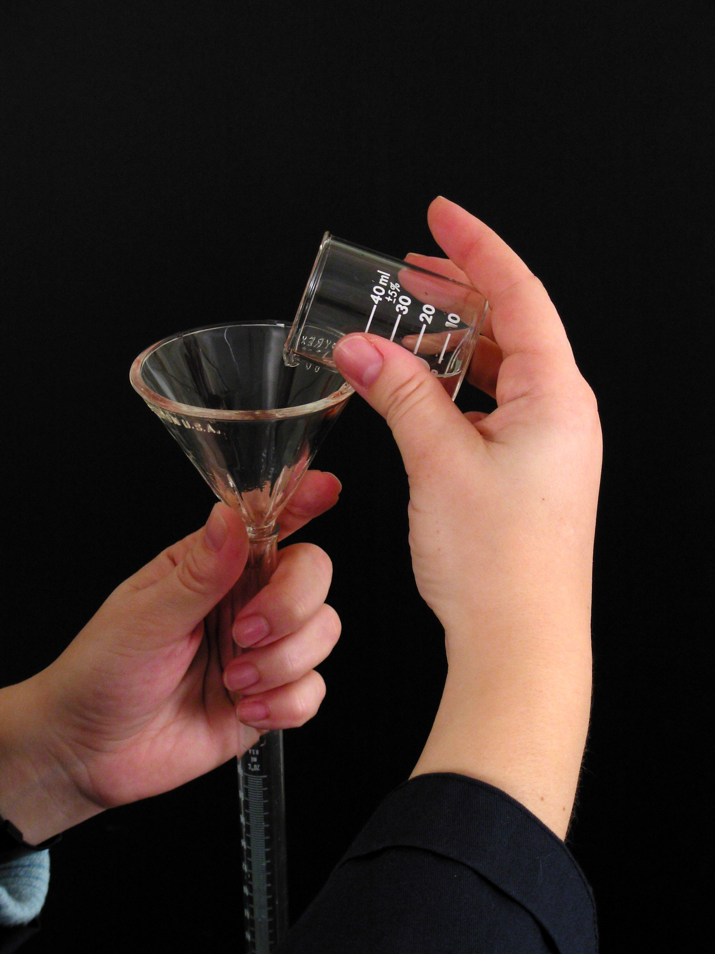
Carefully pour 40 mL of 6M HCl through a funnel into a 100 mL gas buret.

Slide 8
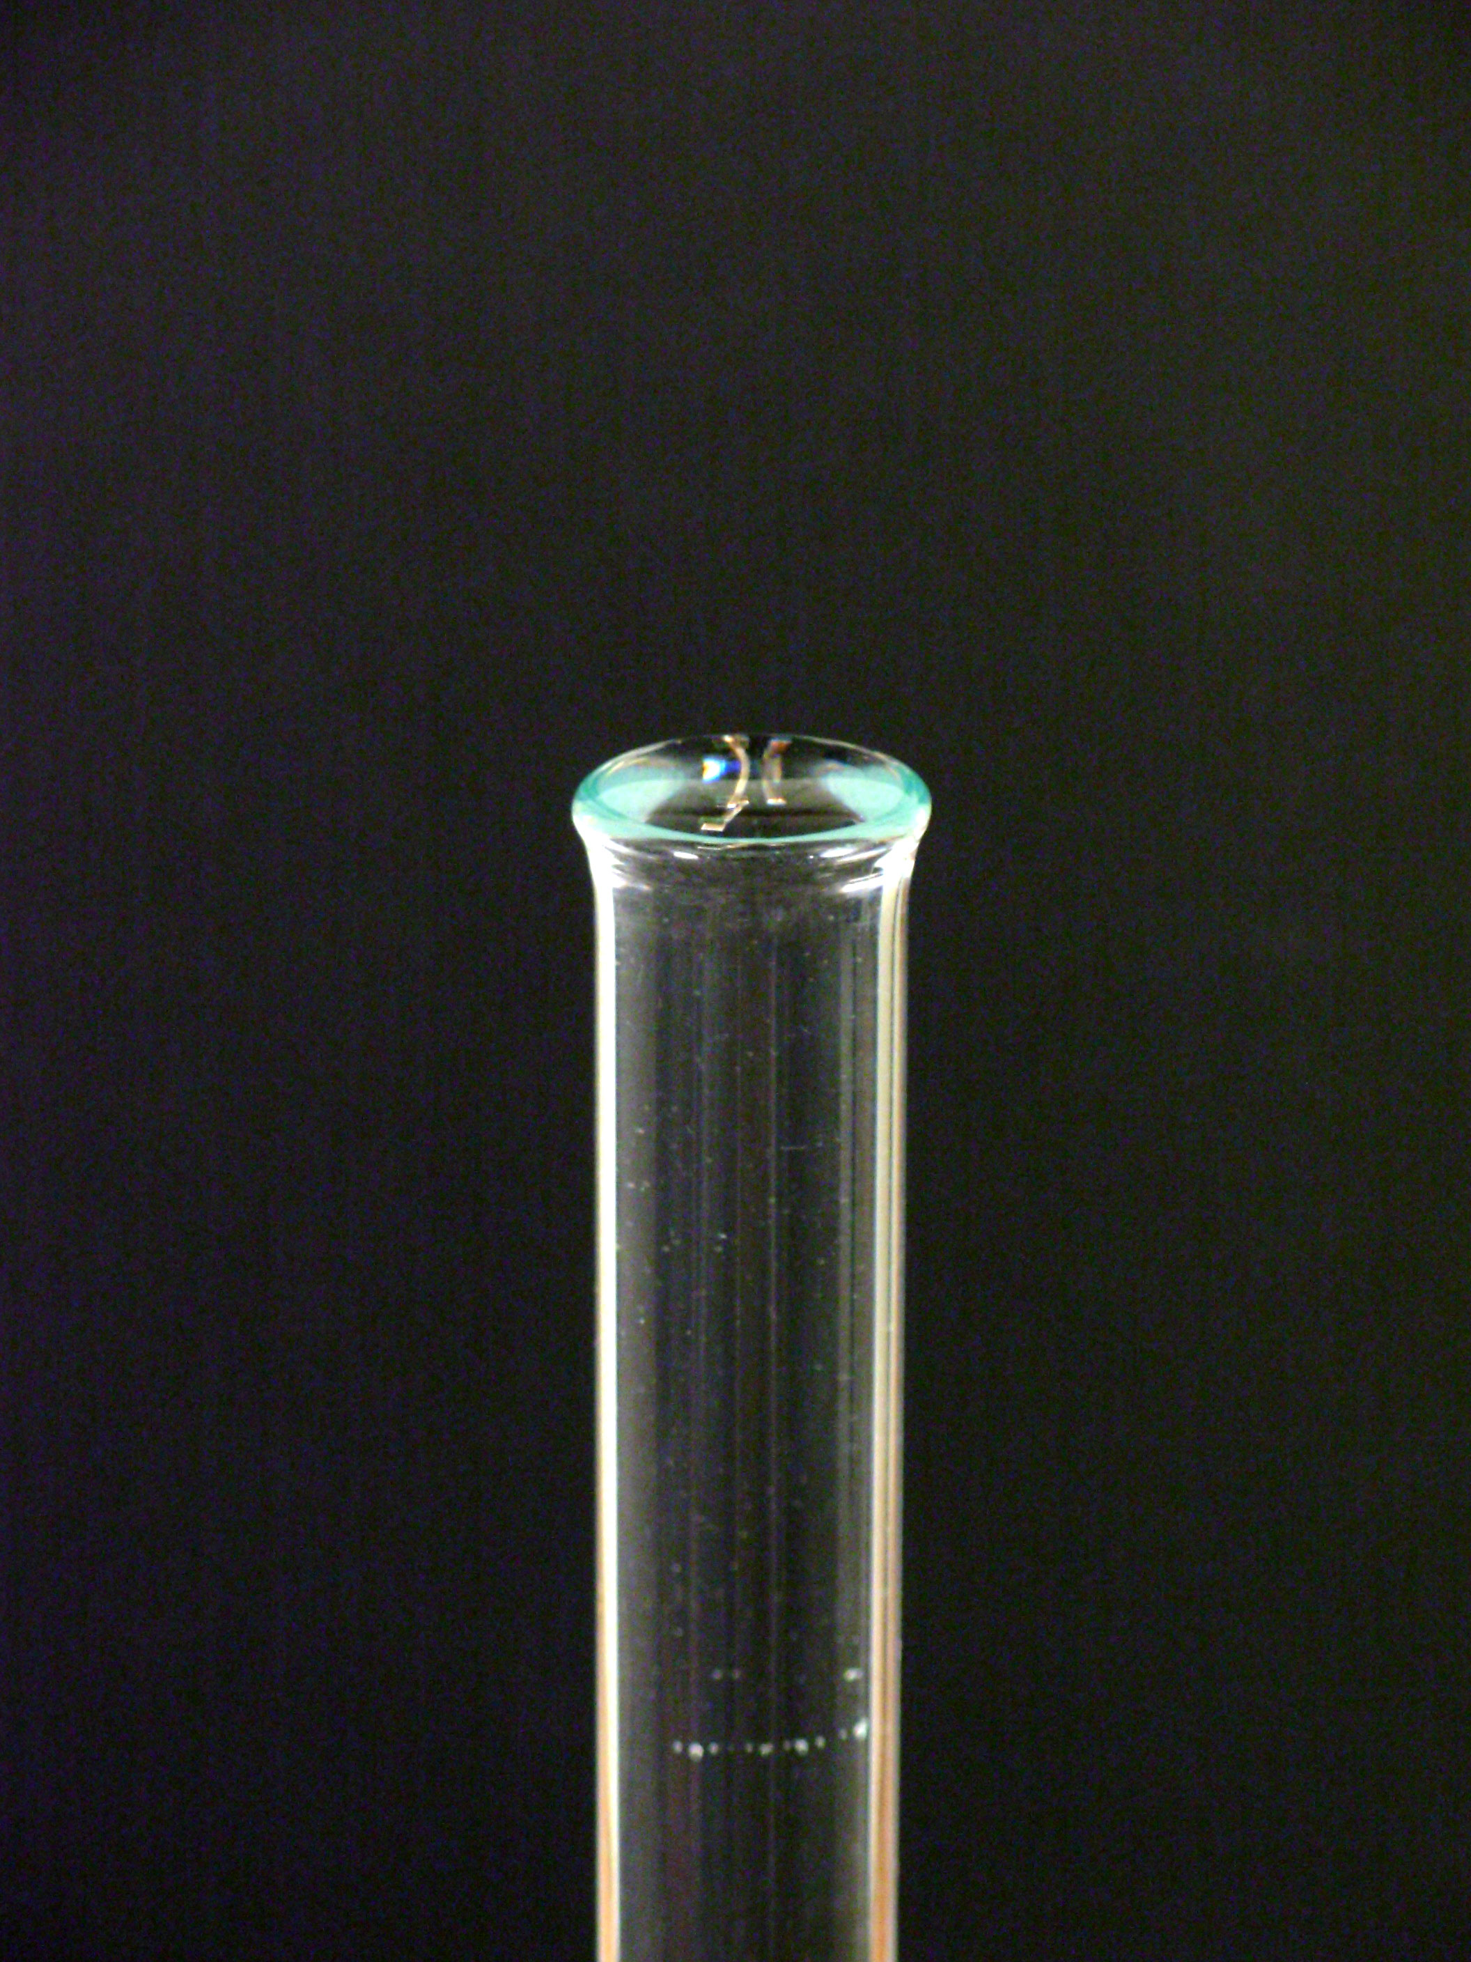
Fill the buret right to the top with distilled water,

Slide 9
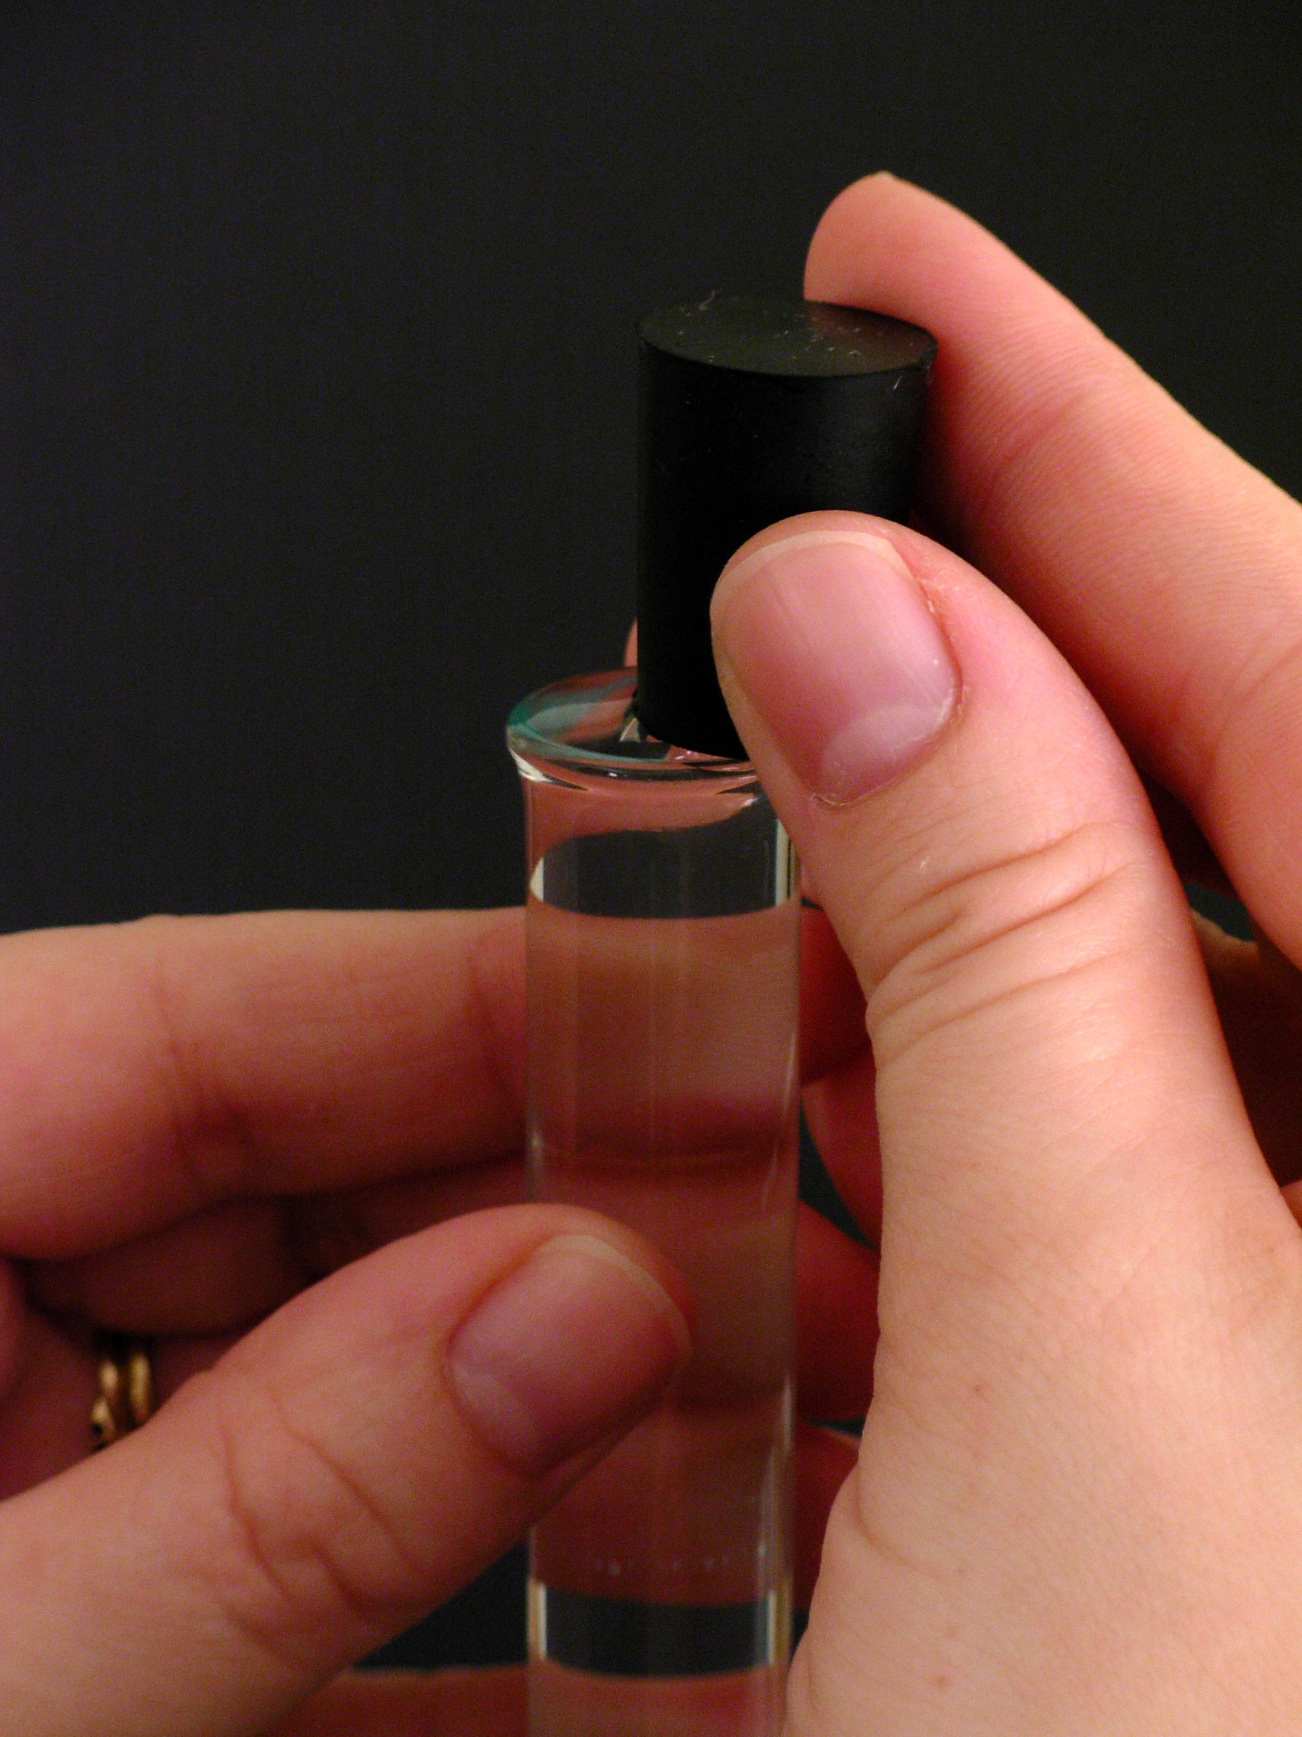
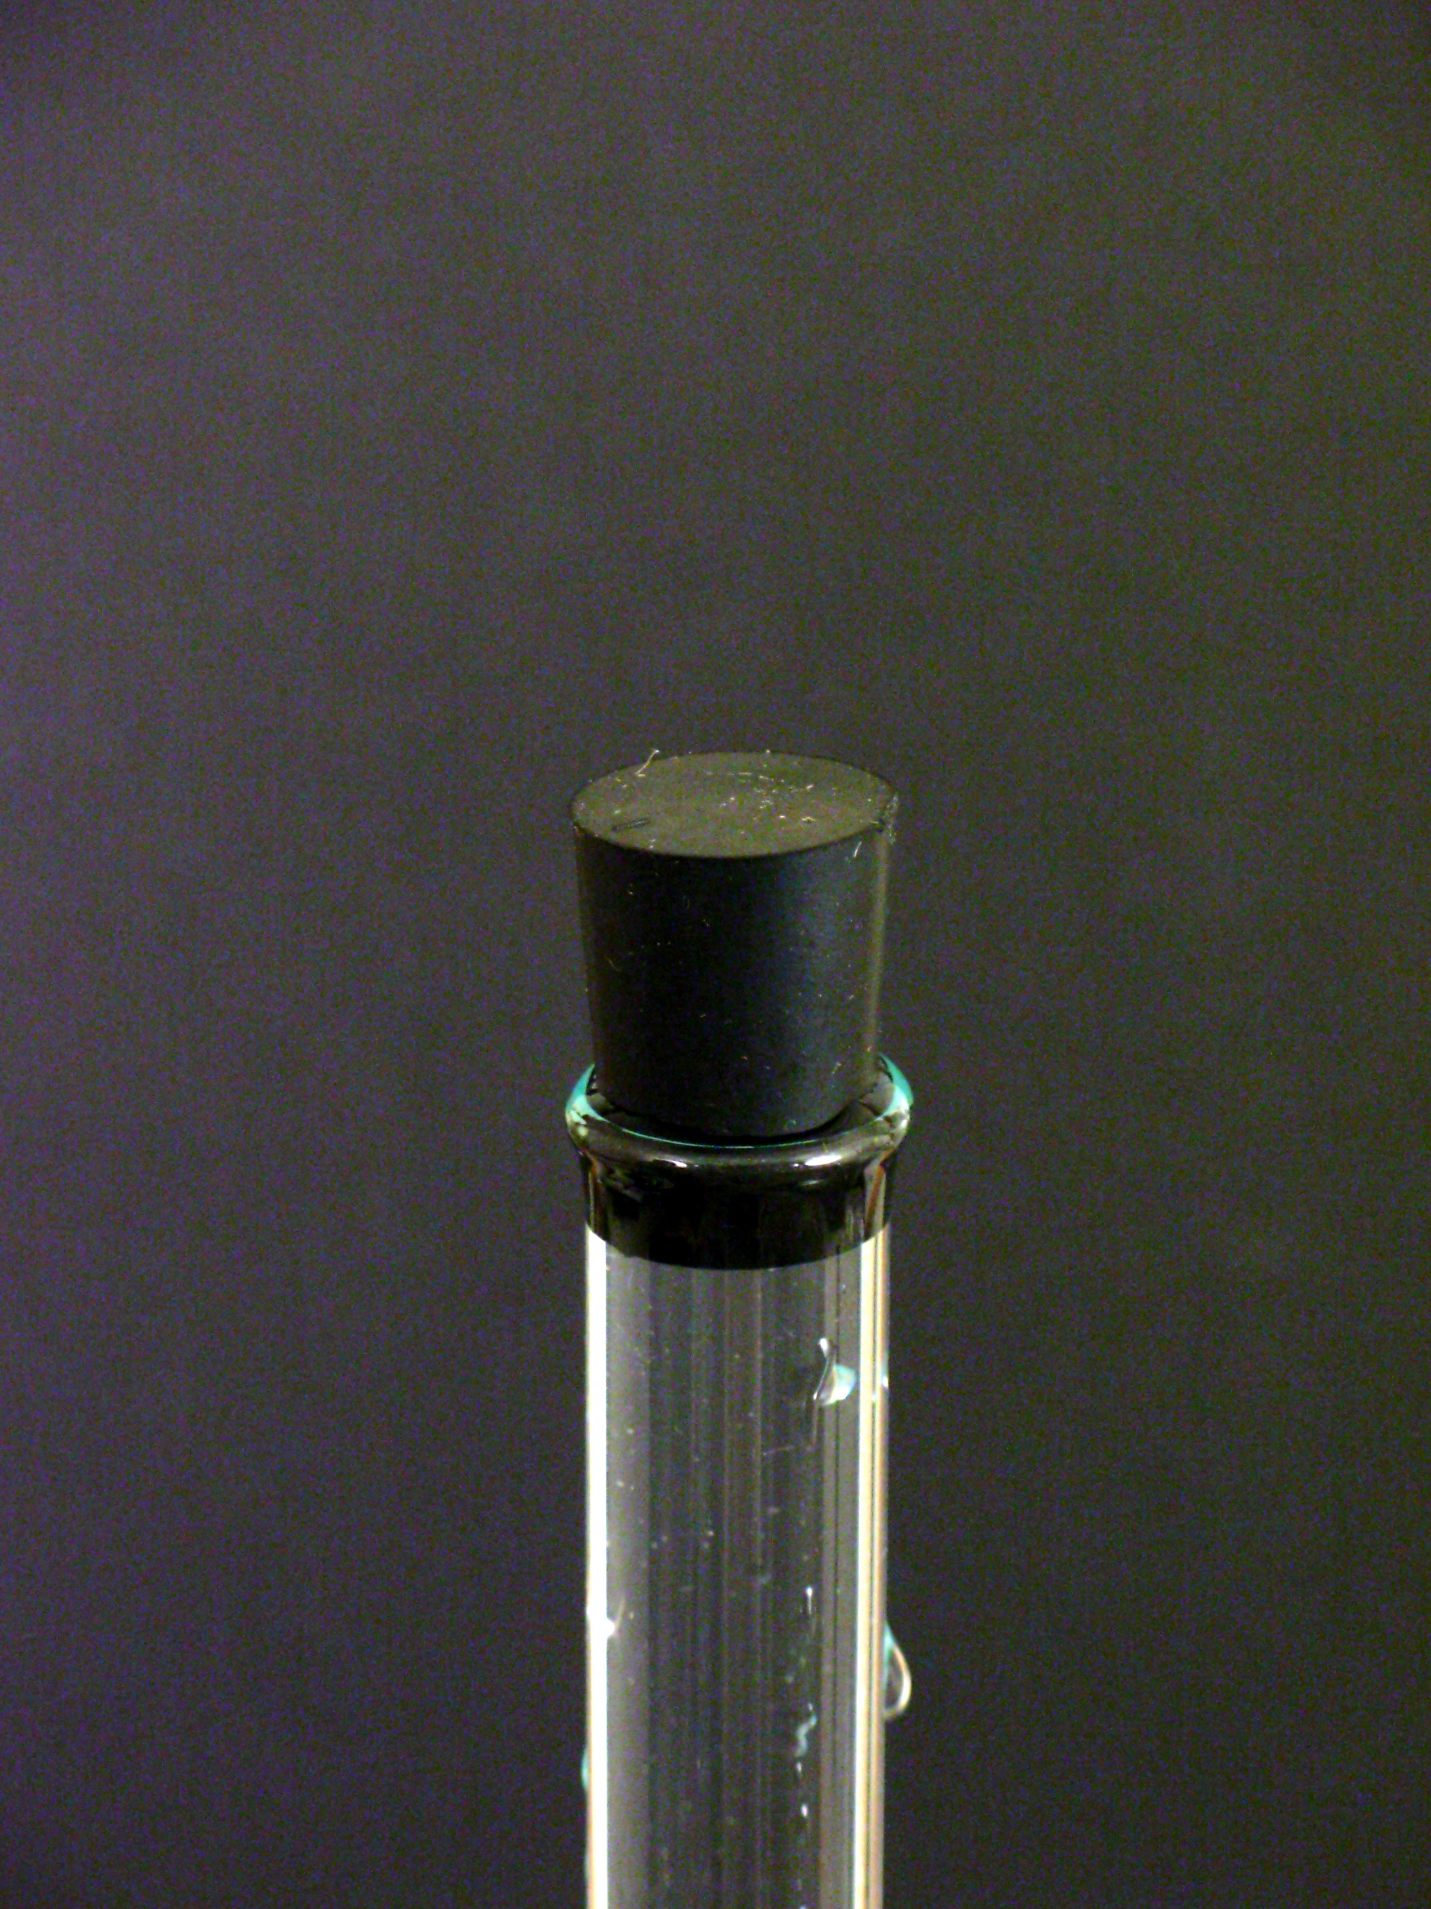
Then seal it with a rubber stopper so that all air bubbles are excluded.

Slide 10
Carefully invert the 100 mL gas buret,

Slide 11
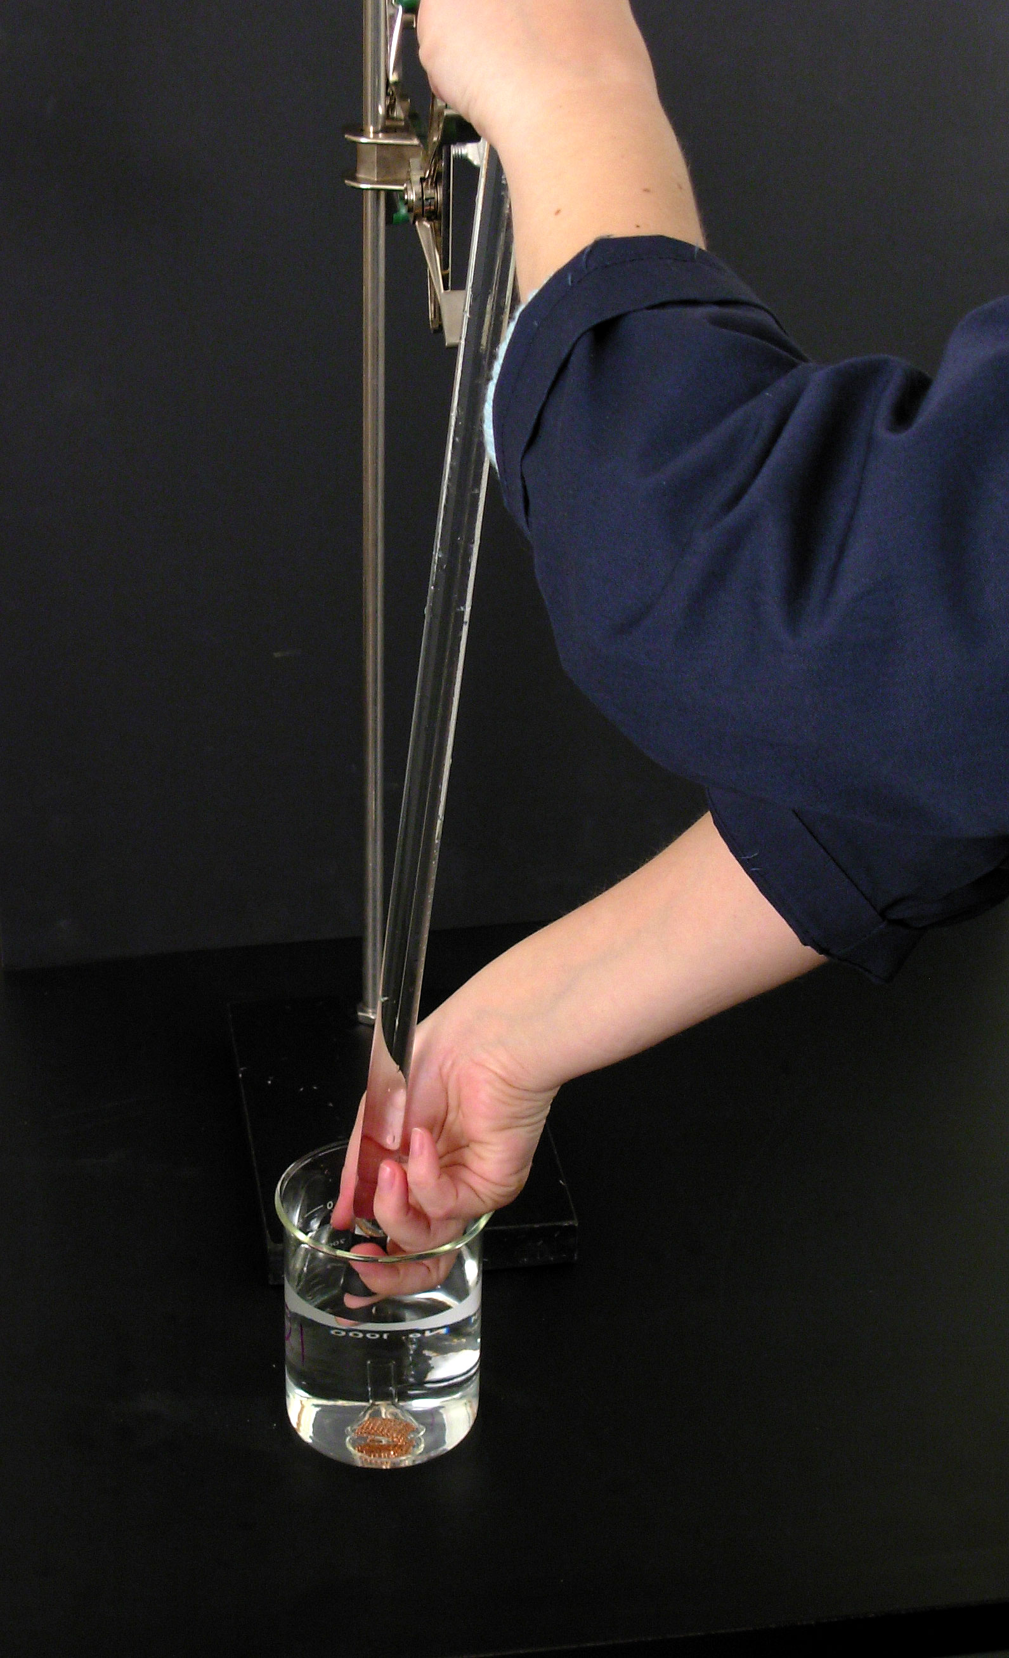
And place the stopper end under the surface of the water in the 600 mL beaker.

Slide 12
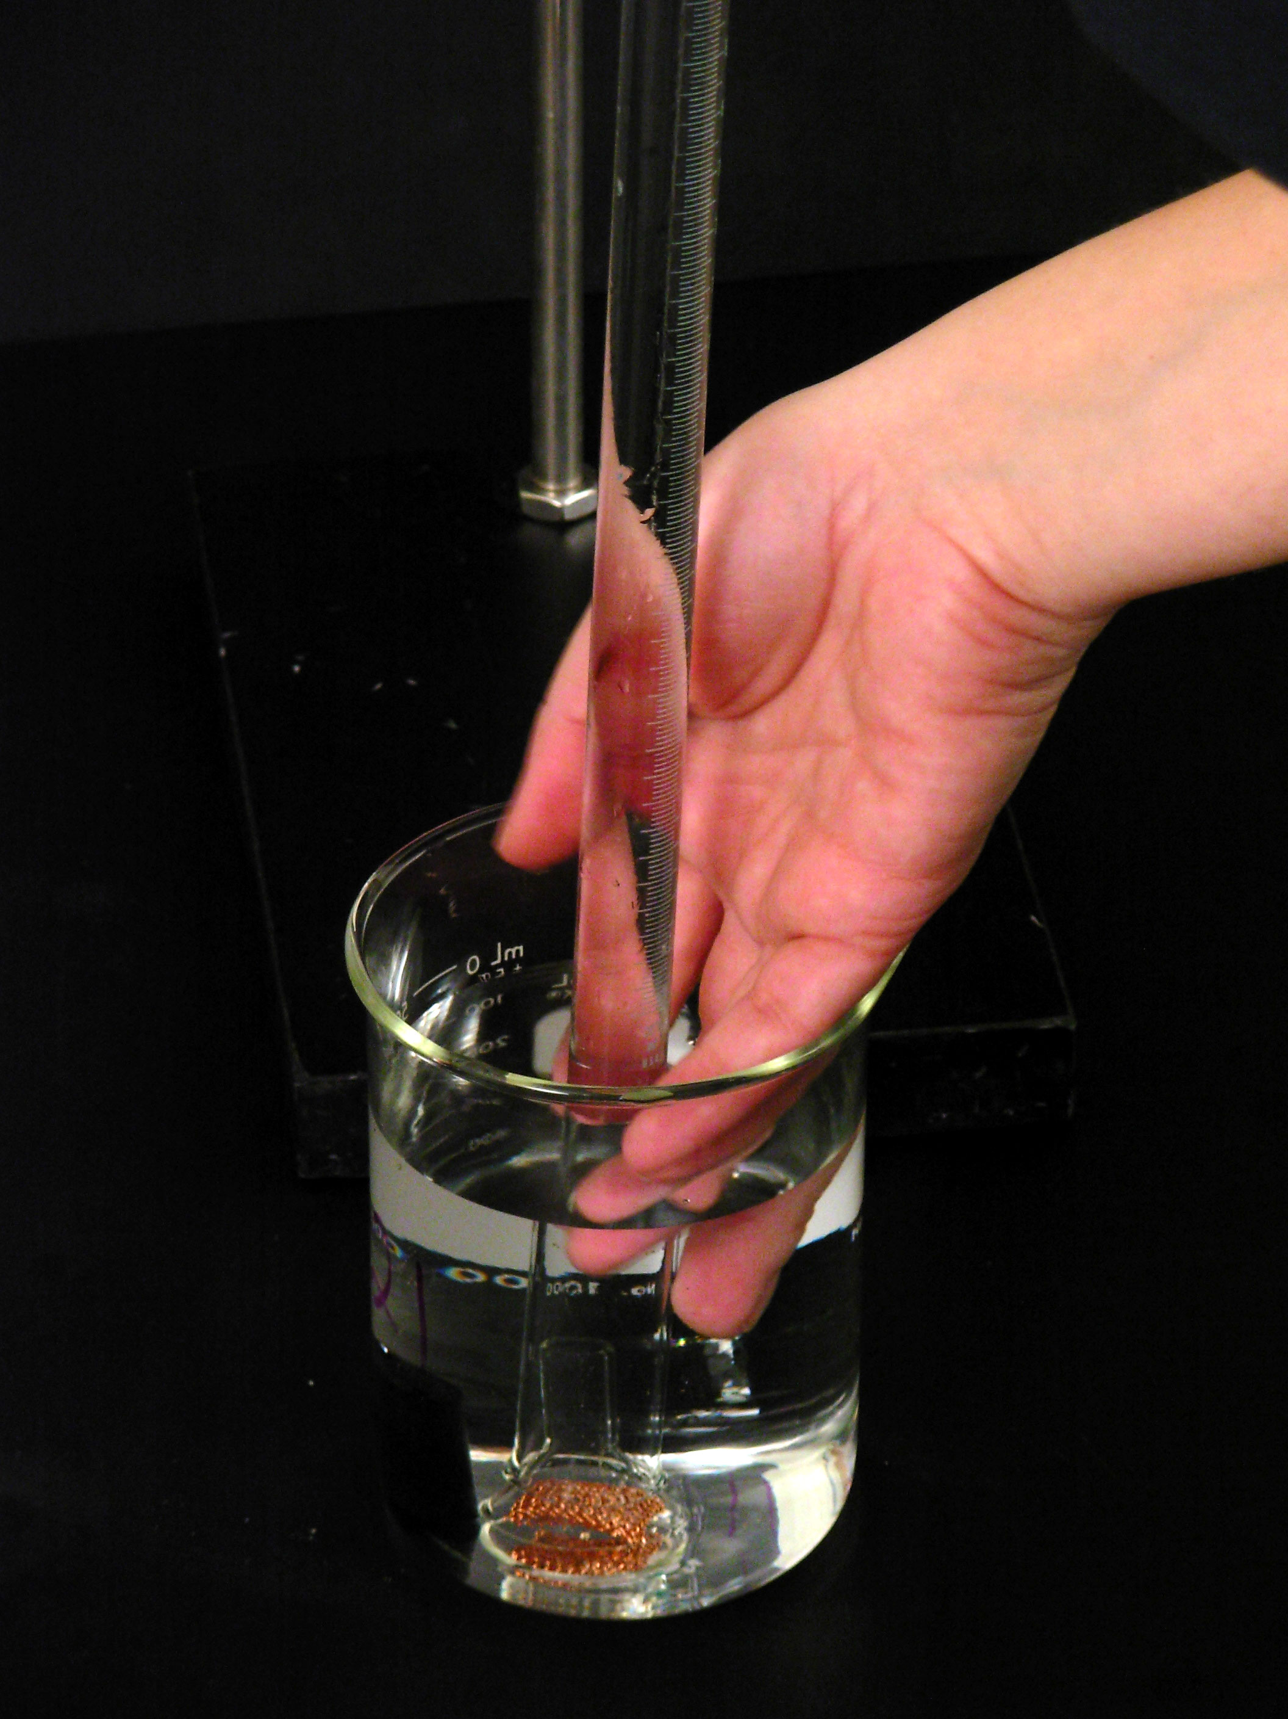
Remove the stopper and carefully lower the open end of the gas buret over the stem of the small funnel until the gas buret rests on it.

Slide 13
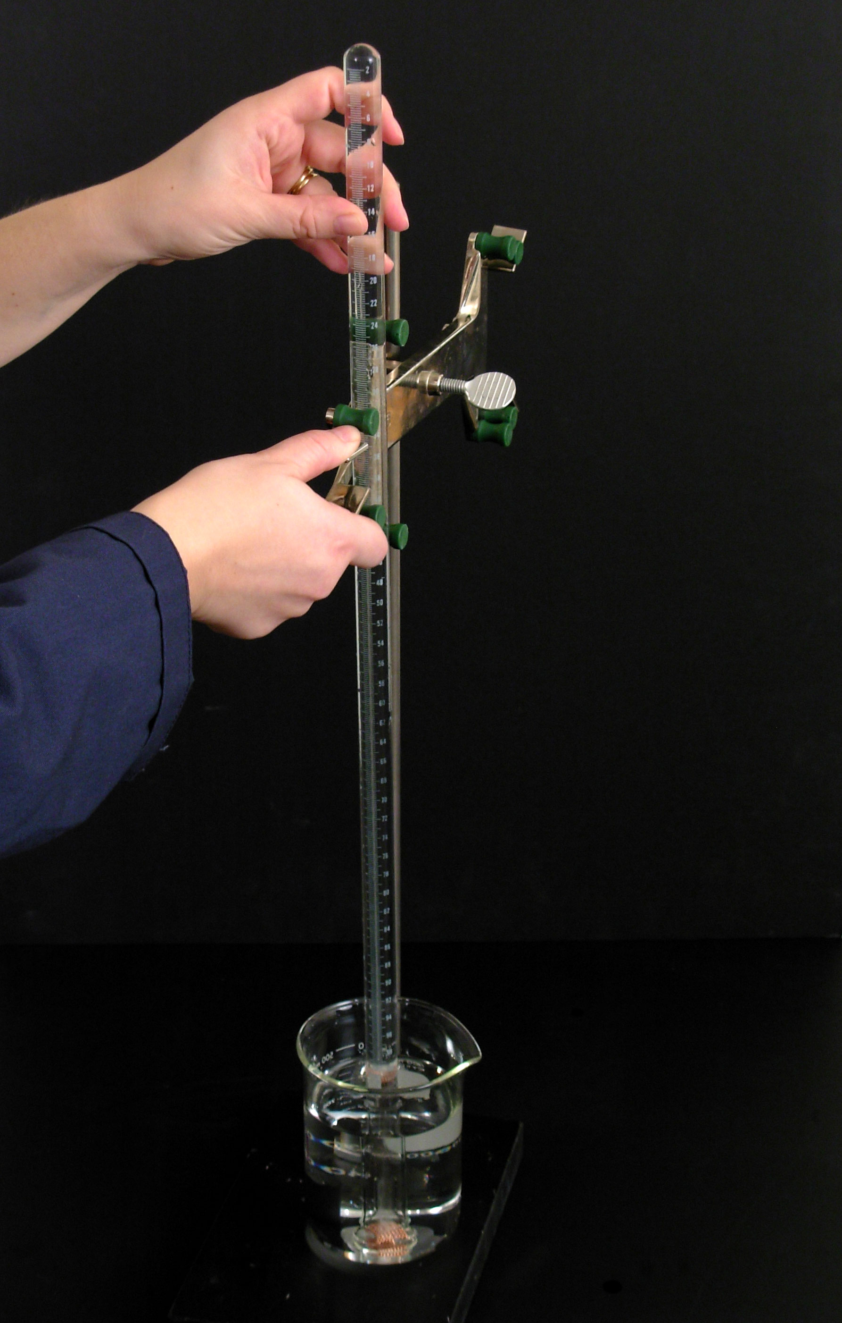
Grasping the whole assembly, clamp the gas buret in a buret clamp to maintain it in a vertical position.

Slide 14
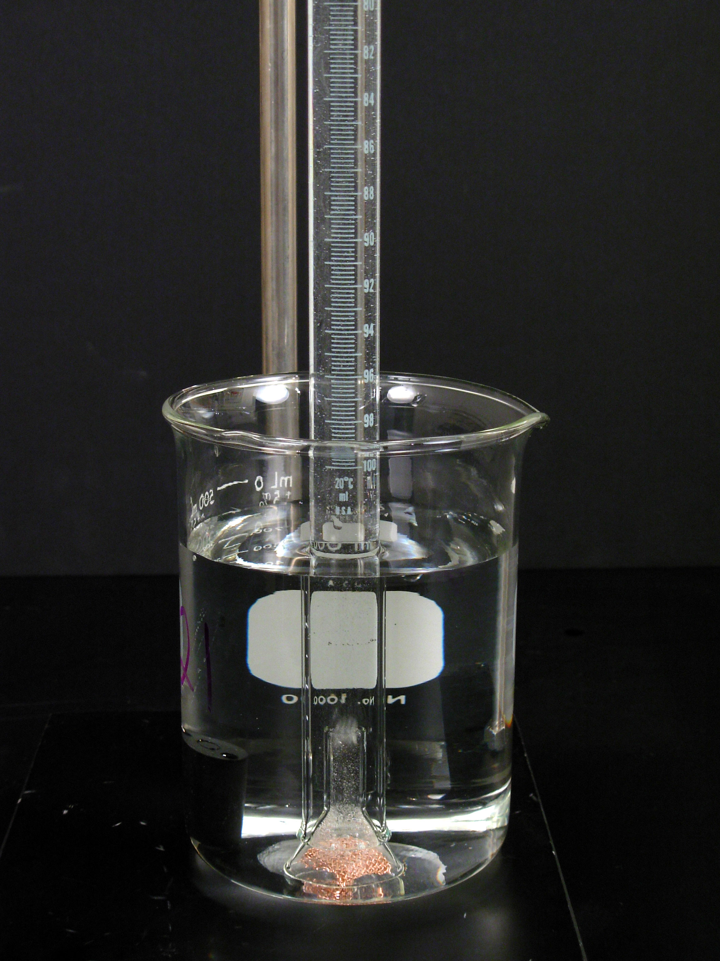
Evolution of hydrogen gas

Slide 15
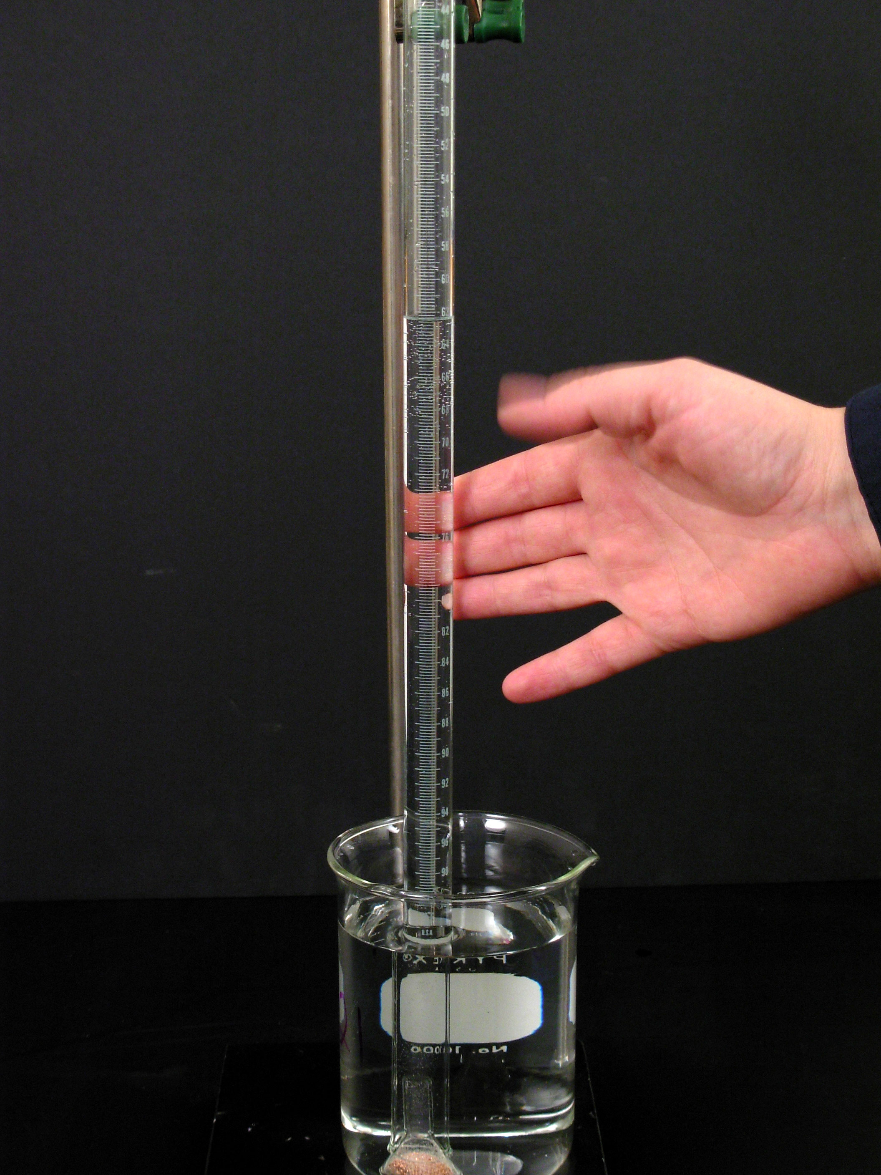
After hydrogen gas evolution has ceased, tap the gas buret to dislodge any bubbles trapped in the copper gauze..

Slide 16
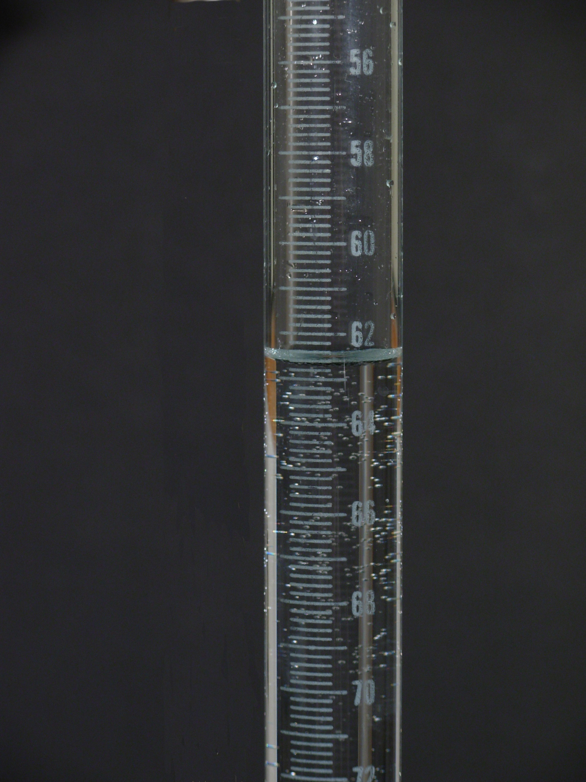
Measure the volume (in mL) of the hydrogen gas.
62.5 mL

Slide 17
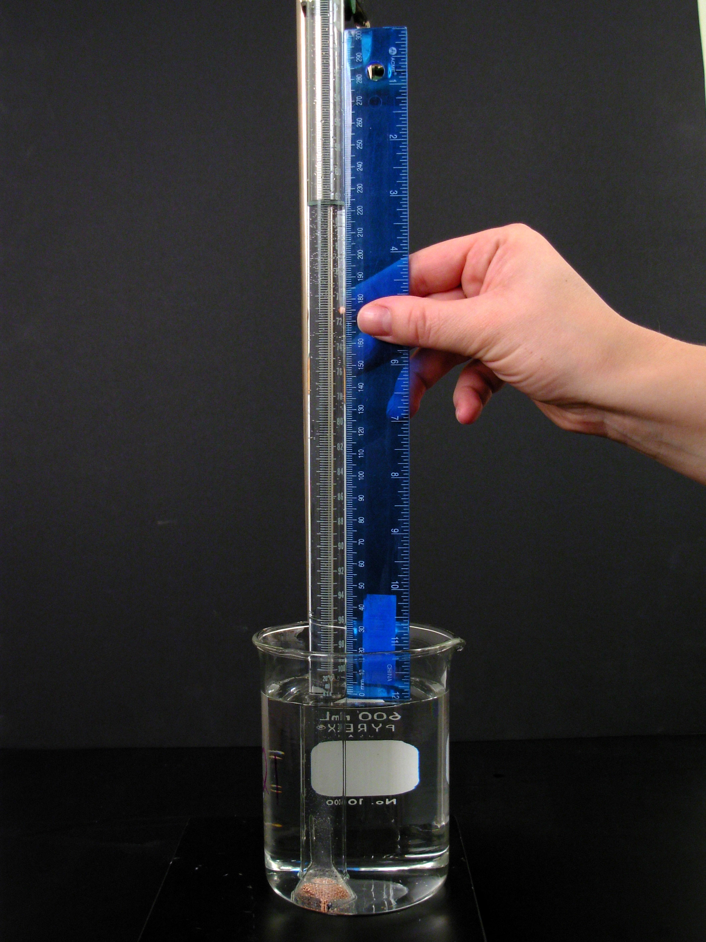
Measure the difference in height (in mm) of the solution levels in the buret and the beaker.

Slide 18
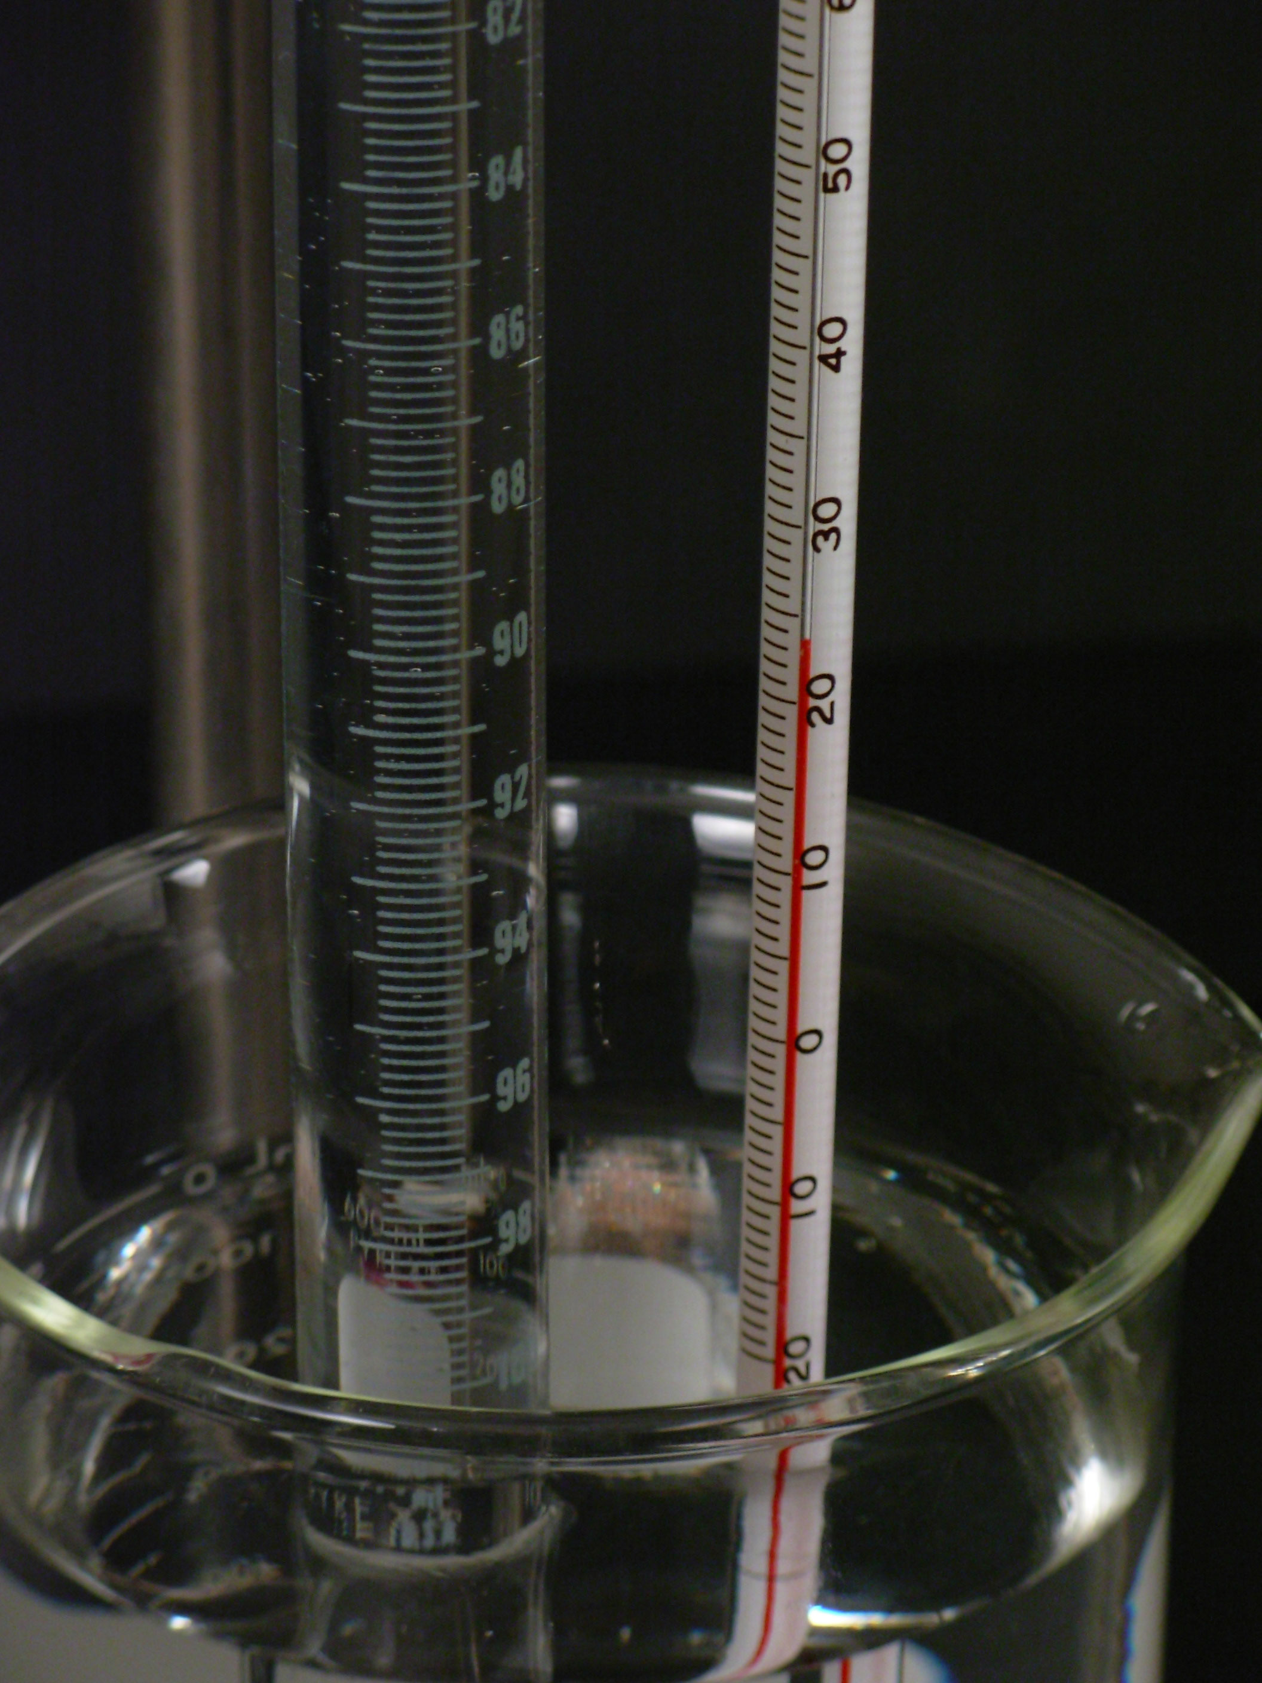
Measure the temperature of the solution in the beaker.

Slide 19
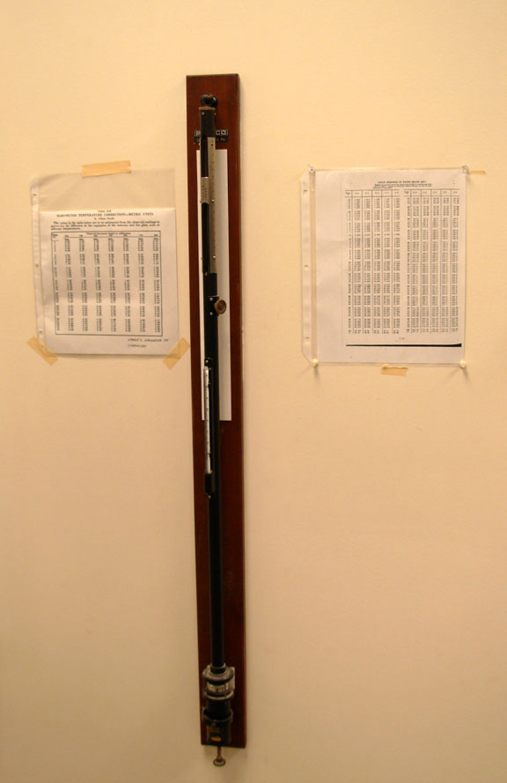
Record the vapour pressure of water in mm Hg.
Record the atmospheric pressure in mm Hg.

Slide 20
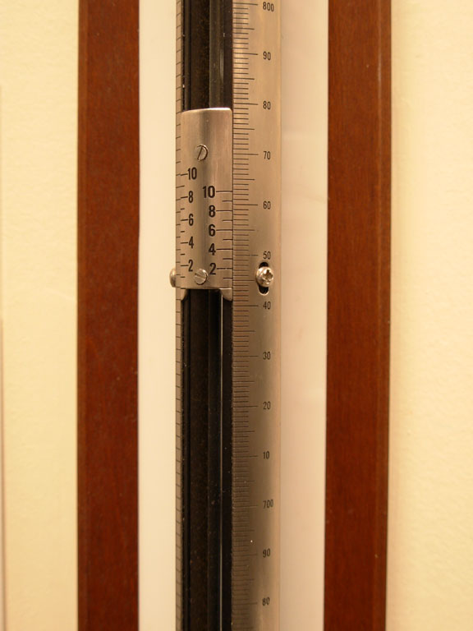
Review the page 26 in the CHEM 1110 Laboratory Manual for reading the barometer.

