Slide 1
Quantitative determination of nickel in a compound
Go to browse and set to full screen.

Slide 2
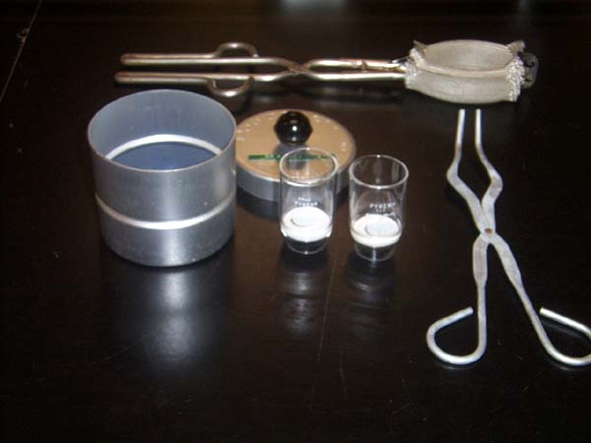
Part 1
Beaker tongs
Crucibles
Desicooler
Crucible tongs

Slide 3
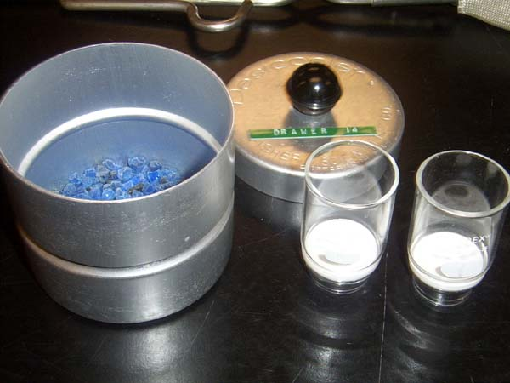
Drying agent

Slide 4
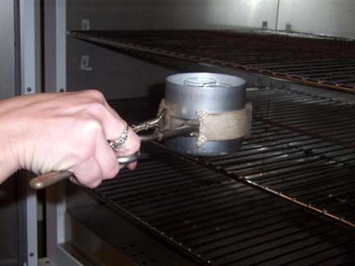
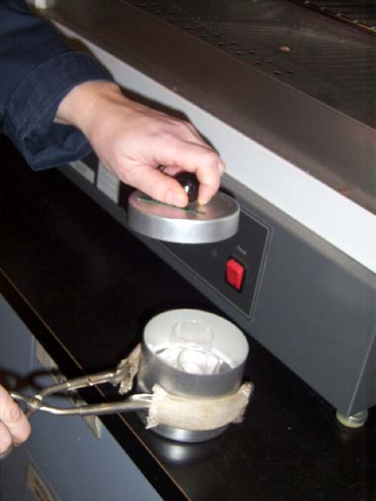
Obtain two crucibles from the oven, put the lid on and let them cool on the bench top for 20 min. Then weigh them accurately on the analytical balance.

Slide 5
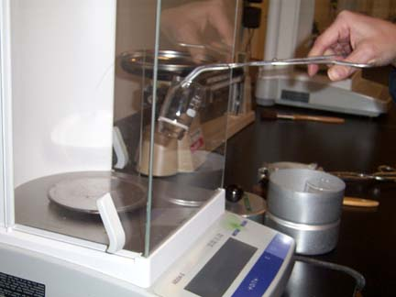
Use crucible tongs to transfer crucible to analytical balance.
Record the mass in your notebook.

Slide 6
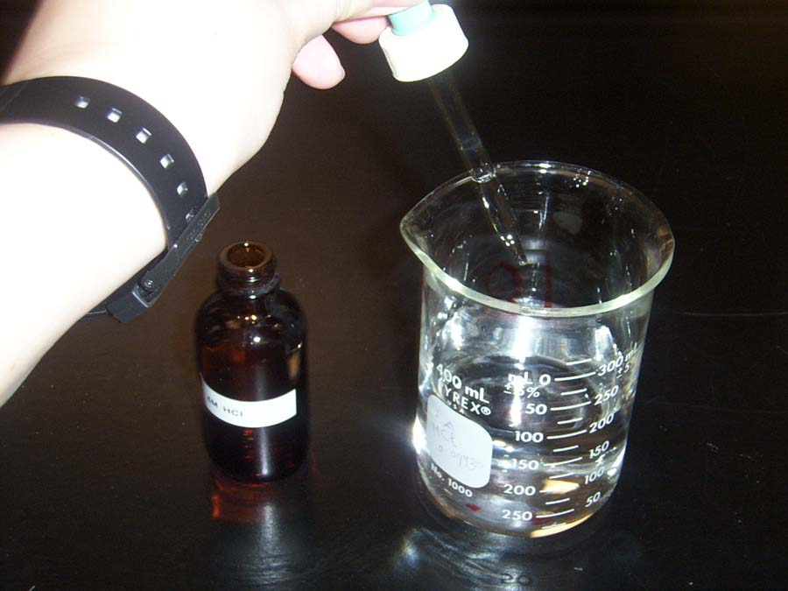
Part 2
Homogeneous precipitation
To a clean 400 mL beaker add about 200 mL of distilled water and 5 drops of 6 M HCl.

Slide 7
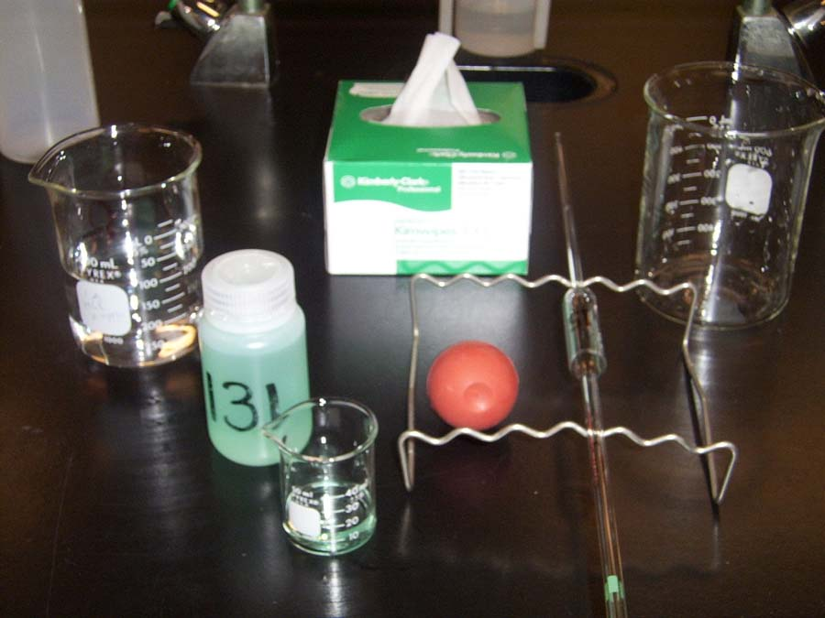
Add 15.00 mL of your unknown solution to the solution in 400 mL beaker.
Waste beaker
15.00 mL pipet
Record the unknown number in your notebook.

Slide 8
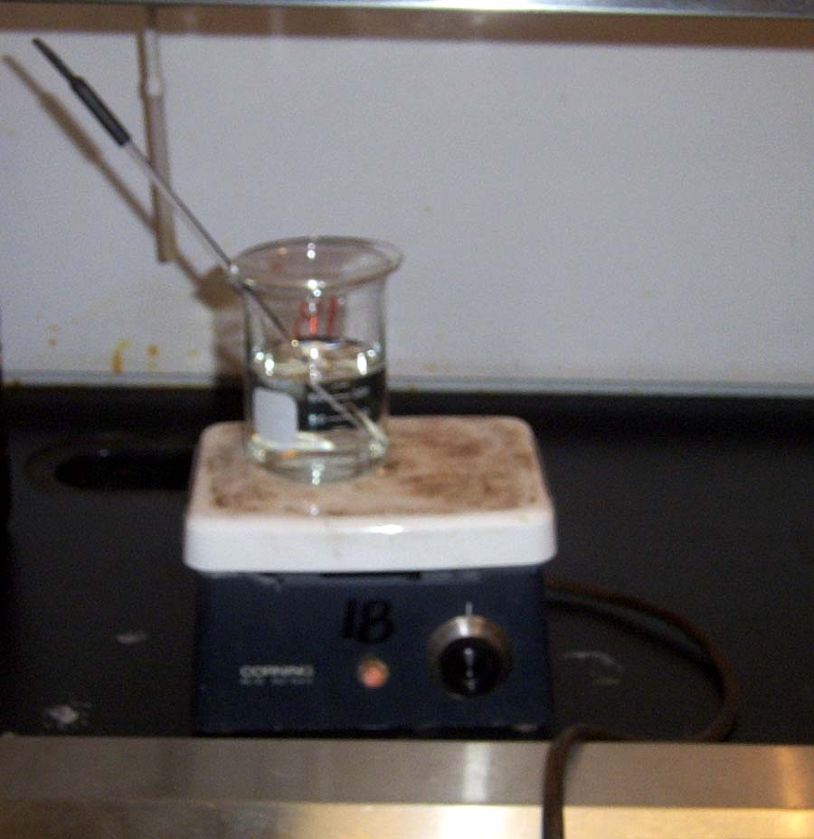
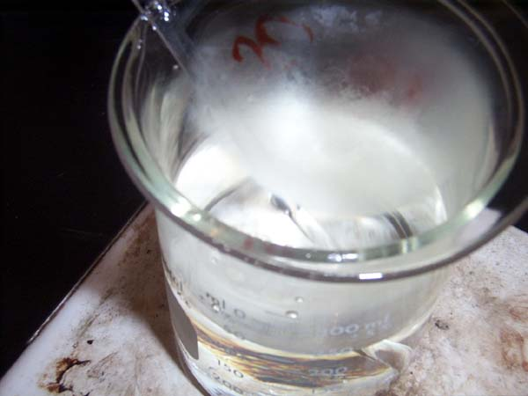
Place this dilute acidic nickel solution on a hot plate in the fume hood.
Set the hot plate on medium heat.
Steaming nickel solution.

Slide 9
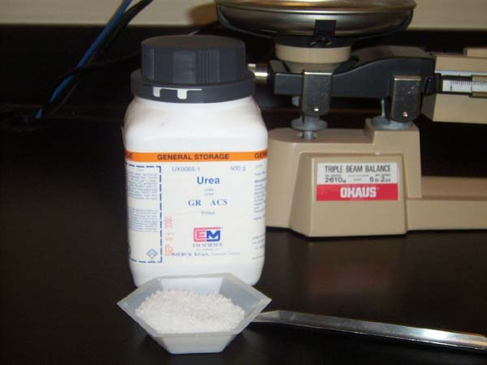
Add about 20 g of urea.
Weigh on the triple beam balance.

Slide 10
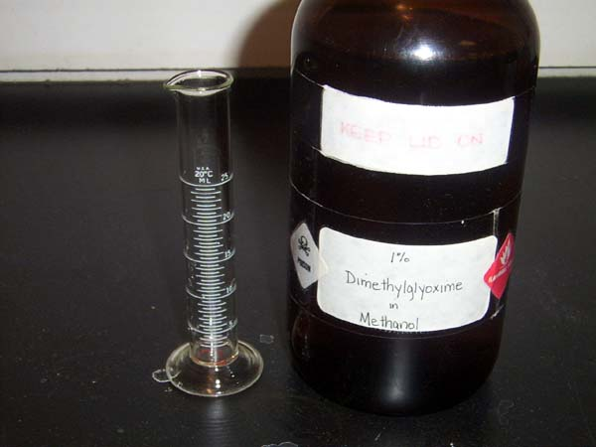
Add 20 mL of 1% DMG solution to the hot nickel solution.

Slide 11
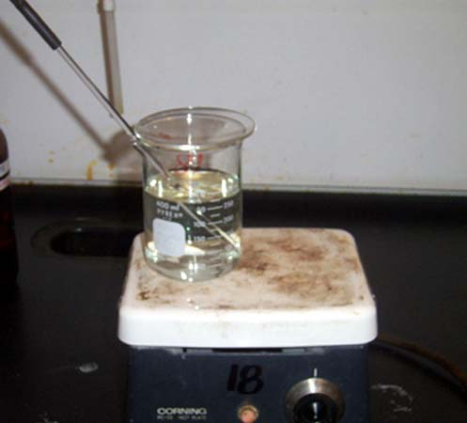
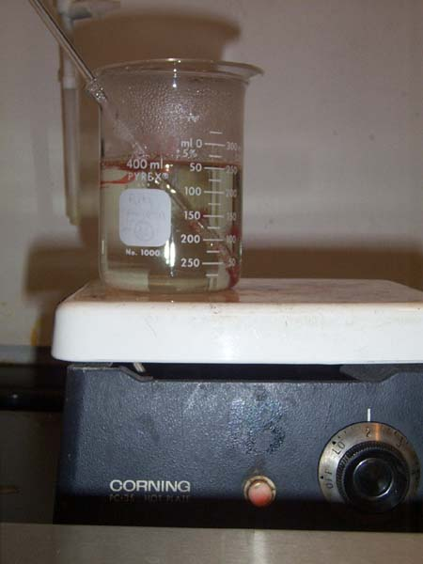
Cover the beaker with watch glass and let the solution heat for one hour.
After one hour the solution should be colorless with a red precipitate dispersed in it.

Slide 12
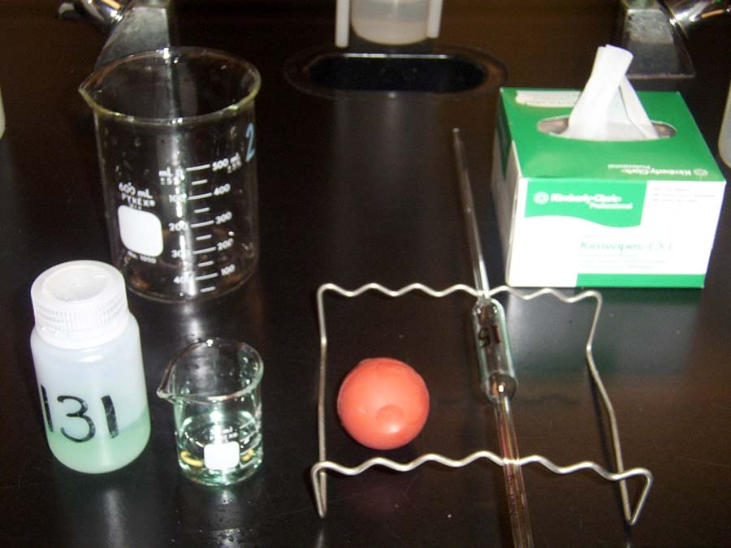
Part 3
Heterogeneous precipitation
Pipet 15.00 mL of your unknown Ni solution into a clean 600 mL beaker.

Slide 13
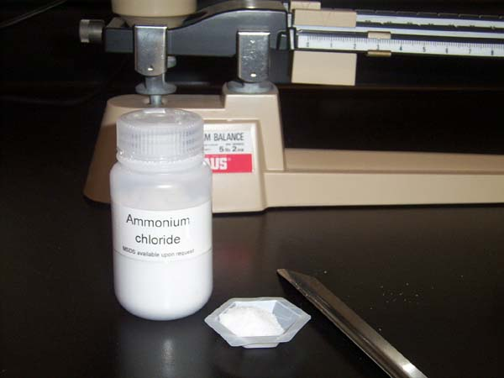
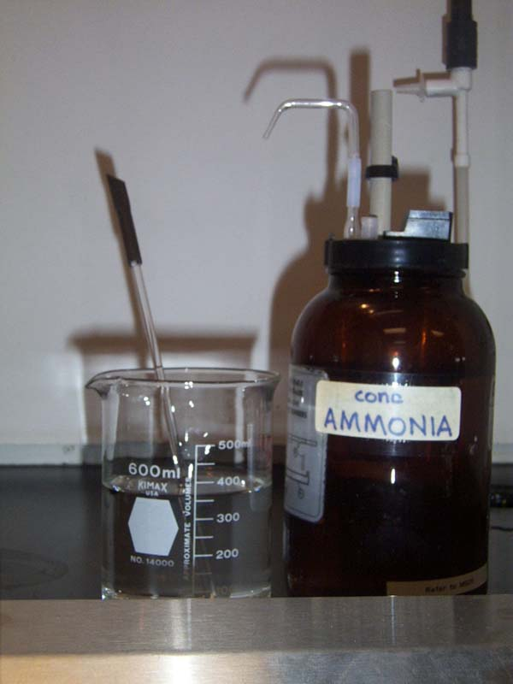
Add 350 mL distilled water,
2.50 g of NH₄Cl.
And then add 2.5 mL of concentrated ammonia.

Slide 14
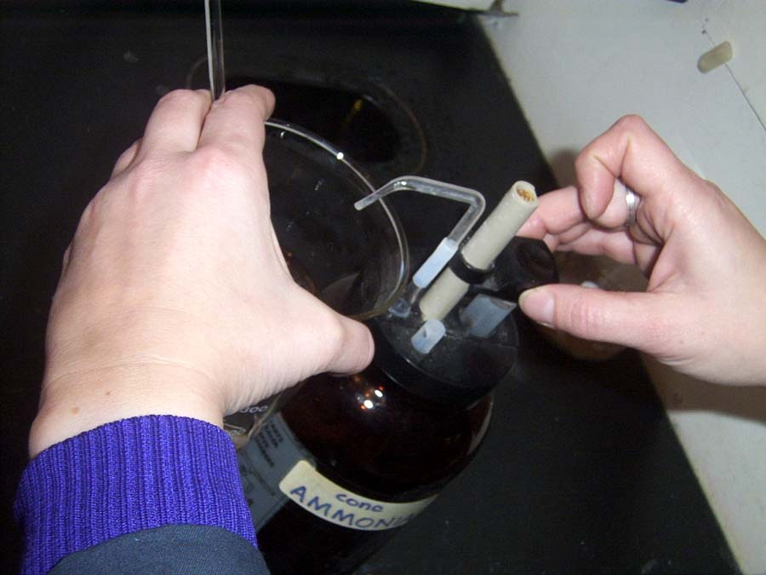
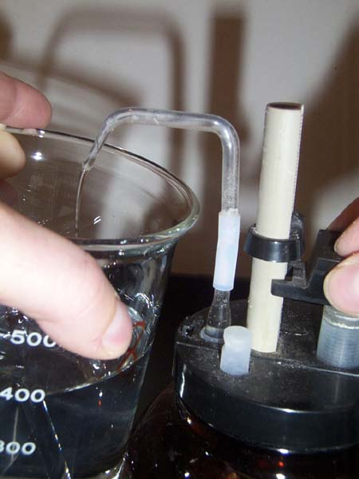
lift plunger carefully
press down slowly

Slide 15
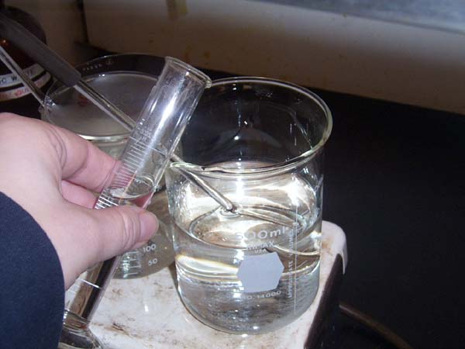
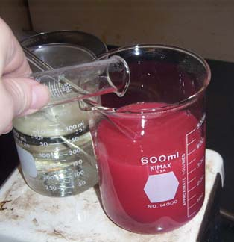
Place the beaker on the hot plate.
Add about 20 mL of the 1% DMG reagent to the solution.
Homogeneous solution
from part 2
Heterogeneous solution

Slide 16
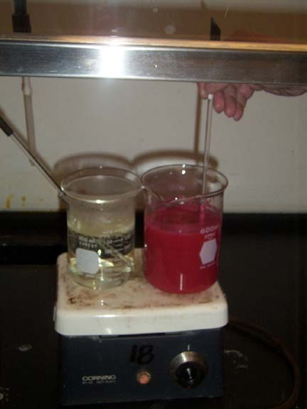
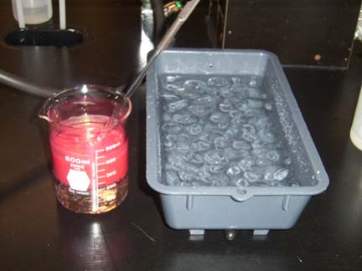
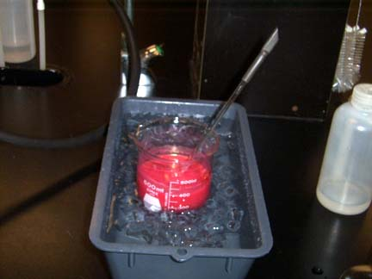
Let it cool for 5 minutes.
Then place it in an ice-water bath for 10 min.
After adding 20 ml of 1% DMG (heterogeneous solution) stir well for 20 minutes or until the precipitate settles.

Slide 17
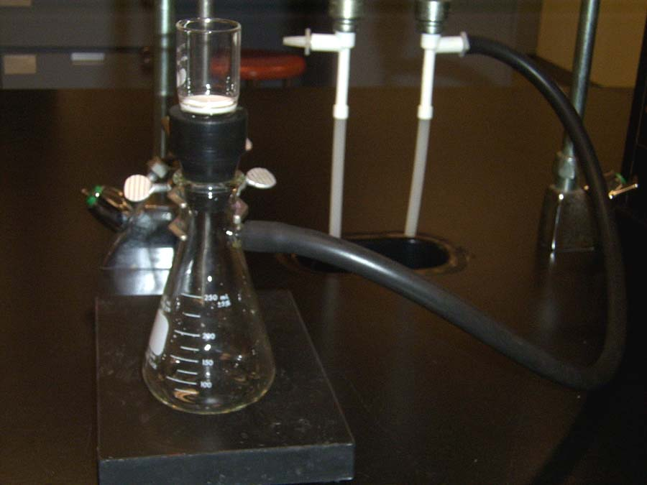
crucible
aspirator
rubber cone
utility clamp
vacuum filter flask
black vacuum (rubber) tubing
stand

Slide 18
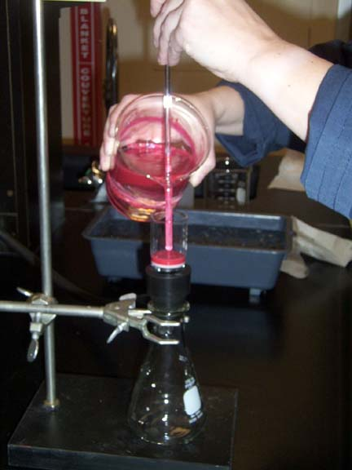
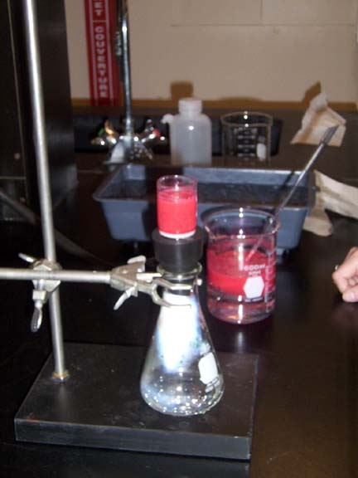
Filter the solution through one of the pre-weighed crucible.

Slide 19
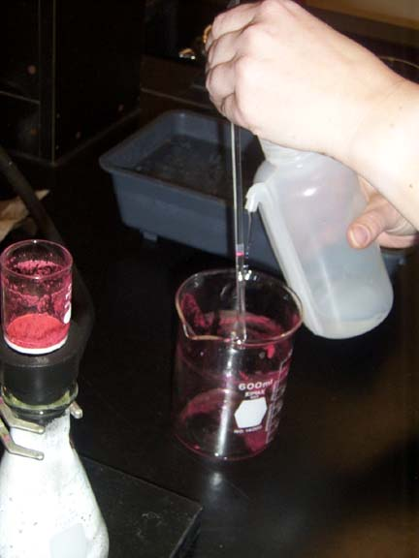
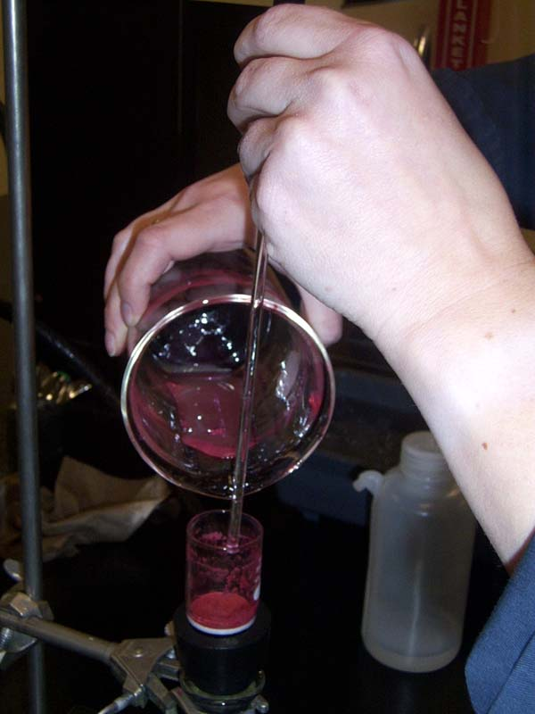
Rinse beaker several times with the small quantity of cold distilled water.

Slide 20
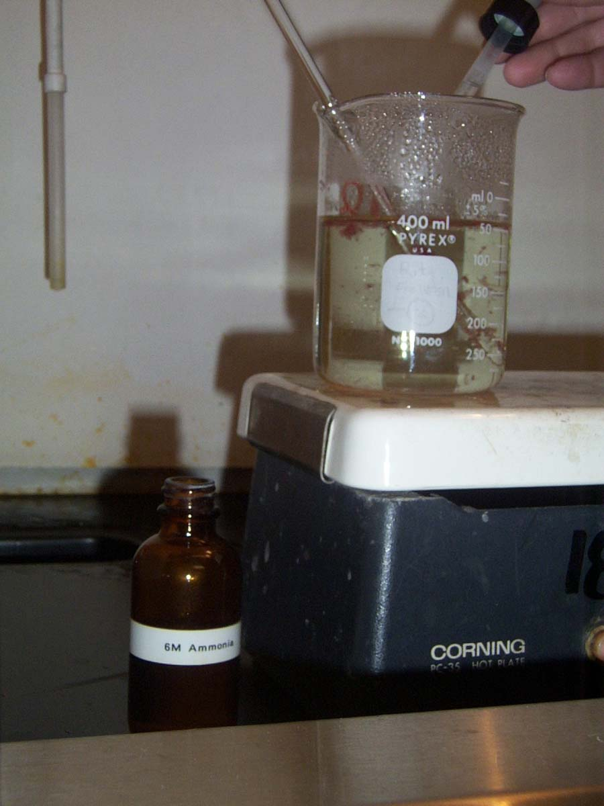
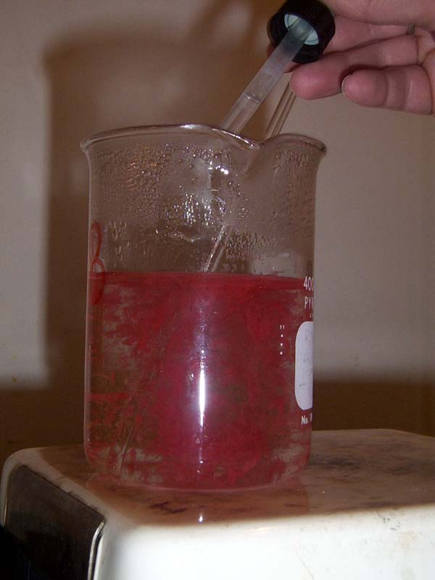
Back to part 2 – homogeneous precipitation.
After one hour add 5 drops of 6 M ammonia solution and swirl. Remove the solution from the heat. Let it cool for 5 minutes, then place it in ice-water bath for 10 minutes and repeat the filtration through one of the pre-weighed crucible.

Slide 21
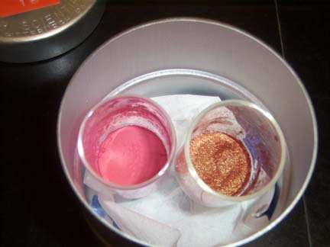
Place them in the oven and dry to constant mass.
Homogeneous precipitate
Heterogeneous precipitate

Slide 22
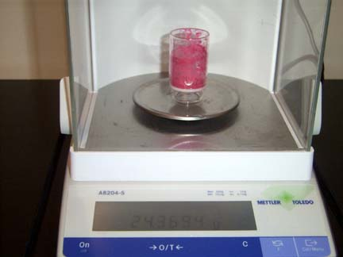
Do final weighing to obtain the mass of precipitate.

